Slide 1
The Effects of Using Animation Movies to Develop Listening and Speaking Skills for Grade 8 Students
The Research Title
by
Phuwitch Ngiwline

Slide 2
Background of the Research
Different countries use English language to communicate to each other.
Communicative activities have an important role in creating opportunities for students.
The government of Thailand tries to improve its population’s English communication.
Watching films in English can improve students’ listening and speaking skills
Using movies to teach in English class has been one of the most rewarding experiences.

Slide 3
Problem Statements
1. The result of the final English listening and speaking test of Grade 8 students of the Demonstration School of Suan Sunandha Rajabhat University was average and also quite poor.
2. Listening and speaking activities for teaching English by teachers in the classrooms were not enough and successful to improve listening and speaking skills of English languages.

Slide 4
Research Objectives
The research objectives were:
  1) To develop and examine the English learning activities by using Animation Movies to meet the standard efficiency of 75/75.
  2) To compare the students’ English listening and speaking ability before and after learning.

Slide 5
Research Questions
Do the English learning activities by using animation movies meet the standard efficiency of 75/75?
How was Grade 8 students’ English listening and speaking achievement before and after learning?

Slide 6
Research Design
In this study, the research design is:
One Group Pretest - Posttest Design

Slide 7
Materials and Methods
The researcher used the following movies to create activities:
How to develop and examine the English learning activities by using Animation Movies to meet the standard efficiency of 75/75, the researcher let students choose five animation movies from ten as shown below:
Animation Movies
1 | Ice Age | 6 | Dolphin Tale
2 | Alvin and the Chipmunks 2 | 7 | Garfield I
3 | How to Train Your Dragon | 8 | Garfield II
4 | The Ant Bully | 9 | Hachi
5 | Legend of the Guardians: The Owls | 10 | Kung Fu Panda

Slide 8

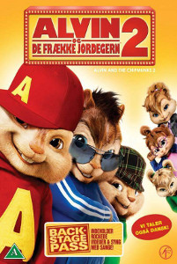

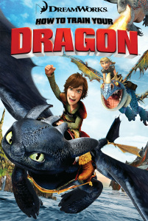

Five Animation Movies
1. Ice Age | 2. Alvin and the Chipmunks 2 | 3. Kung Fu Panda
4. How to Train Your Dragon | 5. Dolphin Tale

Slide 9
Methods
Procedure
1. The students were selected by cluster random sampling.
2. The students took a pre-test of English listening and speaking before watching animation movies.
3. The students watched movies presented to the students for 25 minutes in every session.
4. After watching the movies, some questions were asked to find out learners’ understanding of it and then they described it.
5. After every lesson, the students took a questionnaire for each animation movies.
6. The students took a post-test of English listening and speaking after finishing watching animation movies.

Slide 10
Population and Sampling
Population
  120 students of Grade 8 students
Sampling
  Cluster random sampling was used in this research. The experimental group were 30 students of Grade 8 students who were studying English listening and speaking class.

Slide 11
Research Instruments
The instruments of this research were the following:
1. Five Questionnaires
2. Five Animation Movies
3. Pre-test and Post-test with 30 items
4. Five Lesson Plans

Slide 12
Data Analysis
An efficiency of lesson plans with 75/75 standard
criteria was analyzed by E1/E2.
2. A quiz to check the possible effect of pedagogical movies on students’ listening and speaking skills was analyzed by means, standard deviation, and percentage.
3. A pre-test and post-test for checking the possible differences before and after the study was analyzed by means.

Slide 13
Results
1.The efficiency of the developed English learning activities by using Animation Movie according to value of 75/75 as shown below:
Test | Total score | (X) | S.D. | Efficiency of Activities (percentage)
Quiz | 15 | 12.20 | 1.63 | 89.12
Post-test | 30 | 28.03 | 2.68 | 91.60

Slide 14
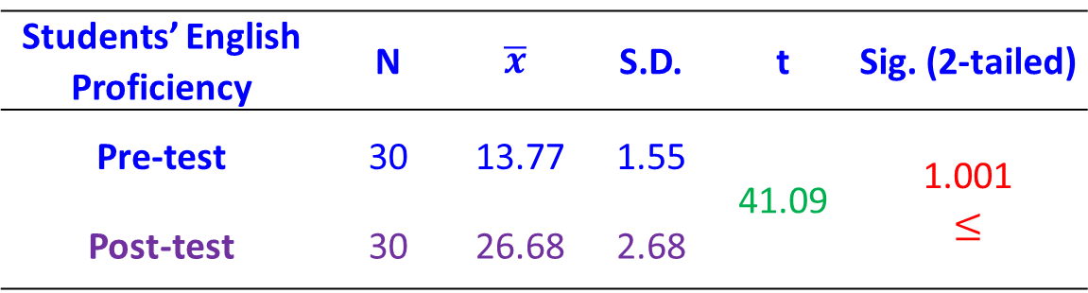
Results (cont.)
2. The students’ English listening and speaking ability before and after learning by using animation movie as shown below:
Students’ English Proficiency | N | $$\overline{x}$$ | S.D. | t | Sig. (2-tailed)
Pre-test | 30 | 13.77 | 1.55 | 41.09 | 1.001 $$≤$$
Post-test | 30 | 26.68 | 2.68

Slide 15
Discussion
1) The efficiency of the developed English learning activities by using animation movie showed the quiz during learning and post-test had a value at 89.12/91.60 which was higher than the set value of 75/75.
The efficiency of the developed English learning activities by using animation movies regarding to this research after learning was higher than the set value of 75/75 standard. It can show that listening and speaking activities should not be passive.

Slide 16
Discussion (cont.)
2) The students’ English listening and speaking average scores before learning by using animation movie was 13.77 and after learning was 26.68, the students had higher average scores of listening and speaking test than that of before at the .05 level of significance.
It can be defined that English activities based on English animation movies focused on student’s skills directly because they can learn by themselves and the movies are interesting and encouraged students to pay attention.

Slide 17
Conclusion
1. It found that the efficiency of the developed English learning activities by using animation movie showed the quiz during learning and post-test had a value at 89.12/91.60 which was higher than the set value of 75/75 and the students’ English listening and speaking average scores before learning by using animation movie was 13.77 and after learning was 26.68.
2. The students had higher average scores of listening and speaking test than that of before at the .05 level of significance. The students have learned about 1,000 to 1,500 basic vocabulary words and be accustomed to different kinds of English accents.
3. They also need to have basic communication skills, being able to understand contexts by listening. These are minimum requirements for learners to be able to use English Mate efficiently. The movies are mostly animation and those with easy vocabularies, slow speaking speed, and a simple story.

Slide 18
Conclusion (cont.-)
4. Students can follow or guess the content of characters’ conversations without difficulty.
5. These movies also teach moral lessons and values for learners to understand naturally.
6. The integrated use of English activities through animation movies can yield positive results and lead to the improvement of communicative competence.
7. Learning English through Animation movies can be able to adapt in education and traveling and working abroad encourages students to learn the language, develops their ability to speak English fluently, and helps them overcome the language barrier.

Slide 19

Thank you for your attention

