Slide 1
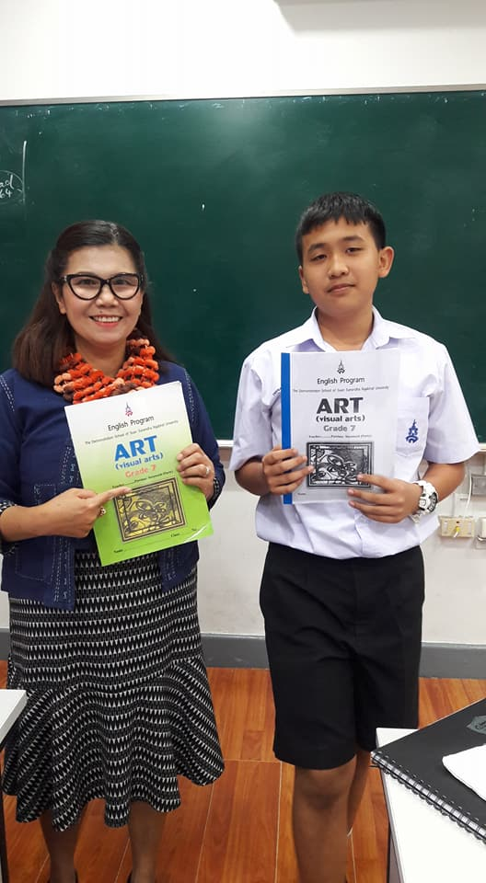
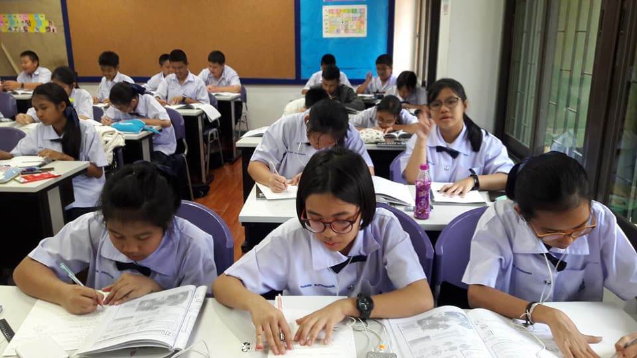
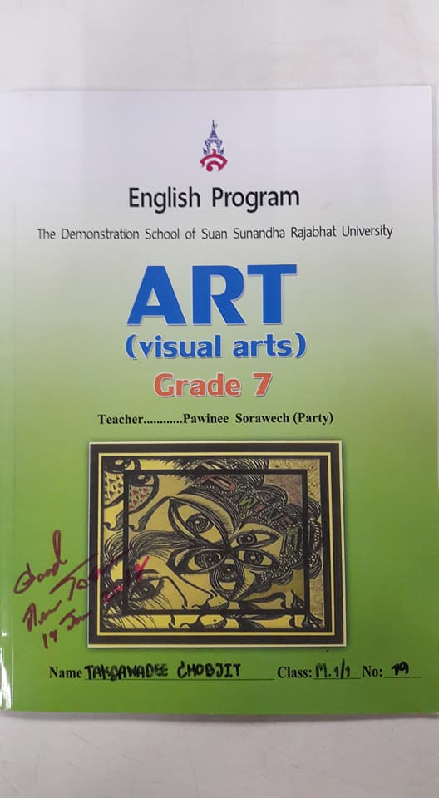
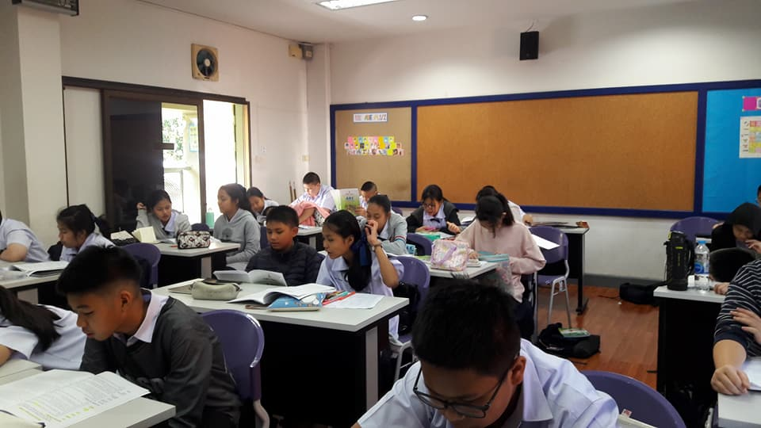
THE VISUAL ELEMENTS
Teacher ;
Aj. PAWINEE SORAWECH

Slide 2
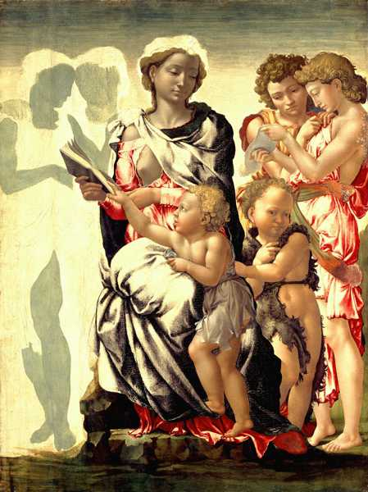
THE VISUAL ELEMENTS
The Building Blocks of Composition in Art
ROBERT WILLIAM BUSS (1804-1875) "Dickens' Dream" (1875) Watercolor
MICHELANGELO BUONARROTI (1475-1564)
"Manchester Madonna", 1497 (tempera on panel)
Line - Shape - Tone - Color - Pattern - Texture - Form

Slide 3
The Visual Elements of line, shape, tone, color, pattern, texture and form are the building blocks of composition in art.
When we analyse any drawing, painting, sculpture or design, we examine these component parts to see how they combine to create the overall effect of the artwork.

Slide 4
The Visual Elements have a relationship to one another:
Most images begin their life as line drawings.
Lines cross over one another to form shapes.
Shapes can be filled with tone and color, or repeated to create pattern.
A shape may be rendered with a rough surface to create a texture.
A shape may be projected into three dimensions to create form.

Slide 5
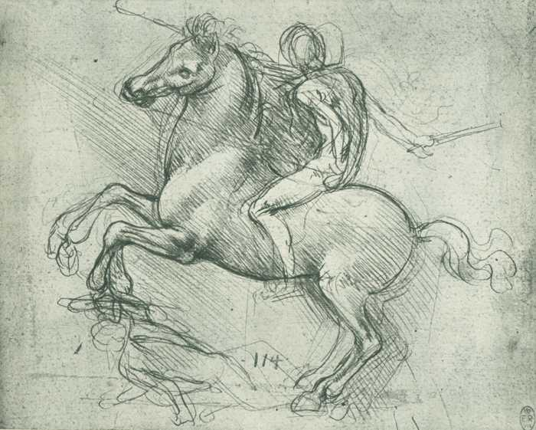
THE VISUAL ELEMENTS - LINE
Line is the foundation of all drawing. It is the first and most versatile of the visual elements of art. Line in an artwork can be used in many different ways. It can be used to suggest shape, pattern, form, structure, growth, depth, distance, rhythm, movement and a range of emotions.
We have a psychological response to different types of lines:
Curved lines suggest comfort and ease
Horizontal lines suggest distance and calm
Vertical lines suggest height and strength
Jagged lines suggest turmoil and anxiety

Slide 6
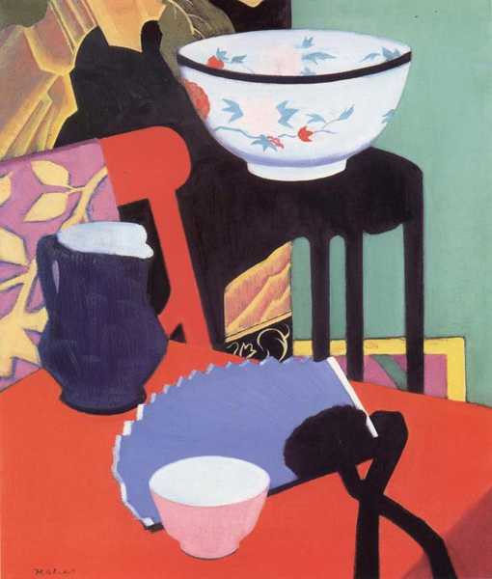
THE VISUAL ELEMENTS - SHAPE
Shape can be natural or man-made, regular or irregular, flat (2-dimensional) or solid (3-dimensional), representational or abstract, geometric or organic, transparent or opaque, positive or negative, decorative or symbolic, colored, patterned or textured.
The Behaviour of Shapes: Shapes can be used to control your feelings in the composition of an artwork:
Squares and Rectangles can portray strength and stability
Circles and Ellipses can represent continuous movement
Triangles can lead the eye in an upward movement
Inverted Triangles can create a sense of imbalance and tension

Slide 7
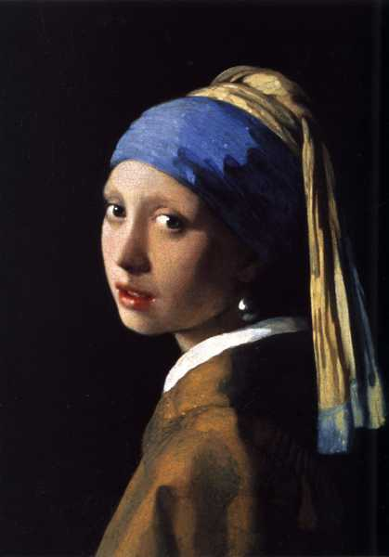
Tone is the lightness or darkness of a color. The tonal values of an artwork can be adjusted to alter its expressive character. Tone can be used: to create a contrast of light and dark. to create the illusion of form. to create a dramatic or tranquil atmosphere. to create a sense of depth and distance. to create a rhythm or pattern within a composition.
THE VISUAL ELEMENTS - TONE

Slide 8
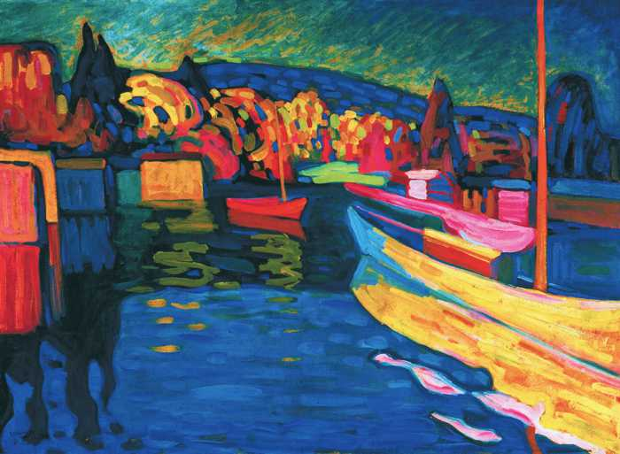
THE VISUAL ELEMENTS - COLOR
Color is the visual element that has the strongest effect on our emotions. We use color to create the mood or atmosphere of an artwork.
There are many different approaches to the use of color:
Color as light
Color as tone
Color as pattern
Color as form
Color as symbol
Color as movement
Color as harmony
Color as contrast
Color as mood

Slide 9
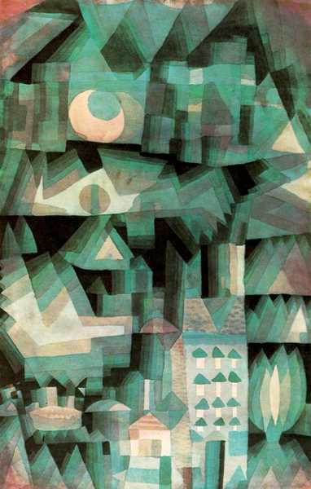
THE VISUAL ELEMENTS - PATTERN
Pattern is made by repeating or echoing the elements of an artwork to communicate a sense of balance, harmony, contrast, rhythm or movement.
There are two basic types of pattern in art: Natural Pattern and Man-Made Pattern. Both natural and man-made patterns can be regular or irregular, organic or geometric, structural or decorative, positive or negative and repeating or random.
Natural Pattern: Pattern in art is often based on the inspiration we get from observing the natural patterns that occur in nature. We can see these in the shape of a leaf and the branches of a tree, the structure of a crystal, the spiral of a shell, the symmetry of a snowflake and the camouflage and signalling patterns on animals, fish and insects.
Man-Made Pattern: Pattern in art is used for both structural and decorative purposes. For example, an artist may plan the basic structure of an artwork by creating a compositional pattern of lines and shapes. Within that composition he/she may develop its visual elements to create a more decorative pattern of color, tone and texture across the work.

Slide 10
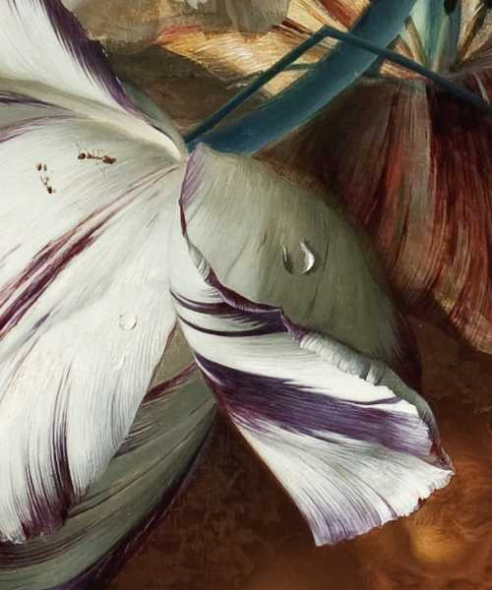
THE VISUAL ELEMENTS - TEXTURE
Texture is the surface quality of an artwork - the roughness or smoothness of the material from which it is made.
We experience texture in two ways: optically (through sight) and physically (through touch).
Optical Texture: An artist may use his/her skillful painting technique to create the illusion of texture. For example, in the detail from a traditional Dutch still life above you can see remarkable verisimilitude (the appearance of being real) in the painted insects.
Physical Texture: An artist may paint with expressive brushstrokes whose texture conveys the physical and emotional energy of both the artist and his/her subject. They may also use the natural texture of their materials to suggest their own unique qualities such as the grain of wood,
Ephemeral Texture: This is a third category of textures whose fleeting forms are subject to change like clouds, smoke, flames, bubbles and liquids.

Slide 11
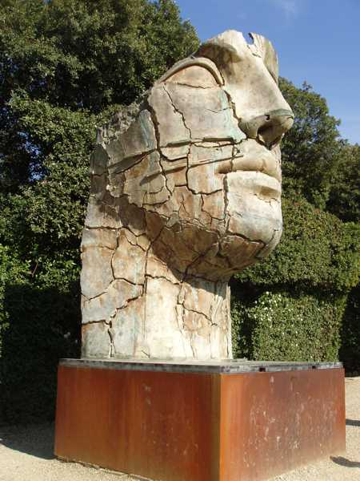
THE VISUAL ELEMENTS - FORM
Form is the physical volume of a shape and the space that it occupies.
Form can be representational or abstract.Form generally refers to sculpture,
Three-Dimensional Form can be modelled (added form), carved (subtracted form) and constructed (built form). It can be created from sculptural materials like clay, wax, plaster, wood, stone, concrete, cast and constructed metal, plastics, resins, glass and mixed media.
Two-Dimensional Form constructs the illusion of 3D in 2D media by a skilful manipulation of the visual elements. Perspective drawing, trompe l'oeil [1], 3D computer graphics programs and holograms are examples of 2D form

Slide 12
Activities in Classroom

Slide 13
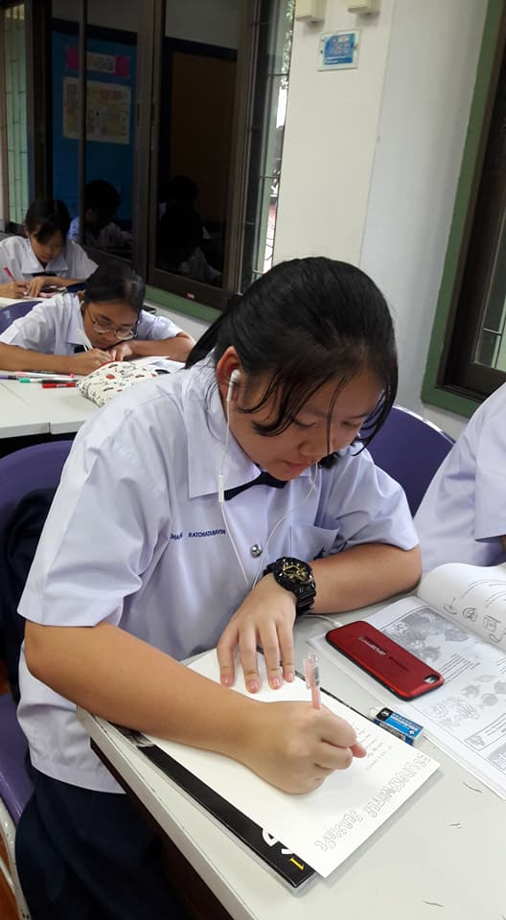
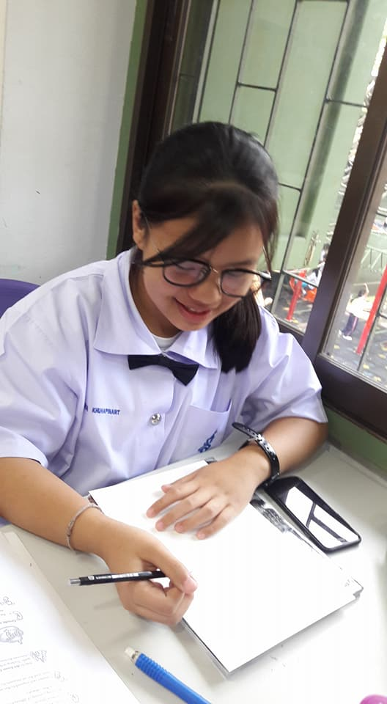
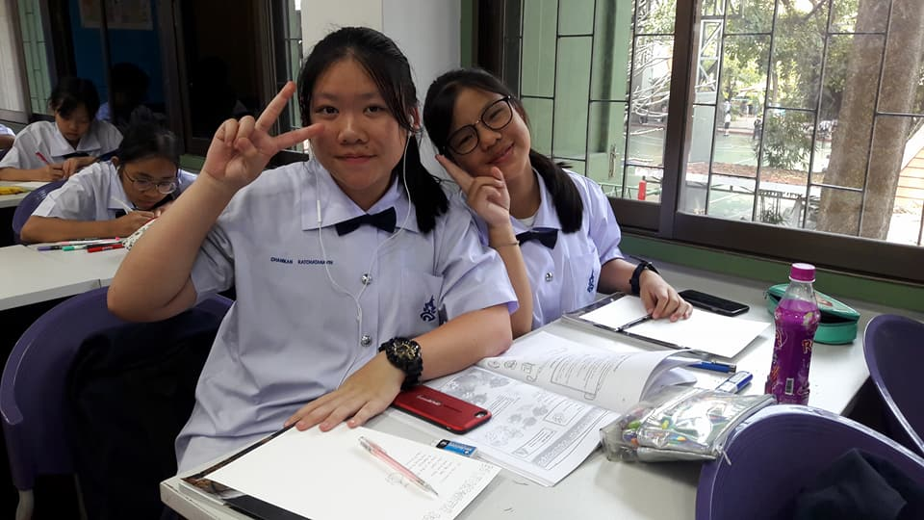

Slide 14
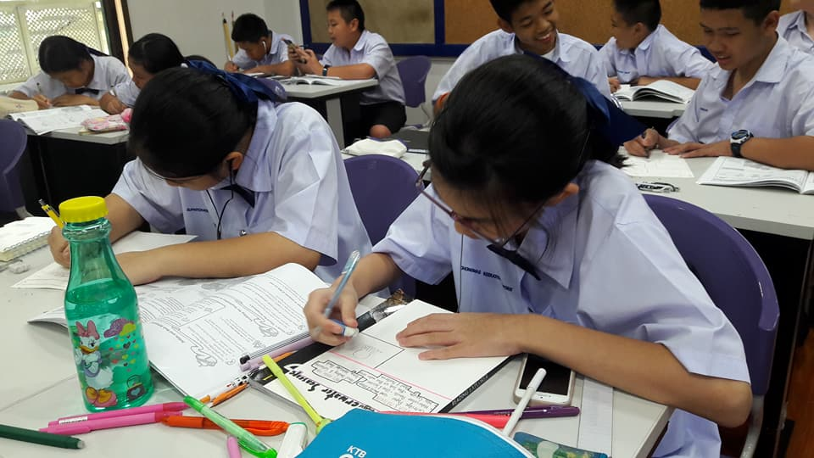

Slide 15
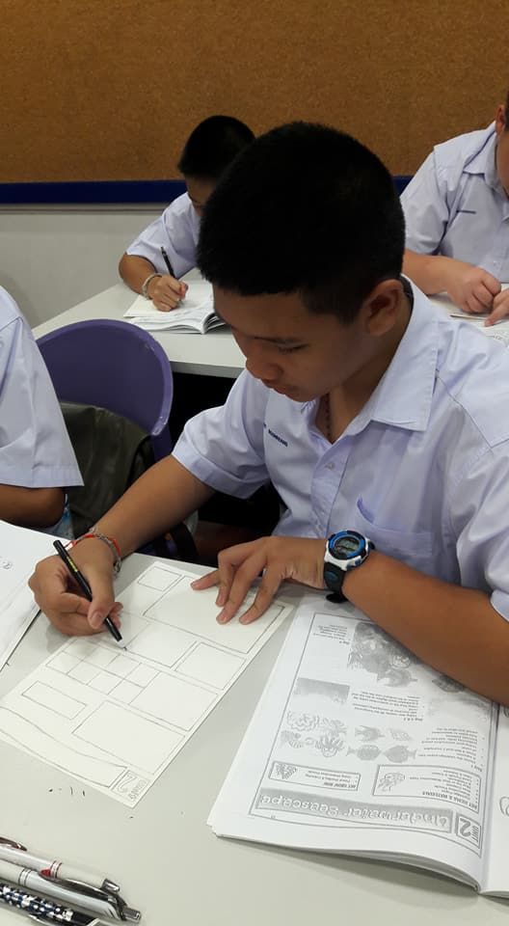
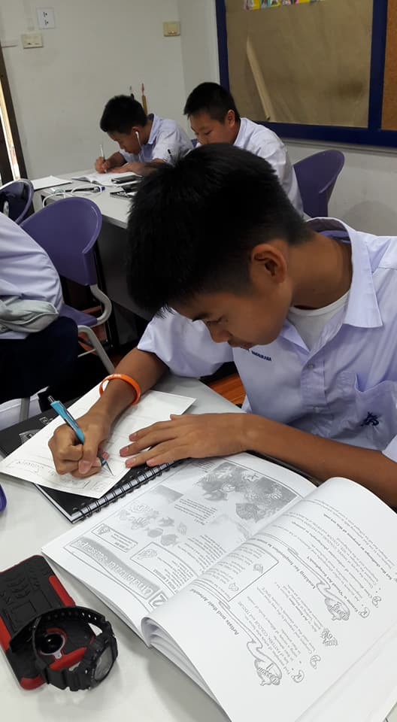
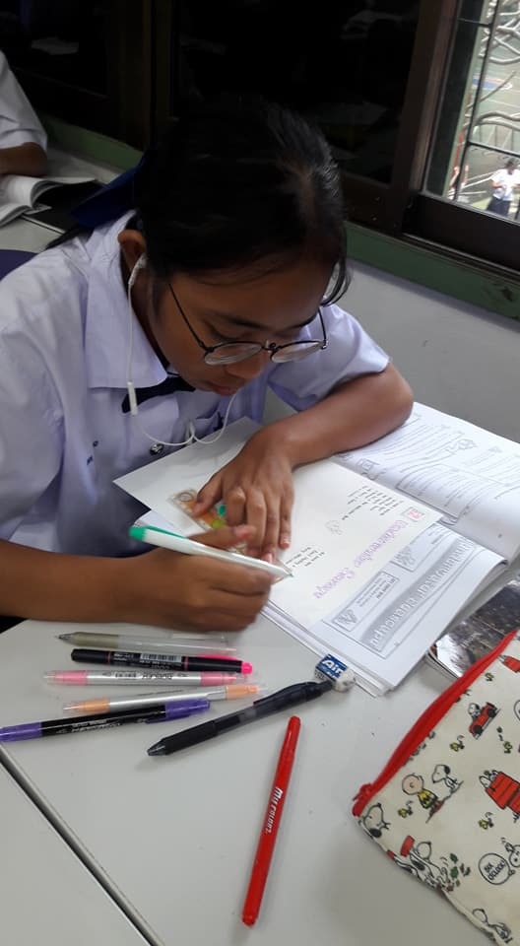

Slide 16
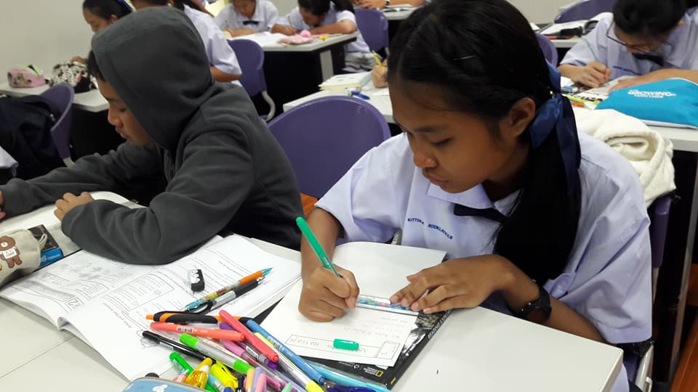

Slide 17
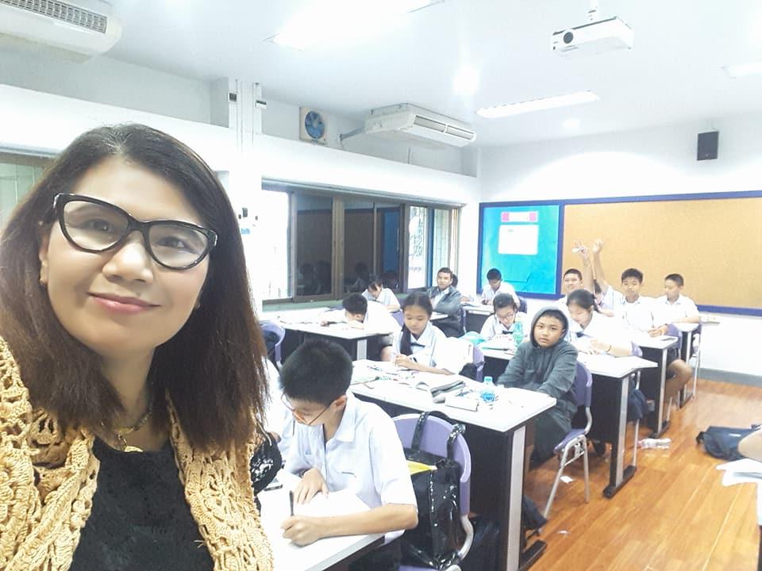

Slide 18
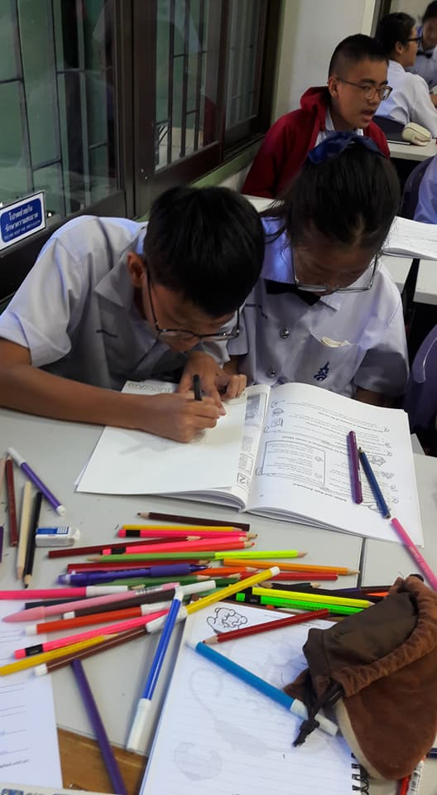
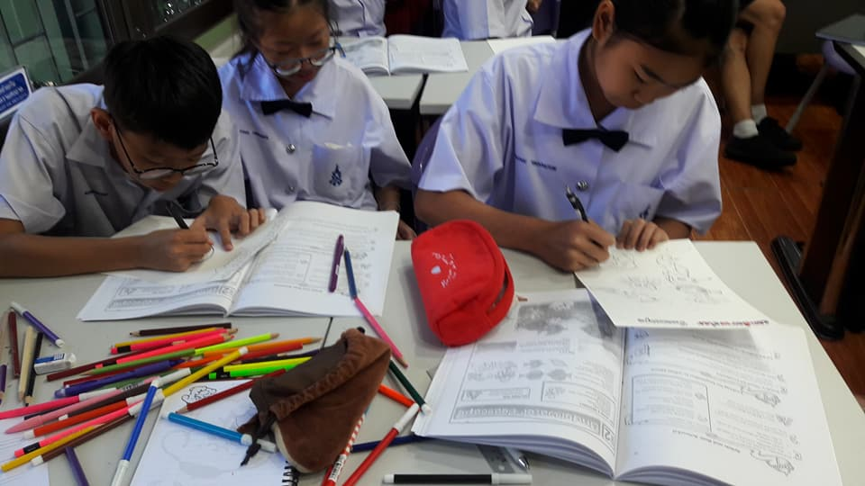

Slide 19
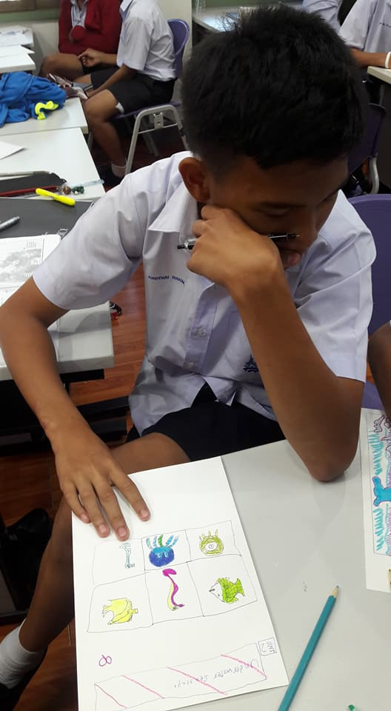
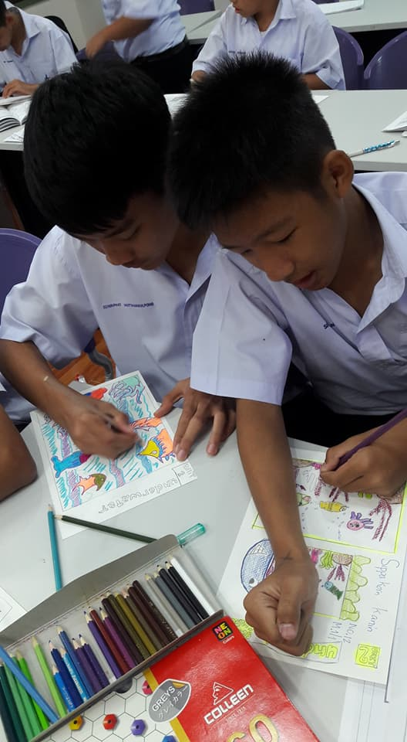

Slide 20
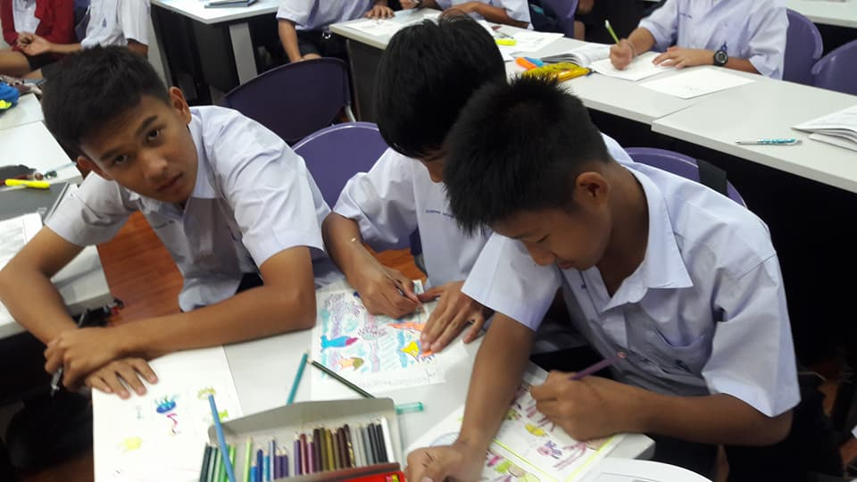

Slide 21
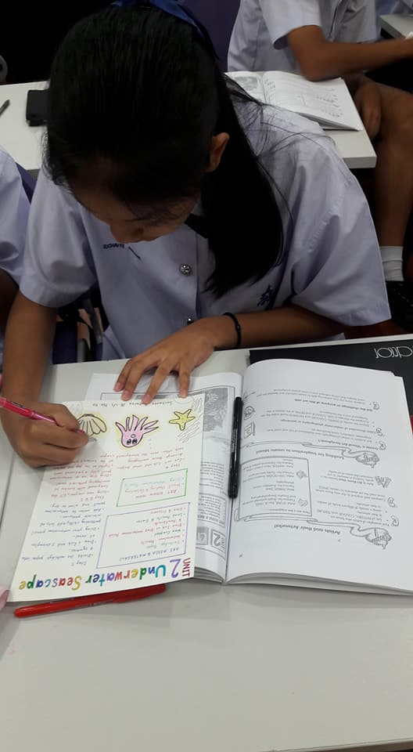
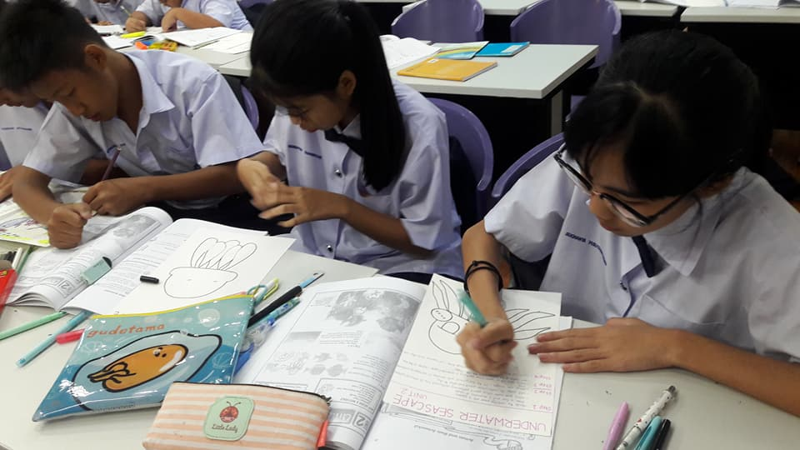

Slide 22
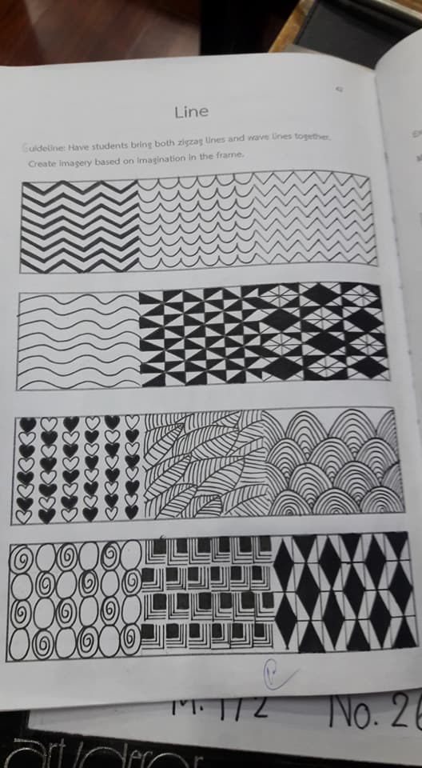
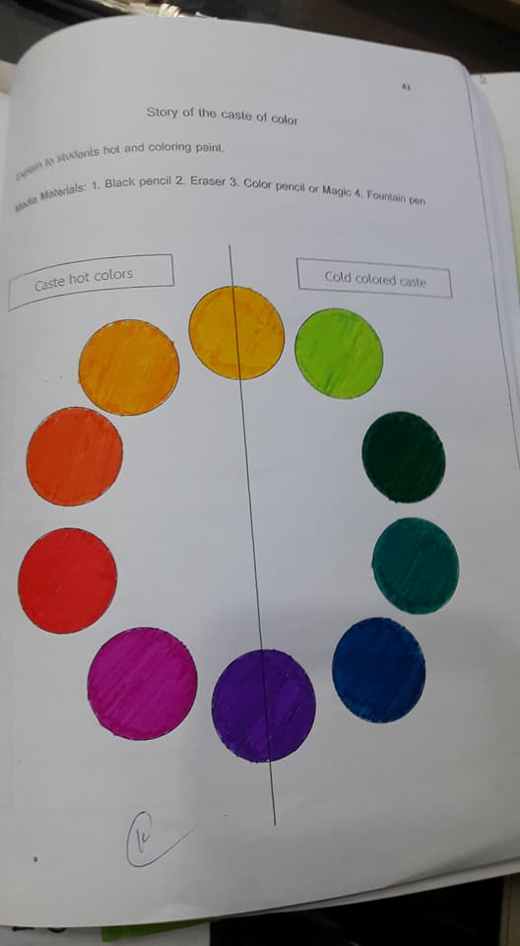
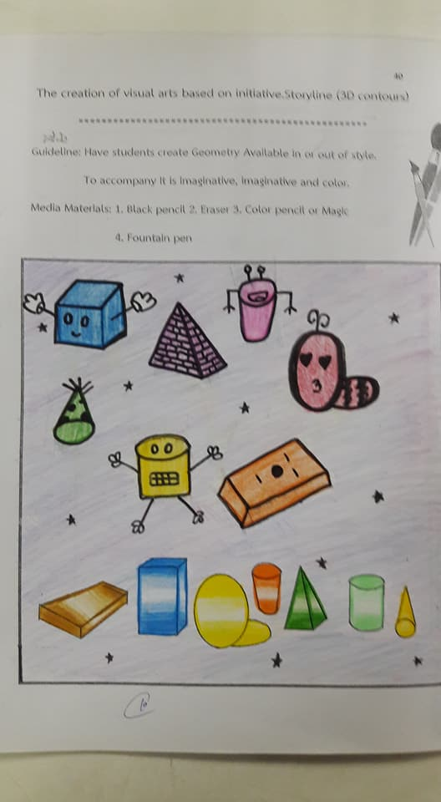

Slide 23
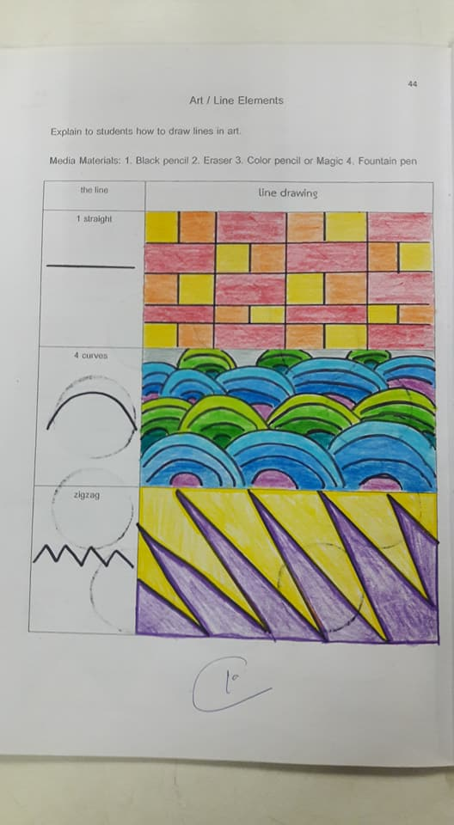
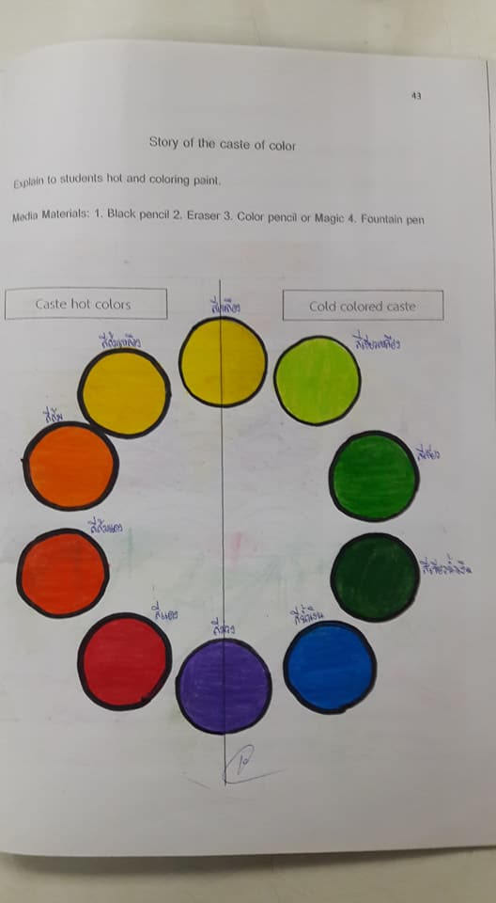
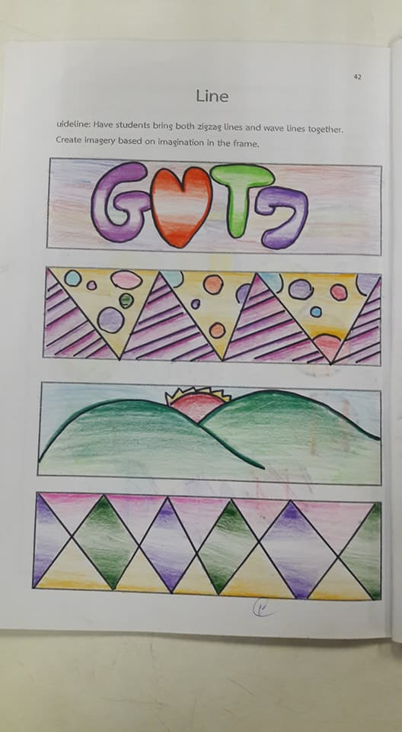

Slide 24
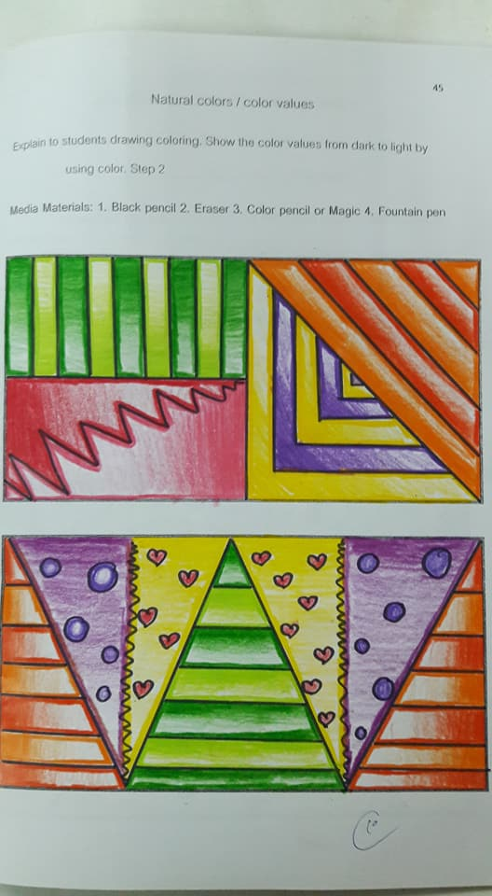
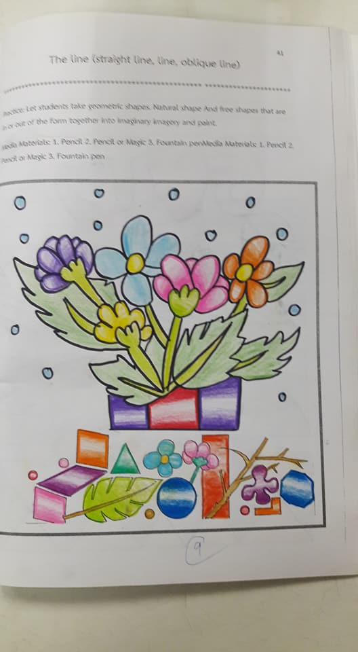
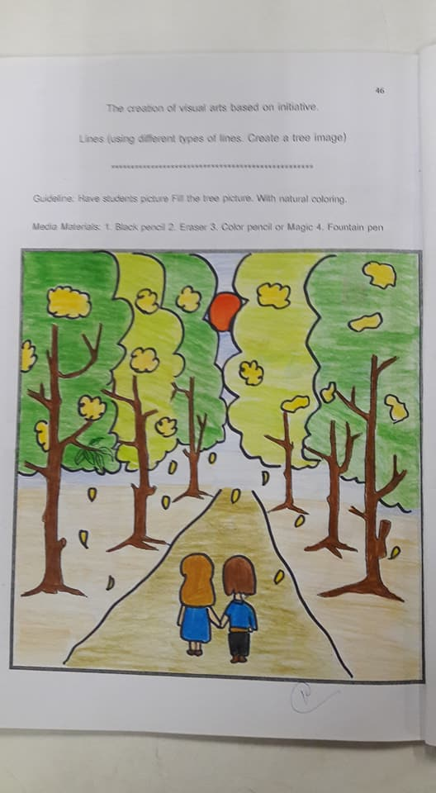

Slide 25
