Slide 1
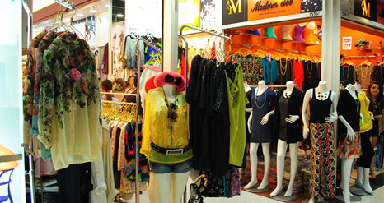
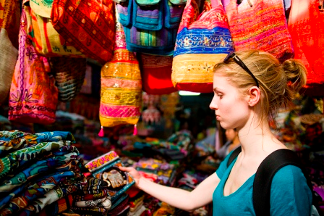
UNIT 4 SHOPPING

Slide 2
Words study
Remind – ระลึก
Memorable - ที่น่าจดจำ
Statistic - สถิติ
classified - การจัดแบ่งลำดับ
Tour operator - บริษัทจัดการการท่องเที่ยว

Slide 3
Reading Practice

Slide 4
Words study
Melting pot - การหลอมรวม
Diversity - ความหลากหลาย
Precious - ล้ำค่า
Keepsake – ของที่ระลึก, สิ่งเตือนใจ
Blades - ใบมีด
Wickerwork - งานเครื่องสาน
Leather- เครื่องหนัง
Illegal - ผิดกฎหมาย
confiscate – ยึด, ริบ

Slide 6
Words study
Expenditure - ค่าใช้จ่าย
Respectively – ตามลำดับ
Hub - จุดศูนย์กลาง
Incentive – สิ่งกระตุ้น
Purchasing power - กำลังซื้อ
Measure - ปริมาณ
Cheat - หลอกลวง
Overcharge - คิดราคาแพงเกินไป
Affect - กระทบ

Slide 8
A) Read the passage and write it down on schedule
Topic | Information
Thai products | Silk, ceramics, woodcarving, lacquerware, gems, jewelry, clothing, dolls, metal blades, wickerwork, batik, leather goods
Tourist expenditure on shopping | 70 – 76 million Baht. Per year
problems | Cheating Overcharging

Slide 9
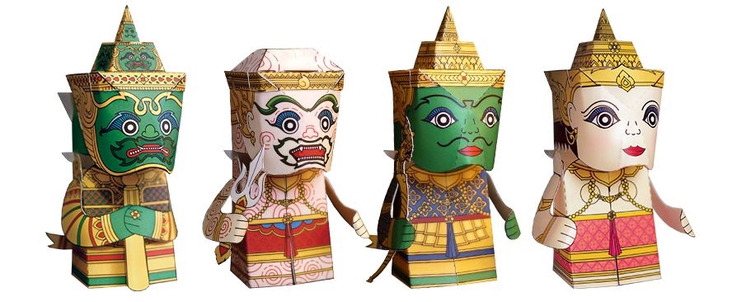
B) Answer the questions
Is Thailand a good place for shopping? Why?
Yes, because it provide many kind of souvenirs and it is not too expensive.

Slide 10
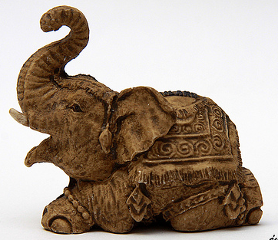
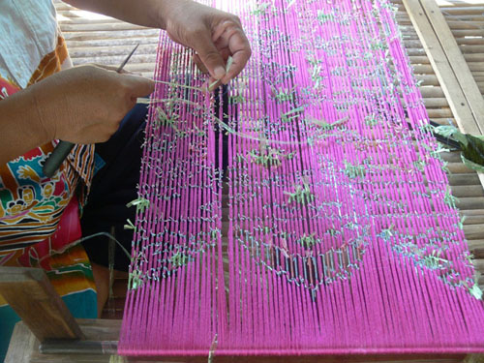
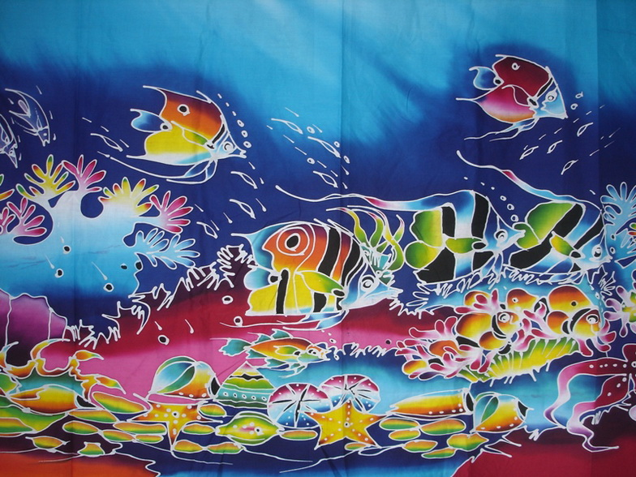
2. If a tourist would like to buy some souvenirs from the North, the Northeast and the South what would you suggest to them?
Woodcarving from the North.
Matmi silk from the Northeast .
Batik from the South.

Slide 11
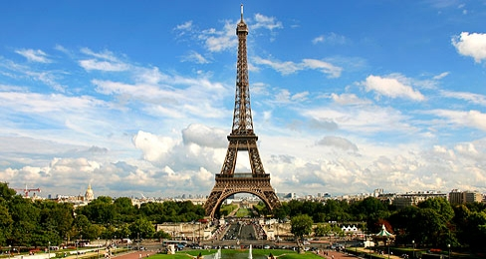
3. What country was classified as the best in the world for good shopping?
France

Slide 12
4. What does a cultural melting pot mean?
A place where people from all around the world have come to live together.

Slide 13
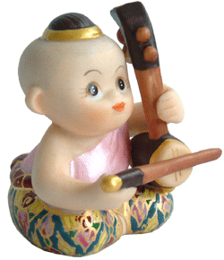
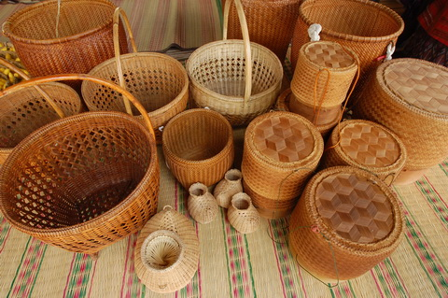
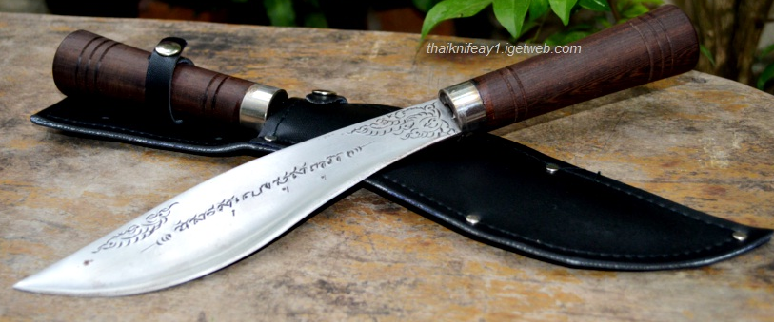
5. Give some examples of souvenirs that reflect Thai culture and history.
Thai dolls, metal blades, wickerwork.

Slide 14
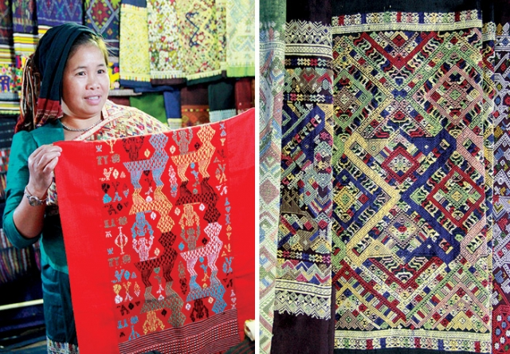
6. What souvenirs show the influence of Lao culture on Thai people?
Matmi silk .

Slide 15
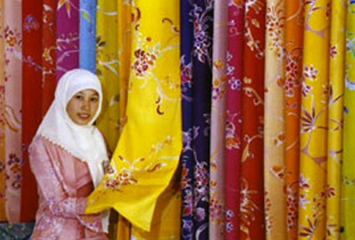
7. What souvenirs show the influence of Malaysian culture on Thai people?
Batik.

Slide 16
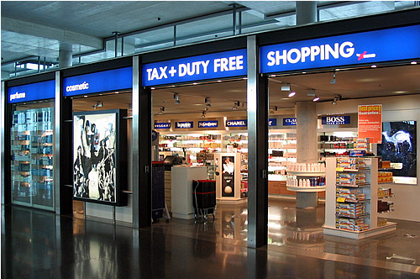
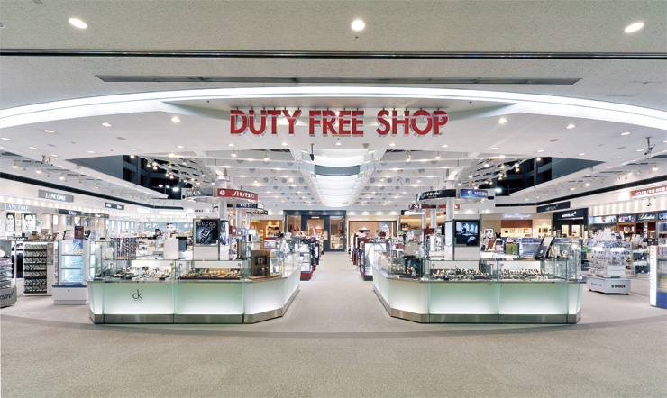
8. What are some incentives to promote shopping in Thailand?
The duty free shop.

Slide 17
9. What other measures do you think are necessary to promote shopping?
Product development, give them special promotion, quality control.

Slide 18
10. How was the data collected by the Singapore Monthly Report on Tourism Statistics?
They surveyed 1450 tour operators in 28 countries around the world.

Slide 19
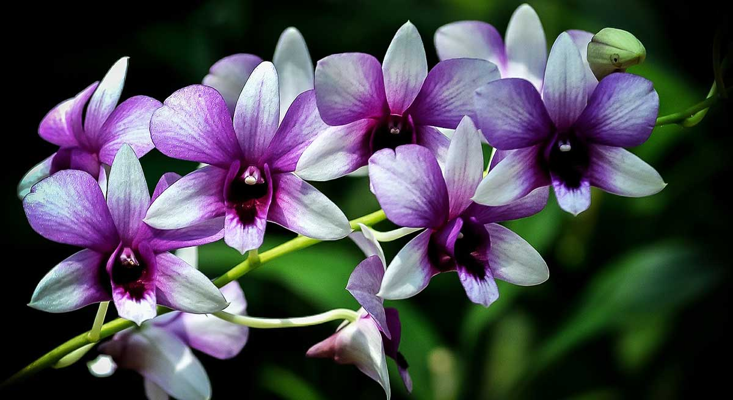
11. What product should tourist not buy? Why?
The products made from endangered animals and plants.

Slide 20
8)Listen to CD
Information from their friends and family that the most important to decide about their vacation.
People are more distrustful less likely to purchase goods and services in Thai.
Promote honesty and transparency in all business interactions, provide information to tourists to avoid scams.

Slide 21
9) Extended exercises
Tourist officer | Tourist
1 | 4
5 | 6
3 | 7
10 | 2
8 | 9

Slide 22
B) Complete the dialogue.
Good morning, How can I help you?
I think Chatuchak weekend market is the best place to buy some antiques.
For the antique is no problem for bring it back but please don’t buy products made of endangered species of plants and animals in Thailand and neighboring countries.
They are considered illegal for Thailand now. You will be fined and confiscated.
You’re welcome.

