Slide 1
Dining at a Resturant

Slide 2
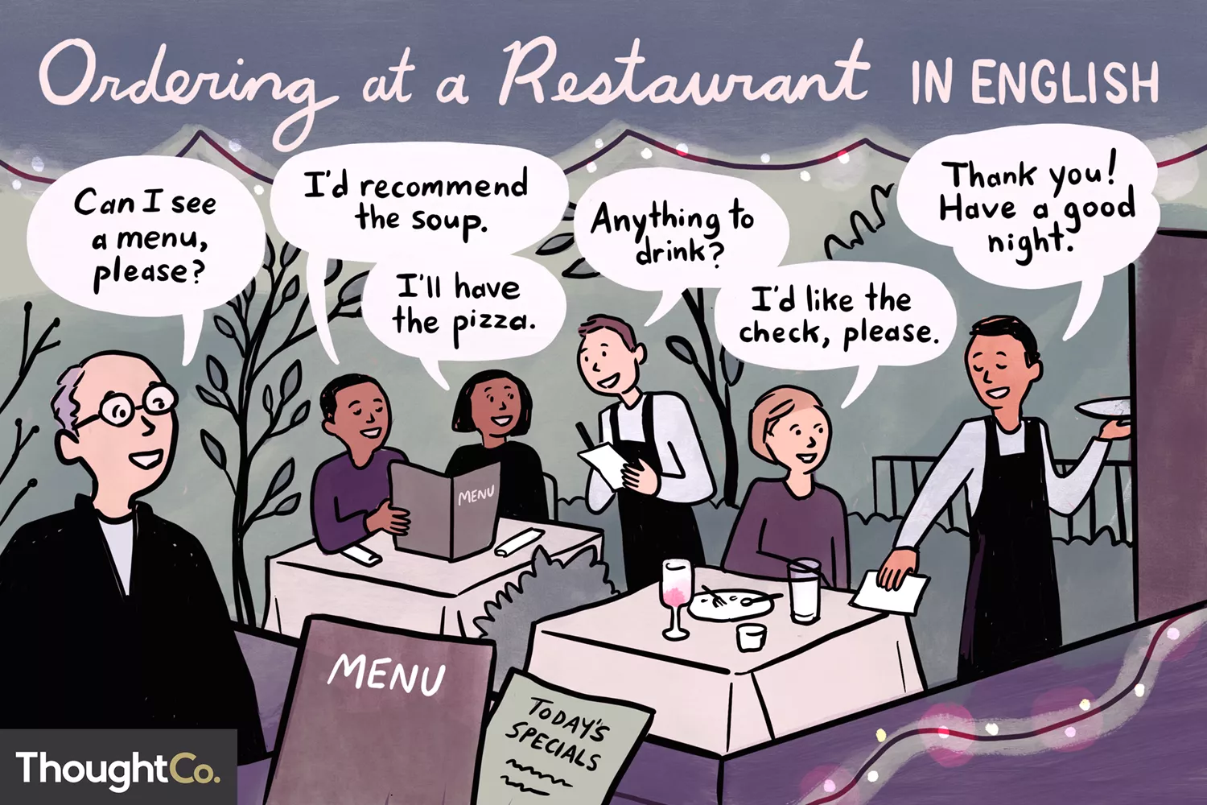

Slide 3
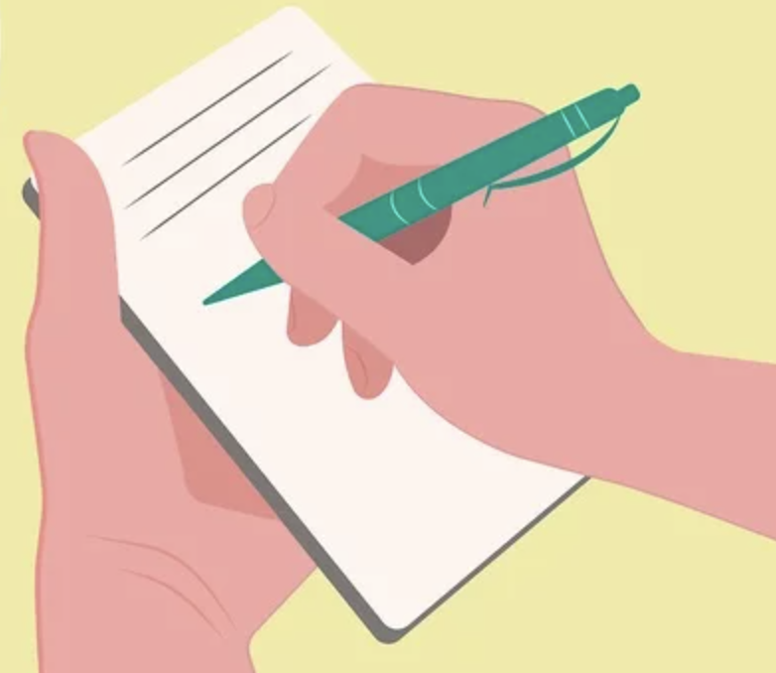
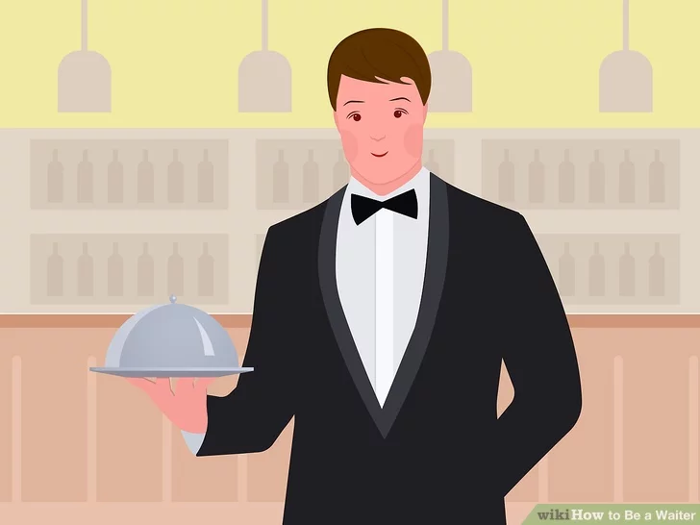
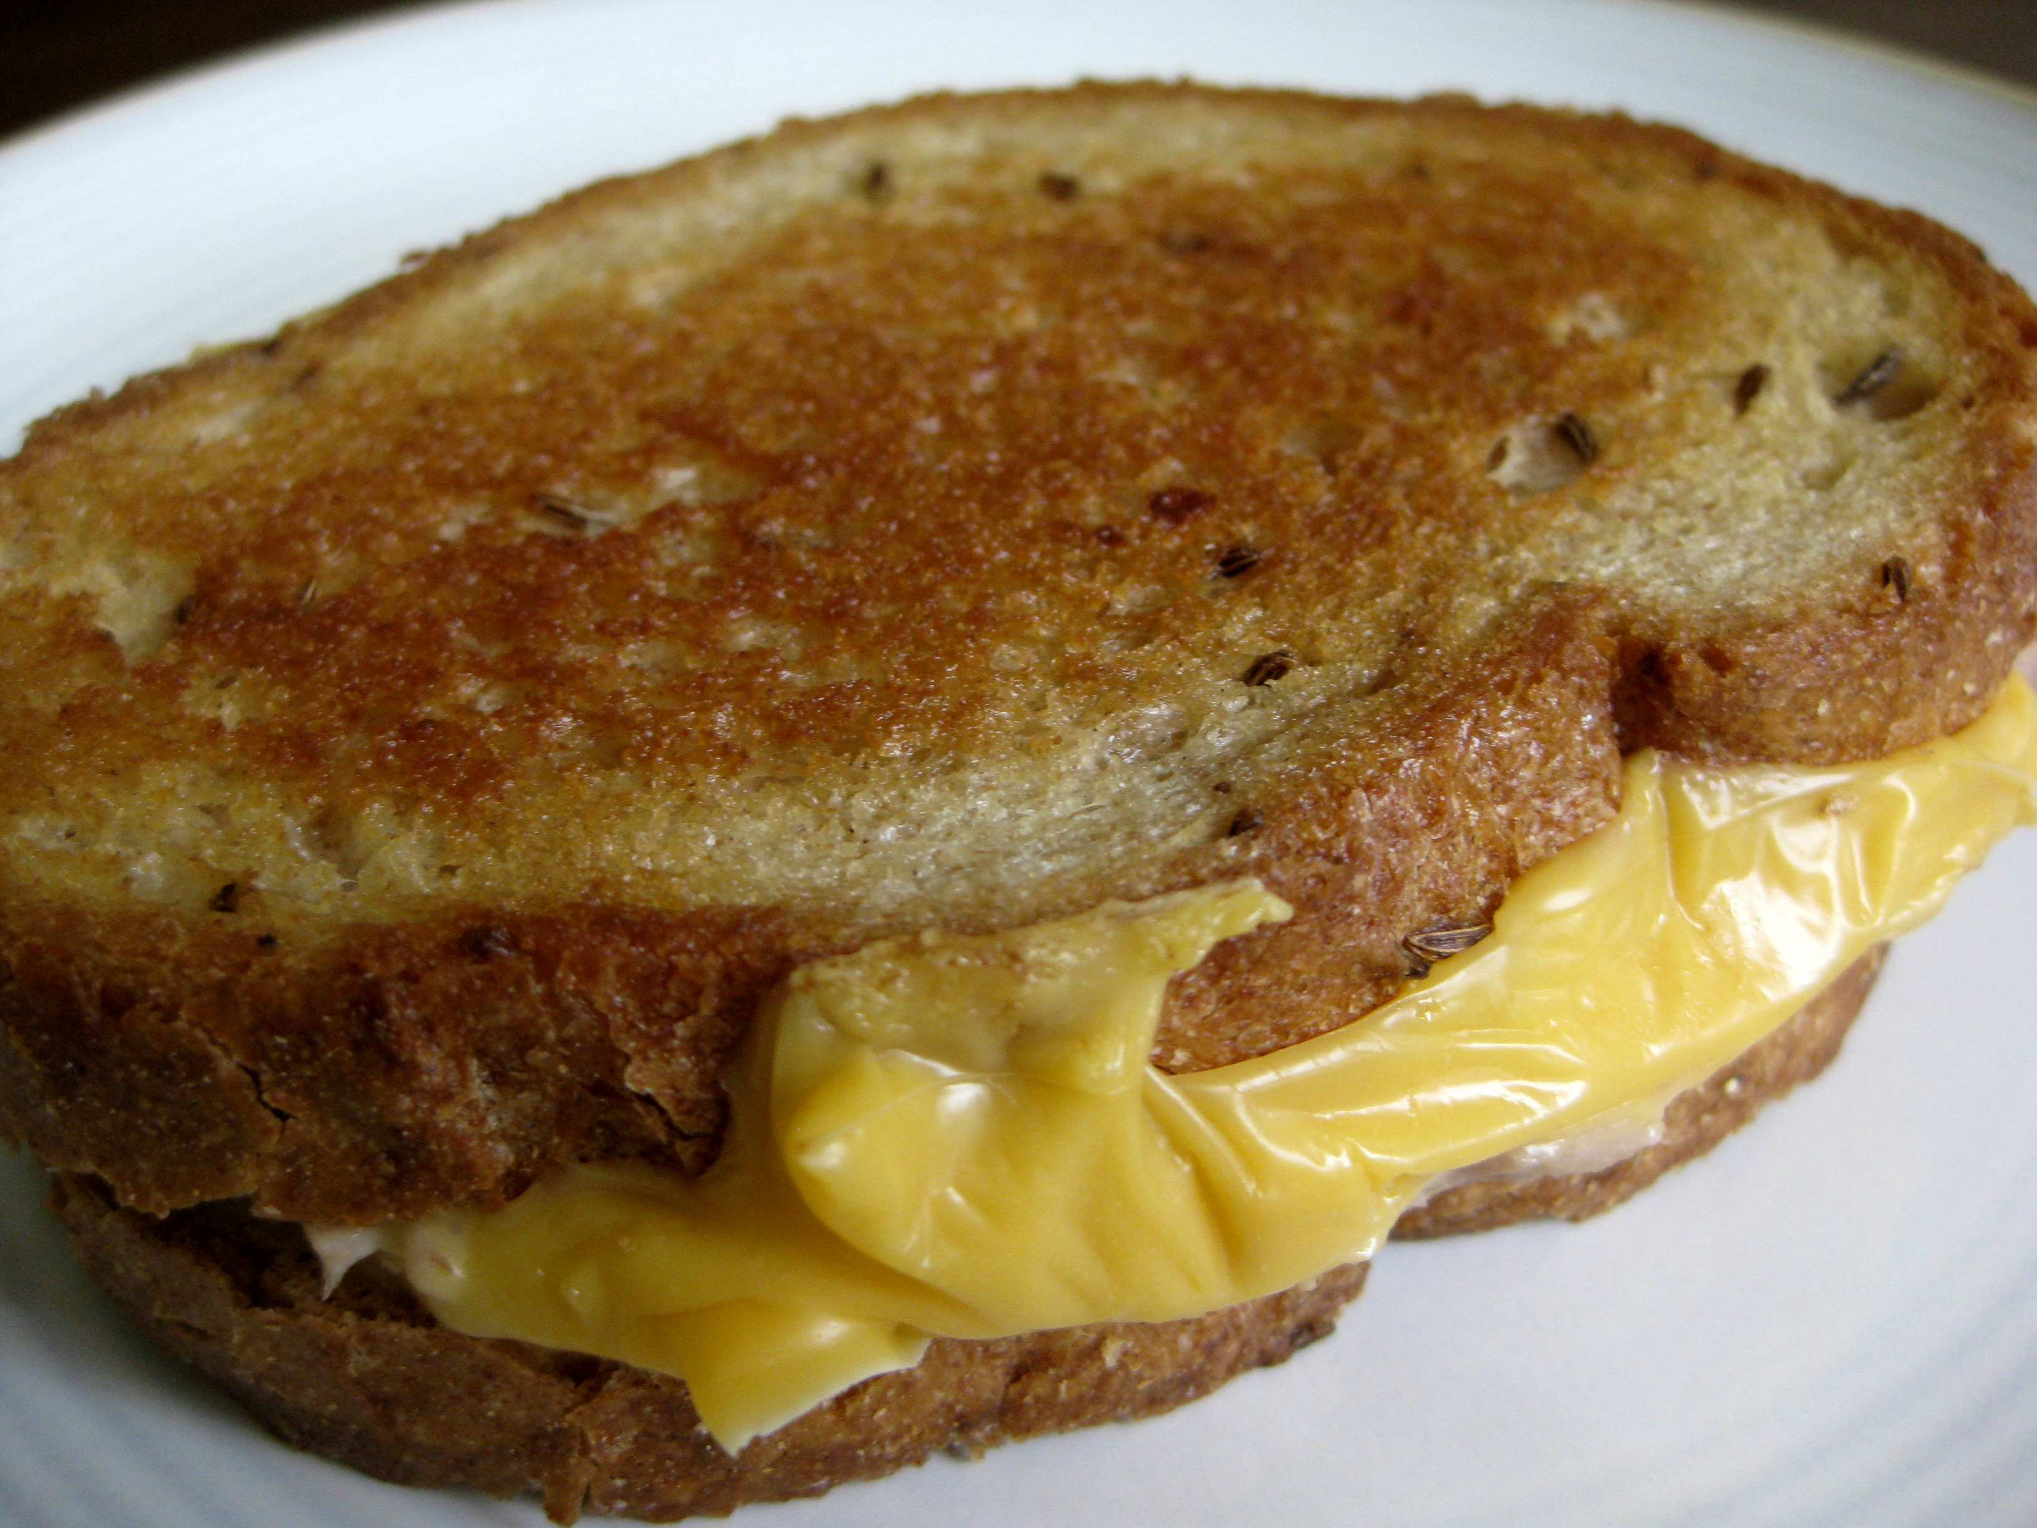
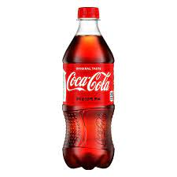
Dining at a Restaurant Alone This dialogue includes most of the basic questions you'll need to know when going to a restaurant alone. Practice it with a friend.
Waitperson: Hi. How are you doing this afternoon?
Customer (you): Fine, thank you. Can I see a menu, please?
Waitperson: Certainly, here you are.
Customer: Thank you. What's today's special?
Waitperson: Grilled tuna and cheese on rye.
Customer: That sounds good. I'll have that.
Waitperson: Would you like something to drink?
Customer: Yes, I'd like a coke.
Waitperson: Thank you.
(returning with the food)
Waitperson: Here you are. Enjoy your meal!
Customer: Thank you.
Waitperson: Can I get you anything else?
Customer: No thanks. I'd like the check, please.
Waitperson: That'll be $14.95.
Customer: Here you are. Keep the change!
Waitperson: Thank you! Have a good day!
Customer: Goodbye.

Slide 4
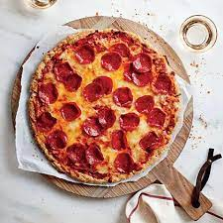
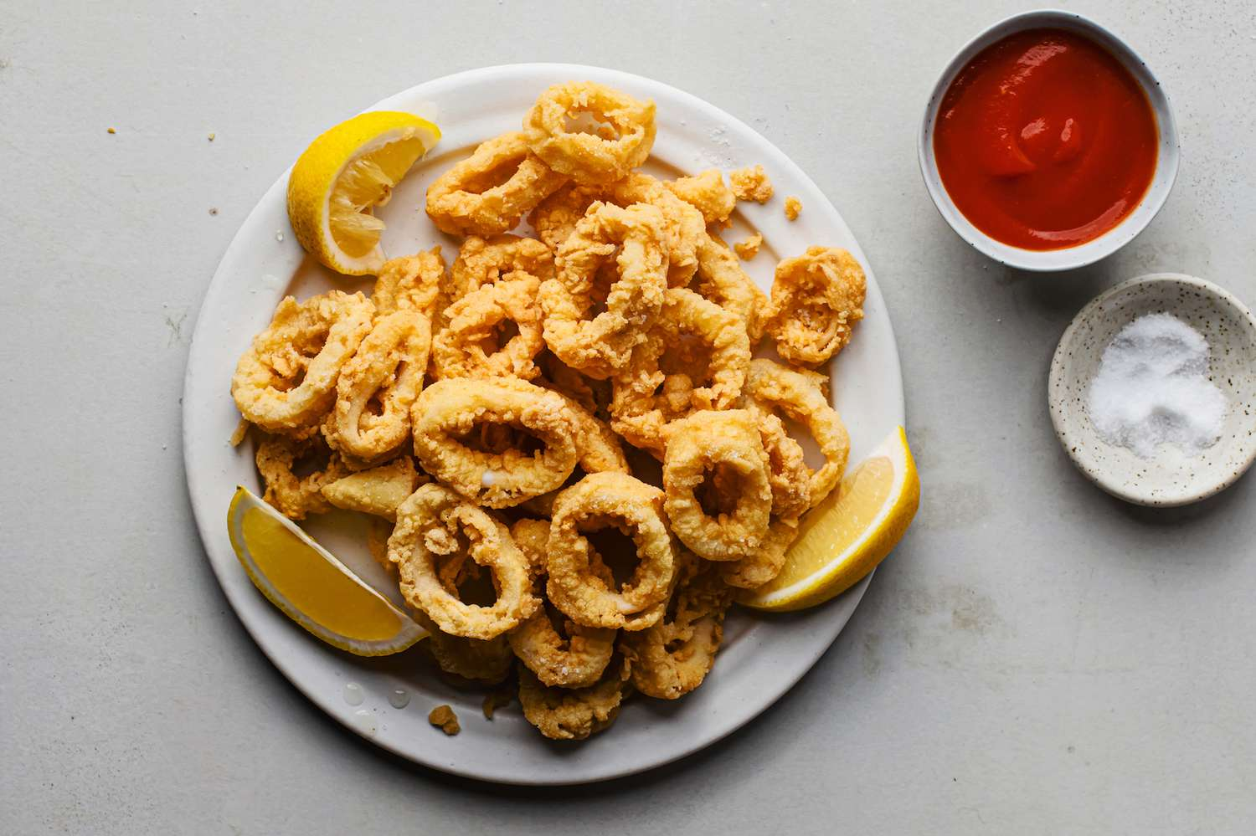
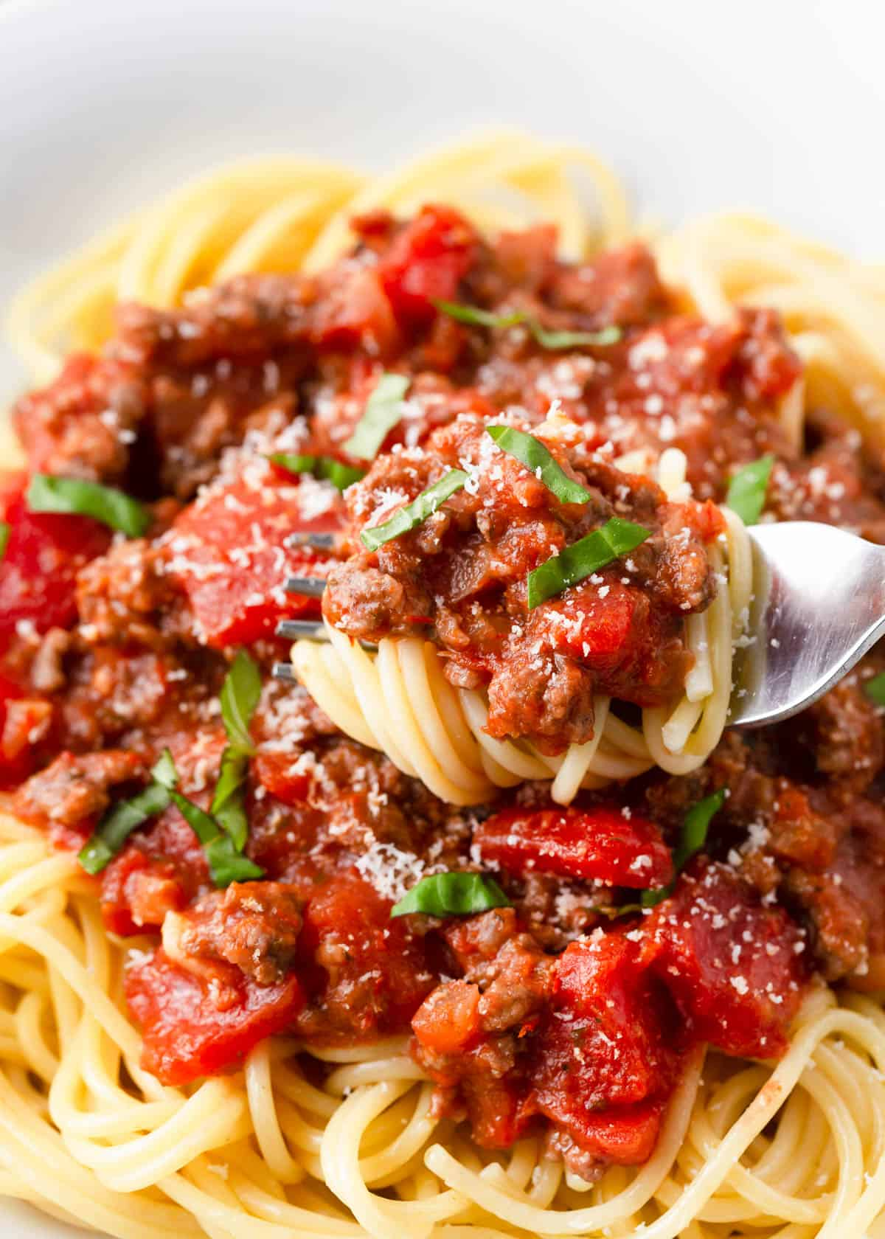
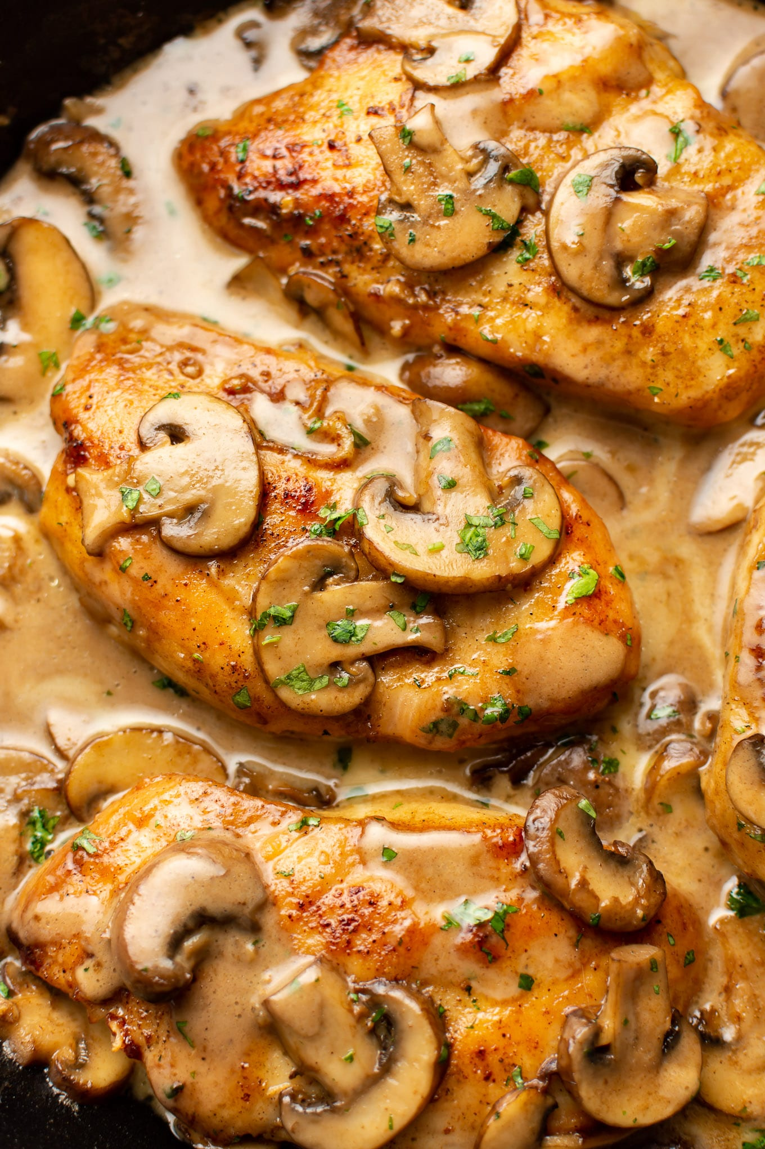
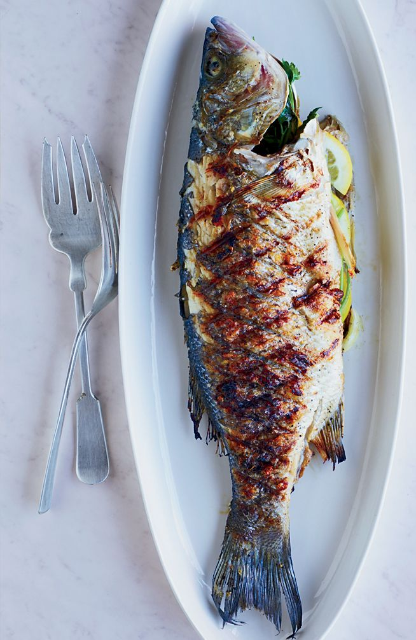
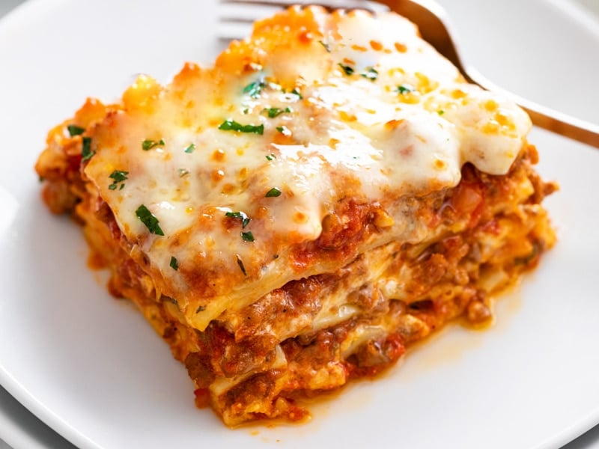
At a Restaurant With Friends Next, use this dialogue to practice speaking at a restaurant when eating with friends. The dialogue includes questions to help you choose what to eat. For this role-play, you'll need three people instead of two.
Kevin: The spaghetti looks really good.
Alice: It is! I had it the last time I was here.
Peter: How is the pizza, Alice?
Alice: It's good, but I think the pasta is better. What would you recommend?
Waitperson: I'd recommend the lasagna. It's excellent!
Alice: That sounds great. I'll have that.
Waitperson: Fine. Would you like an appetizer?
Alice: No, lasagna is more than enough for me!
Kevin: I think I'll have the lasagna as well.
Waitperson: Right. That's two lasagnas. Would you care for an appetizer?
Kevin: Yes, I'll take the calamari.
Peter: Oh, that sounds good! I can't decide between the chicken marsala and grilled fish.
Waitperson: The fish is fresh, so I'd recommend that.
Peter: Great. I'll have the fish. I'd also like a salad.

Slide 5
At a Restaurant With Friends (cont.) Next, use this dialogue to practice speaking at a restaurant when eating with friends. The dialogue includes questions to help you choose what to eat. For this role-play, you'll need three people instead of two.
Waitperson: What would you like to drink?
Kevin: I'll have water.
Alice: I'd like a beer.
Peter: I'll take a glass of red wine.
Waitperson: Thank you. I'll get the drinks and the appetizers.
Kevin: Thank you.

Slide 6
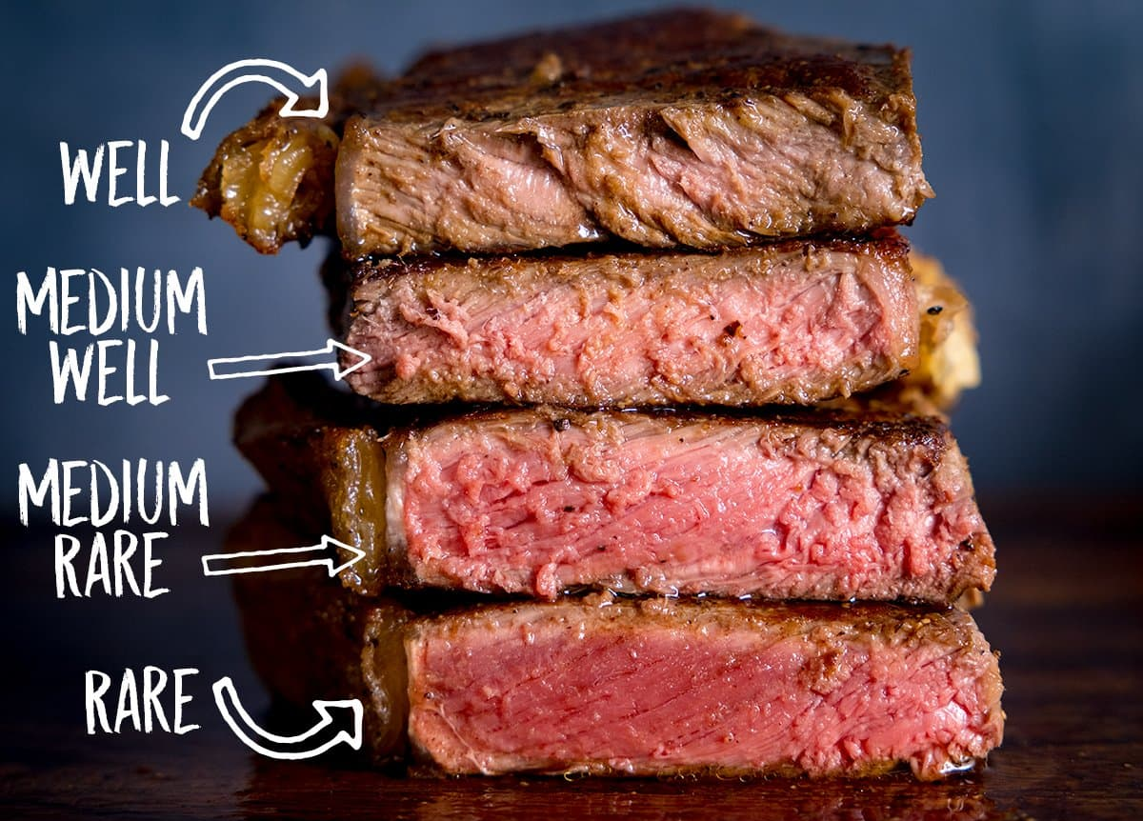
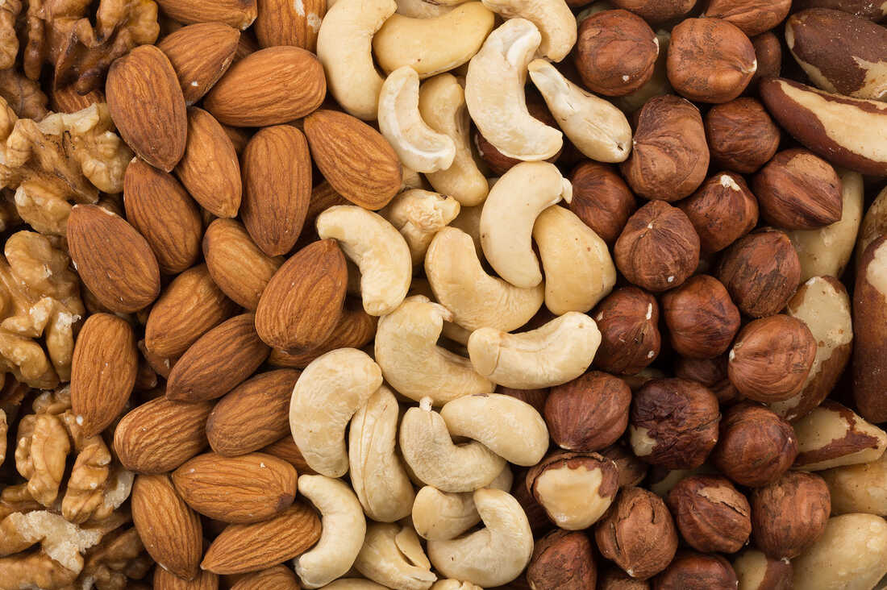
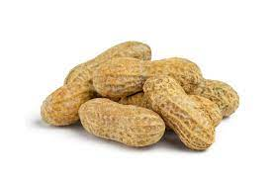
Key Vocabulary and Phrases
Could I have a menu, please?
Here you are.
Enjoy your meal!
Would you like ...
Can I get you anything else?
I'd like the check, please.
That'll be ...
Have a good day!
The spaghetti/steak/chicken looks good.
How is the pizza/fish/beer?
What would you recommend?
I'd like my steak rare/medium/well done.
Are there any nuts/peanuts? My child has allergies.
Do you have any vegetarian dishes?
Could I have a glass of water, please?
Could you tell me where the restroom is?
I'd recommend the lasagna/steak/pizza.
Would you care for an appetizer/a beer/a cocktail?
I'd like to have a beer/steak/glass of wine.

