Slide 1
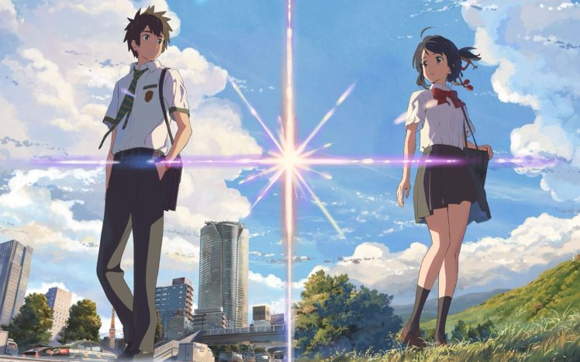
Ki mi no Na wa 君 の 名 は Your name

Slide 2
Your name (2016)
romantic fantasy drama film
directed, written, and edited by Makoto Shinkai
own novel of the same name published only a month before the film's premiere.

Slide 3
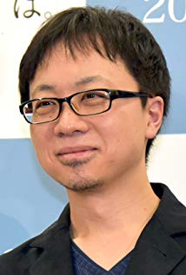
Makoto Shinkai: The History of the Director of ‘Your Name’ (Kimi no Na wa)
One film director is attempting to change the structure of the world’s animated movies. He is Makoto Shinkai, the director of the Japanese anime film Your Name (Kimi no Na wa), the anime film that caused a cinematic whirlwind throughout Asia and has won the Los Angeles Film Critics Association Award for Best Animated Film.
Your Name has the record for the second highest box-office revenues for a Japanese movie in its native country, Japan, and has become a great hit overseas as well. It has become the biggest Japanese hit movie in the world.
Born February 9, 1973 in Nagano, Japan
Birth Name Makoto Niitsu
Nickname The New Hayao Miyazaki

Slide 4
Makoto Shinkai: The History of the Director of ‘Your Name’ (Kimi no Na wa)
Makoto Shinkai is a Japanese director, writer, producer, animator, editor, cinematographer, voice actor, manga artist and former graphic designer.
Shinkai studied Japanese literature at Chuo University where he was a member of juvenile literature club where he drew picture books. In 1999, Shinkai released She and Her Cat, a five-minute short piece done in monochrome.
His best knows films are The Place Promised in Our Early Days (2004), 5 Centimeters Per Second (2007), Children Who Chase Lost Voices (2011), The Garden of Words (2013), and Your Name (2016).
His favorite anime is Castle in the Sky (1986) by Hayao Miyazaki.
Born February 9, 1973 in Nagano, Japan
Birth Name Makoto Niitsu
Nickname The New Hayao Miyazaki

Slide 5
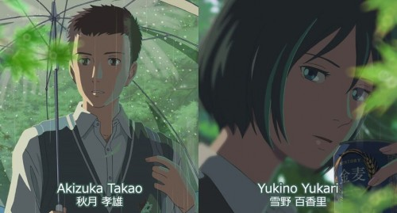
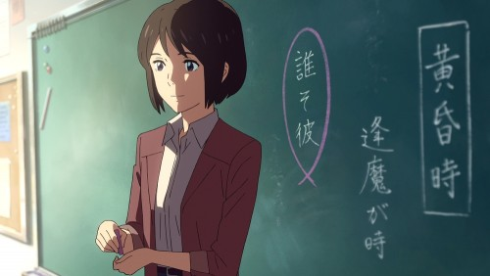
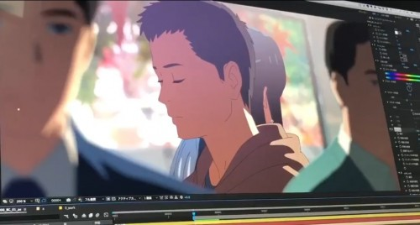
The 5 Centimeters Per Second (Byousoku 5 Centimeters) was referenced by Yourname (Kimi no Na wa) about reality in this world and that is some Easter eggs about the story.
The Easter eggs from The Garden of Words (Koto no Ha no Niwa) to Yourname (Kimi no Na wa)
Yukino Yukari, the lead female character. resigned from the school to be the teacher of Mitsuha the lead female character in YourName in another school.
Akizuki Takao, the lead male character. Had showed up at the last period of the Yourname movie.
https://twitter.com/i/status/948556207312093184

Slide 6
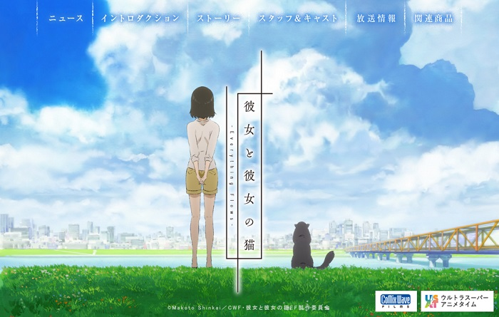
A Challenge Which He Started Alone
Before making anime films, Shinkai used to work at a game company creating package designs and the opening movies of games. At the same time, he started independently producing anime movies. In 2000, he released the movie She and Her Cat (Kanojo to Kanojo no Neko), and in 2002 he released The Voices of a Distant Star (Hoshi no Koe), which became his first short movie shown in theaters. Since both movies were made almost all by himself, their high quality surprised the viewers.

Slide 7
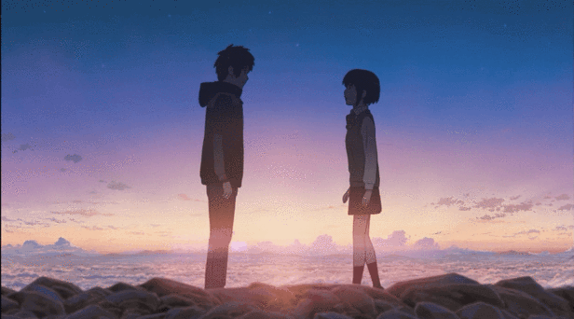
Plot

Slide 8
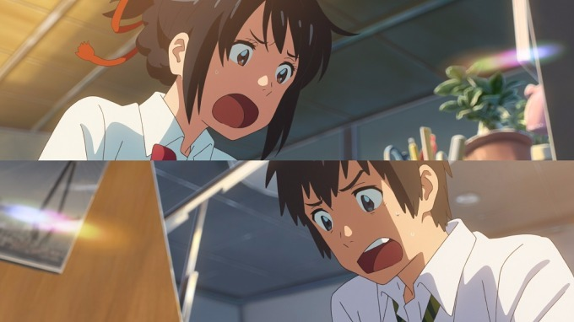
A boy in the big, bustling city of Tokyo and a girl in a country village where life is slow but idyllic.
They find they wake up in each other's bodies for weeks at a time with no reason.
They both think these experiences are just dreams, but when the reality of their situations sinks in, they learn to adjust and even enjoy it.
They start to leave notes about who they are and what they are doing also discover more about each other. they uncover some disturbing hints that their distance is more than just physical and tragedy haunts them.

Slide 9
Main Character

Slide 10
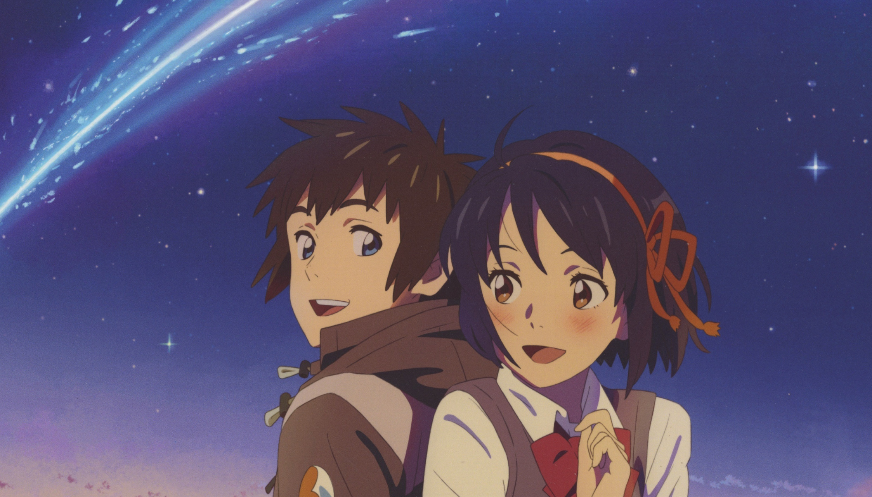
Mitsuha Miyamizu
17-year old
living in a town called Itomori with her grandmother and sister
switching bodies with Taki Tachibana
Taki Tachibana
17-year old
Doing part-time job at an Italian restaurant
His lifestyle takes a turn when he starts switching bodies with Mitsuha.

Slide 11
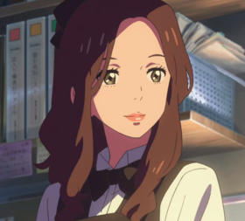
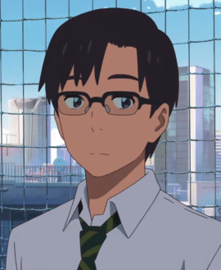
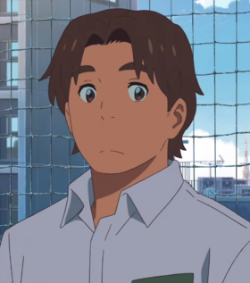
Supporting Character
Miki Okudera
Tsukasa Fuiji
Shita Takagi

Slide 12
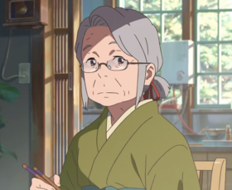
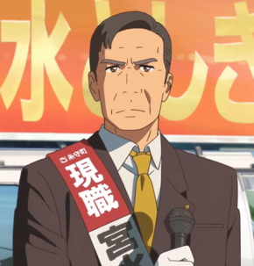
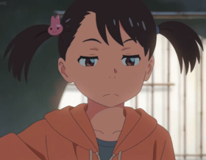
Hitoha Miyamizu
Toshiki Miyamizu
Yoshiha Miyamizu
Futaba Miyamizu

Slide 13
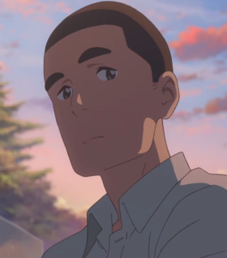
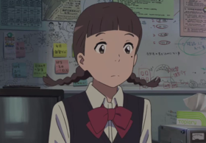
Katsuhiko Teshigawara
Sayaka Natori

Slide 14
‘Weathering with you’ the new movie of Makoto Shinkai
Plot
High school freshman Hodaka Morishima leaves his home on an isolated island and moves to Tokyo, but he immediately becomes broke. He lives his days in isolation, but finally finds a job as a writer for a shady occult magazine. After he starts his job, the weather has been rainy day after day. Then one day in a corner of the crowded and busy city, Hodaka meets a young girl named Hina Amano. Due to certain circumstances, Hina and her younger brother live together, but have a cheerful and sturdy life. This bright and strong­willed girl possesses a strange and wonderful ability: the power to stop the rain and clear the sky.
https://www.youtube.com/watch?v=rzKcrJ77wBY Trailer1
https://www.youtube.com/watch?v=VGksHFs04Rc Trailer2

