Slide 1
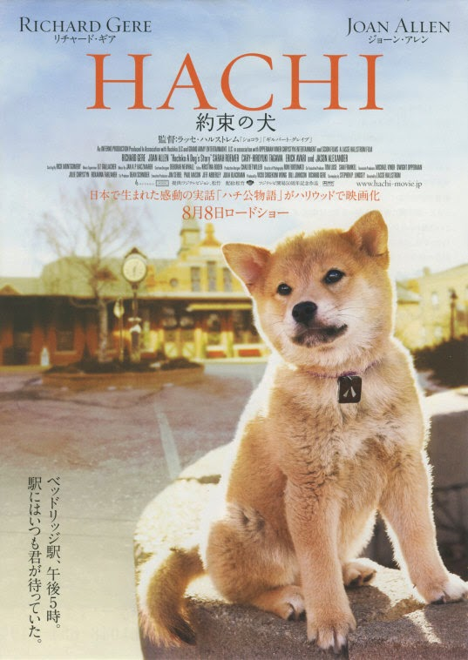
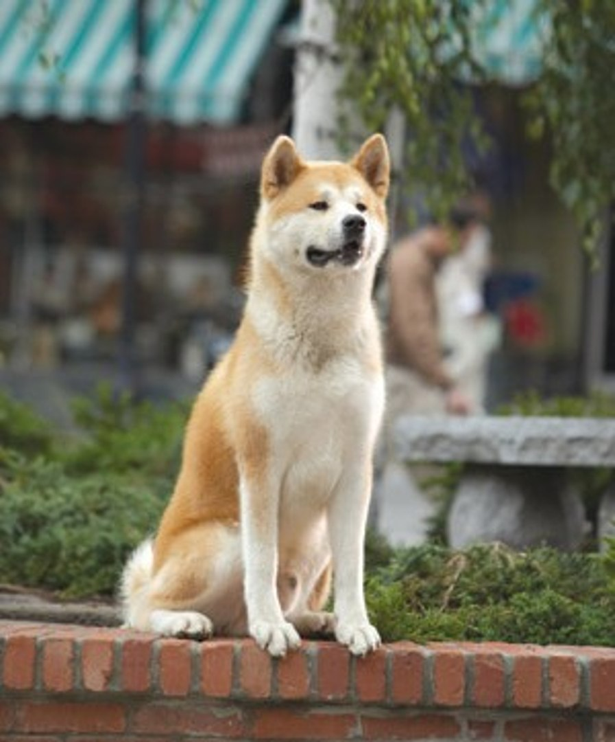
Hachi

Slide 2
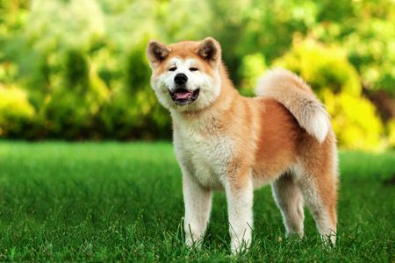
Hachi is a Akita dog, a Japanese dog breed. Haji can be called a lost dog, or it can be called a dog that is chosen.

Slide 3
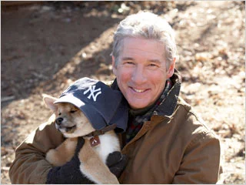
On the day of being sent to the land of freedom It met with a kind-hearted professor named Wilson Parker, who was originally Not thinking of raising But until Can not find anyone, where to feed it.

Slide 4
Combined with the love it has for everyone in the family Even if his wife doesn't like it But she finally accepted Haji as a member of the family.

Slide 5
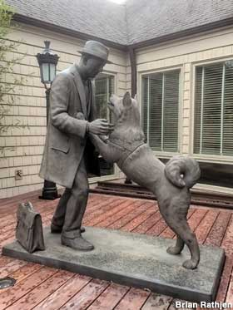
Regardless of the time of the day, Parker gave his love to him fully. Haji appeared in the family time Especially during the important time. In addition, it made a difference from Japanese dogs. But the bond makes it an amazing thing to do.

Slide 6
It went to send the professor every day. And it went to wait for the professor to go home at the train station every day as well Counting the days, fame began to spread. People know it all. Haji never bites anyone. And being serious about sitting and waiting for the professor to go home regularly

Slide 7
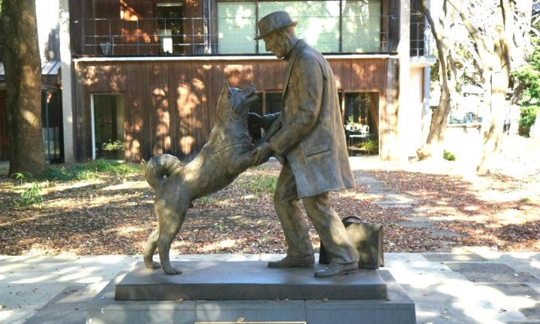
Moral
True love is true. And for love, we must have patience
Honesty And have hope Breathe.

