Slide 1
PLANT TISSUE CULTURE

Slide 2
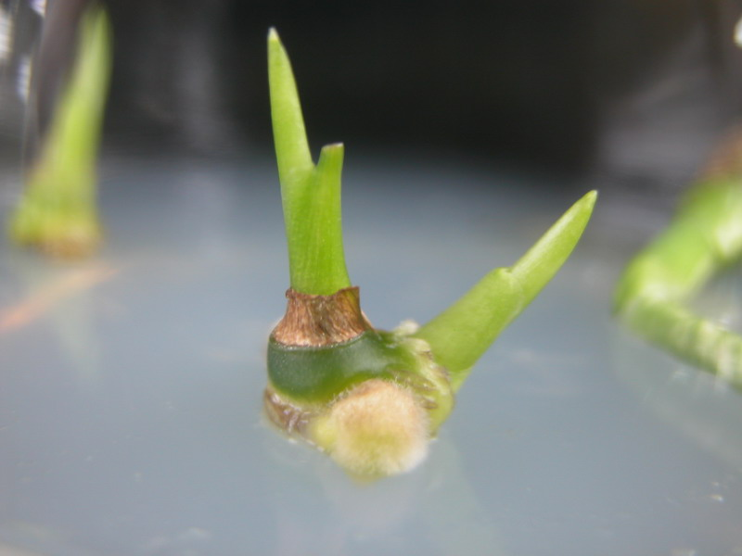
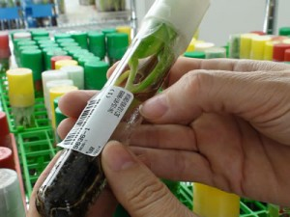
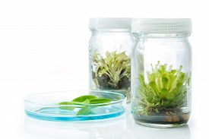
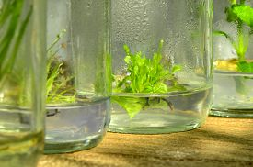
PLANT TISSUE CULTURE TECHNIQUES
Tissue culture is a biological method of asexual propagation where a very small piece of tissue (shoot apex, leaf section, or even an individual cell) is excised (which is known as Explants) and placed in sterile /aseptic culture in a test tube/petri dish/tissue culture container containing a special culture media.

Slide 3
Some Hormones used in Plant Tissue Culture:
Auxins neoline (Indole-3-acetic acid, Indole-3-butyric acid, Potassium Salt— Naph­thalene acetic acid 2, 4-Dichlorophenoxyacetic acid p-Chloro-phenoxy acetic acid).
2. Cytokinins (6-Benzylaminopurine, 6-Dimethylallylaminopurine (2ip), Kinetin)
one of the major regulators of plant cell proliferation and differentiation. Some of the processes in which the plant growth factors cytokinins are involved are: Cell proliferation, Cell Differentiation, Nutritional signal transduction, Delay of senescence, and Controlling the balance of roots and shoot.
3. Gibberellins (Gibberellic Acid)
Gibberellins (GAs) are plant hormones that are essential for many developmental processes in plants, including seed germination, stem elongation, leaf expansion, trichome development, pollen maturation and the induction of flowering
4. Abscisic Acid (ABA) (Abscisic Acid)
A plant hormone that functions in many plant developmental processes, including bud dormancy, inhibition of seed germination, and plant stress tolerance.
5. Polyamines (Putrescine, Spermidine)
Polyamines (PAs) in plant growth and developmental processes.
The PAs, putrescine, spermidine and spermine are low molecular weight cations present in all living organisms. PAs and their biosynthetic enzymes have been implicated in a wide range of metabolic processes in plants, ranging from cell division and organogenesis to protection against stress.

Slide 4
A hormone is any chemical produced in one part of the body that has a target elsewhere in the body.
Hormones and enzymes serve as control chemicals in multicellular organisms.
One important aspect of this is the obtaining of food and/or nutrients
Plants have five classes of hormones. Animals, especially chordates, have a much larger number.

Slide 5
Five major types of plant hormones: auxin, gibberellin, cytokinin, ethylene, and abscisic acid. These hormones can work together or independently to influence plant growth.
1. Auxins promote stem elongation, inhibit growth of lateral buds (maintains apical dominance).
They are produced in the stem, buds, and root tips.
Auxin is a plant hormone produced in the stem tip that promotes cell elongation.
Auxin moves to the darker side of the plant, causing the cells there to grow larger than corresponding cells on the lighter side of the plant.
This produces a curving of the plant stem tip toward the light, a plant movement known as phototropism.
Auxin also plays a role in maintaining apical dominance.
Most plants have lateral (sometimes called axillary) buds located at nodes (where leaves attach to the stem).
Buds are embryonic meristems maintained in a dormant state. Auxin maintains this dormancy.
As long as sufficient auxin is produced by the apical meristem, the lateral buds remain dormant.
If the apex of the shoot is removed, the auxin is no longer produced.
This will cause the lateral buds to break their dormancy and begin to grow.
In effect, the plant becomes bushier.
When a gardener trims a hedge, they are applying apical dominance.

Slide 6
In normally growing plants, the auxin phytohormones are responsible for phototropism and apical dominance.
They also influence abscission of blooms, leaves, and fruit, making them valuable tools in bringing fruits and horticultural products to market.
Auxins are widely used in plant propagation and tissue culture.
Cuttings are routinely treated with auxins to induce root formation.
In tissue culture, auxins are balanced with cytokinins for full morphogenesis.
2. Gibberellins promote stem elongation.
They are not produced in stem tip.
Gibberellic acid was the first of this class of hormone to be discovered.
3. Cytokinins promote cell division.
They are produced in growing areas, such as meristems at tip of the shoot.
4. Abscisic Acid promotes seed dormancy by inhibiting cell growth.
It is also involved in opening and closing of stomata as leaves wilt.
5. Ethylene is a gas produced by ripe fruits.
Why does one bad apple spoil the whole bunch?
Ethylene is used to ripen crops at the same time.
Sprayed on a field it will cause all fruits to ripen at the same time so they can be harvested.

Slide 7
Plant Nutrition
Unlike animals (which obtain their food from what they eat) plants obtain their nutrition from the soil and atmosphere. Using sunlight as an energy source, plants are capable of making all the organic macromolecules they need by modifications of the sugars they form by photosynthesis. However, plants must take up various minerals through their root systems for use.
A (plant) balanced diet
Carbon, Hydrogen, and Oxygen are considered the essential elements. Nitrogen, Potassium, and Phosphorous are obtained from the soil and are the primary macronutrients. Calcium, Magnesium, and Sulfur are the secondary macronutrients needed in lesser quantity. The micronutrients, needed in very small quantities and toxic in large quantities, include Iron, Manganese, Copper, Zinc, Boron, and Chlorine. A complete fertilizer provides all three primary macronutrients and some of the secondary and micronutrients. The label of the fertilizer will list numbers, for example 5-10-5, which refer to the percent by weight of the primary macronutrients.
Soils play a role
Soil is weathered, decomposed rock and mineral (geological) fragments mixed with air and water. Fertile soil contains the nutrients in a readily available form that plants require for growth. The roots of the plant act as miners moving through the soil and bringing needed minerals into the plant roots.

Slide 8
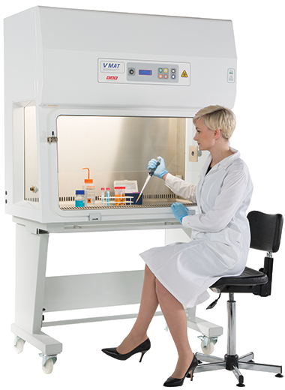
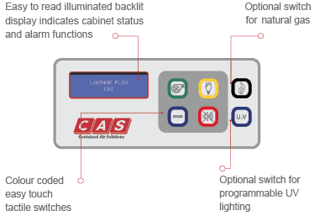
Environmental Conditions:
Nutrient medium
Aseptic conditions - (free from pathogenic microorganisms)
Aeration of the tissue
A tissue culture is used for rapid multiplication of an organism. A very specialized laboratory with sterile/aseptic conditions is required for tissue culture. All the procedure involved in tissue culture should be carried out in a special ventilated cabinet and these conditions are provided by
Laminar Air Flow.
The culture medium is a proper mixture of the nutrients (organic and inorganic), vitamins, sugars, minerals and plant hormones especially Cytokinin and Auxin for shoot and root initiation.

Slide 9
Laminar Air Flow provides a work area with aseptic/sterile conditions for the tissue culture.
Laminar Air Flow has continuous displacement of air (it provides streamline flow of air) that passes through HEPA (High Efficiency Particulate Air) filter that removes the particulates from the air.
Laminar Air Flow are equipped with a UV lamp that should be turned on about 10-20 minutes before being used to sterilize the shell or cabinet or the surface of the Laminar Air Flow to avoid any kind of contaminations. Wipe down the surface with ethanol before and after each use.
Laminar Air Flow can be vertical and horizontal. In the Vertical Laminar Air Flow the air blows down from the top of the cabinet. Vertical Laminar Air Flow is best for working with hazardous specimens since the aerosols that are generated in the cabinet are filtered out before they are released into the surrounding environments.
Horizontal Laminar Air Flow are designed such that the air flows directly at the operator hence they are not useful for working with hazardous specimens but are best protection for Tissue/cell culture.
Laminar Air Flow provides aseptic/sterile conditions for the preparation of Culture Media. All the culture vessels, test tubes, pipette, tip boxes, stocks of sterile eppendorfs should be opened only in the Laminar Air Flow to avoid any kind of contaminations.
Culture Media cannot be prepared outside the Laminar Air Flow because it can get contaminated and there would not be any result.

Slide 10
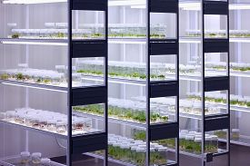
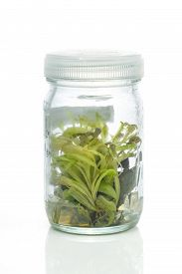
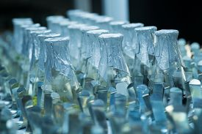
Plant Culture
To meet the current rates of food productions to support the growing population.
These ideas range from simple procedures including selection of the best seeds to more complex procedures requiring the transplantation of genes into different plant species.
Focuses on an important aspect of plant science which is the growth of plant cells in an artificial media. This process is known as plant cell culture and can be applied in many different ways.

Slide 11
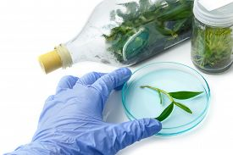
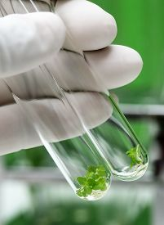
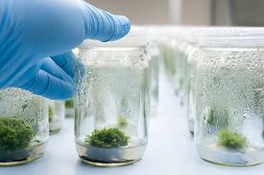
Steps involved in Tissue Culture are
Explants ; excision of the plant parts. Any part of a plant taken out and grown in test tube under sterile conditions in special nutrient media is called explant. Place the explants in a tissue culture container/test tubes/petri dishes.
Multiplication ; Tissue grows and produce small plants.
Rapid multiplication by transfer of fresh culture.
Transplanting the plant into some kind of acclimation container.

Slide 12
Nutrient Medium
The composition of plant tissue culture medium can vary depending upon the type of plant tissues or cell that are used for culture.
A typical nutrient consists of inorganic salts (both micro and macro ele­ments), a carbon source (usually sucrose), vitamins (e.g., nicotonic acid, thiamine, pyridoxine and myoinositol), amino acids (e.g., arginine) and growth regulators (e.g., auxins like 2,4-D or 2,4-dichlorophenoxyacetic acid and cytokinins such as BAP = benzlaminopurine and gibberellins).
Other compounds like casein hydrolysate, coconut milk, malt extract, yeast extract, tomato juice, etc. may be added for specific purposes.
Plant hormones play impor­tant role in growth and differentiation of cultured cells and tissues.
An optimum pH (usually 5.7) is also very important.
The most extensively used nutrient medium is MS medium which was developed by Murashige and Skoog in 1962.
Usually a gelling agent agar (a polysac­charide obtained from a red algae Gelidium amansi) is added to the liquid medium for its solidification.

Slide 13
2. Aseptic Conditions (Sterilization)
Nutrient medium contains ample sugar which increases growth of microorganisms such as bacteria and fungi.
These microbes compete with growing tissue and finally kill it.
It is essential to maintain aseptic conditions of tissue culture.
Thus sterilization means complete destruction or killing of microorganisms so that complete aseptic conditions are created for in vitro culturing.
3. Aeration of the Tissue:
Proper aeration of the cultured tissue is also an important aspect of culture technique.
It is achieved by occasionally stirring the medium by stirring or by automatic shaker.

Slide 14
Methods of Plant Tissue Culture:
Plant tissue culture includes two major methods:
Type of in vitro growth-callus and suspension cultures.
(B) Type of explant— single cell culture, shoot and root cultures, somatic embryo culture, meristem culture, anther culture and haploid production, protoplast culture and somatic hybridization, embryo culture, ovule culture, ovary culture, etc.

Slide 15
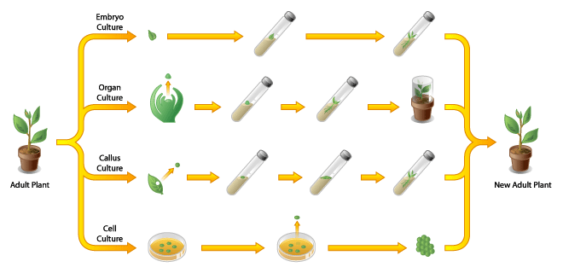
Different methods of cell culture.
Embryo culture. Cells from the embryo are grown on agar media and allowed to develop into plants.
Organ culture. Some specialized tissues are able to regenerate the whole plant. For example, the meristem tip can be excised from a plant and used to generate a whole new plant.
Callus culture results when specific tissues are excised from the adult plant and allowed to form a structure known as a callus. The callus can then be used to generate a new tissue.
Plant cell culture involves the dissociation of cells into a single cell suspension from where new plants can be generated.

Slide 16
Types of Plant Tissue Culture:
Callus and Suspension Cultures:
In callus culture, cell division in explant forms a callus.
Callus is irregular unorganized and undifferentiated mass of actively dividing cells.
Darkness and solid medium gelled by agar stimulates callus formation.
The medium ordinarily contains the auxin and often a cytokinin.
Both are growth regulators. This stimulates cell division in explant.
Callus is obtained within 2-3 weeks.
A suspension culture consists of single cells and small groups of cells suspended in a liquid medium. Usually, the medium contains the auxin. Suspension cultures must be constantly agitated at 100-250 rpm (revolutions per minute).
Suspension cultures grow much faster than callus culture.

Slide 17
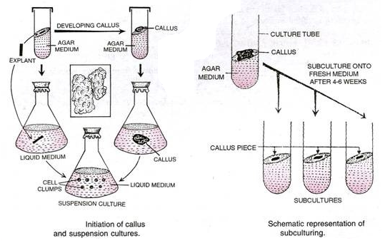
Sub culturing:
If tissue cultures are kept in the same culture vessel, they die in due course of time.
Therefore, cells/tissues are regularly transferred into new culture vessels containing fresh media. This process is called sub culturing.
It is important to note that during subculture; only a part of the culture from a vessel is transferred into the new culture vessel.
The callus and suspension cultures may be used to achieve cell biomass production, regeneration of plantlets, production of transgenic plants and isolation of protoplasts.

