Slide 1
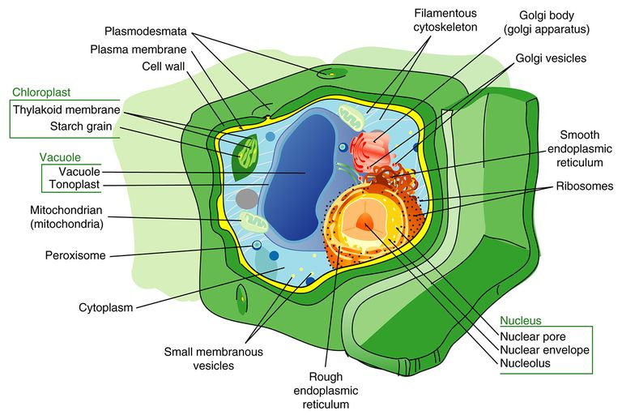
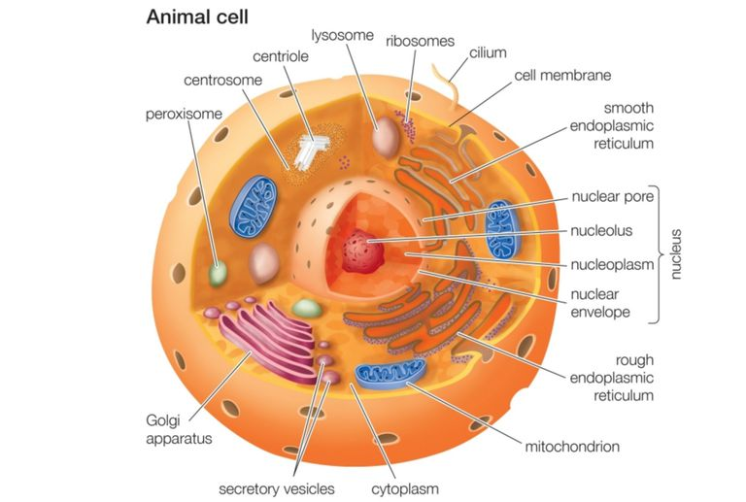
The main role of the mitochondrion in the plant cell, like in all eukaryotic cells, is production of ATP, reducing equivalents and metabolic intermediates for use in biosynthesis elsewhere in the cell.
Mitochondria in plants, as in other eukaryotes, play an essential role in the cell as the major producers of ATP via oxidative phosphorylation.

Slide 2
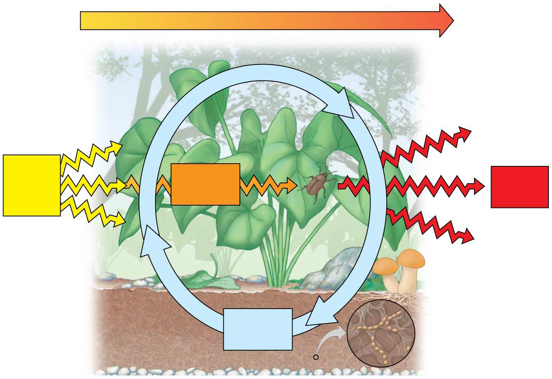
Energy flow
Chemicals pass to organisms that eat plants.
Chemical cycling
Light energy
Chemical energy
Heat
Decomposers return chemicals to soil.
Chemical
elements

Slide 3
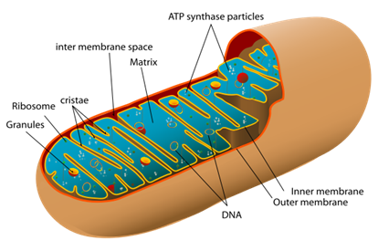
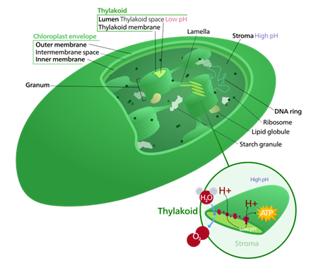
Energy Cycle in Living Things
Plant and animal use tiny energy factories within the cells to handle the energy transformation processes necessary for life.
In plants, these energy factories are called chloroplasts. They collect energy from the sun and use carbon dioxide and water in the process called photosynthesis to produce sugars.
Animals can make use of the sugars provided by the plants in their own cellular energy factories, the mitochondria.
These produce a versatile energy currency in the form of adenosine triphosphate (ATP). This high-energy molecule stores the energy we need to do just about everything we do.

Slide 4
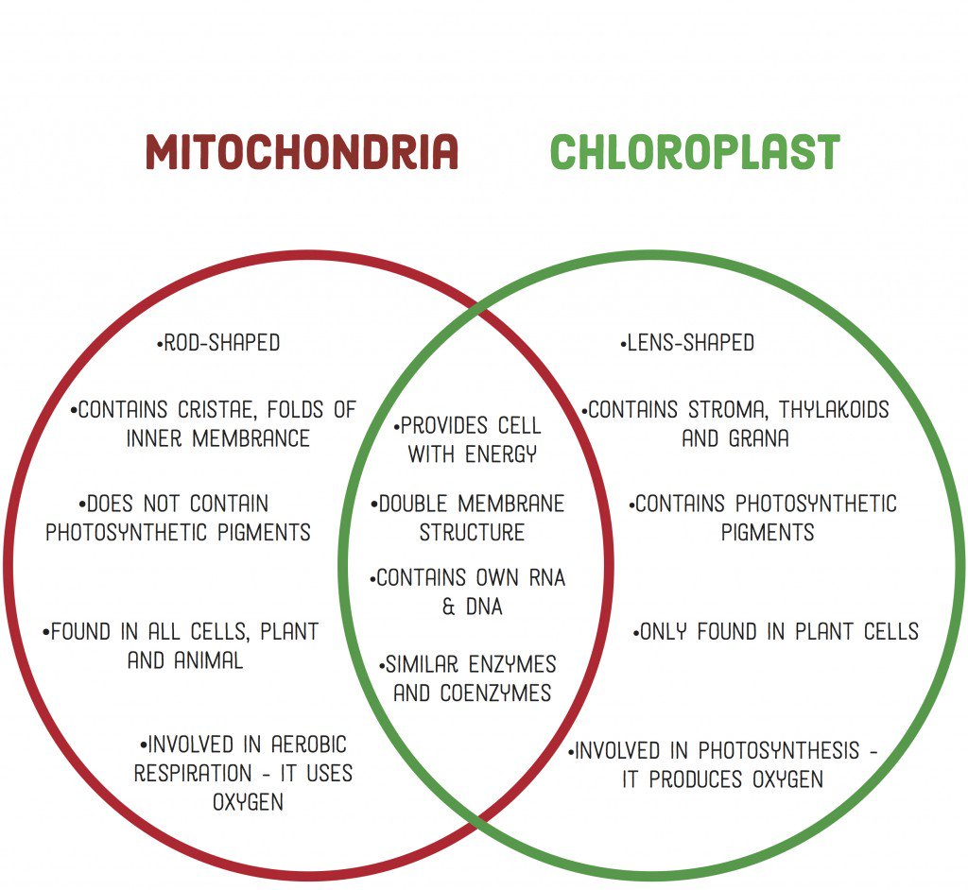
Chloroplast
plural: chloroplasts
usually found in plants and unicellular organisms
converts solar/light energy into chemical energy (sugar)
process is photosynthesis: composed of Light Reactions and Calvin Benson Cycle
has three compartments(parts): thylakoids (traps sunlight), granum (pl: grana; stacks of thylakoids), stroma (fluid inside the outer membrane, which interacts with the cytoplasm. It surrounds the granum and thylakoids
Mitochondrion
plural: mitochondria
found in almost all cells
converts chemical energy (sugar) into another form of chemical energy (ATP), which is simpler and could be used by the cell
process is cellular respiration: composed of Glycolysis, ETC, and Oxidative Phosphorylation
has two compartments. Crista (pl:cristae) is the compartment formed by the inner and outer membrane of the mitochondria; it is the layer of folds in the mitochondria and is studded with proteins. The other compartment is called matrix; it is the fluid inside the foldings (cristae).
Similarities
convert energy
have its own DNA
enclosed by two membranes
oxygen (O₂) and carbon dioxide (CO₂) are involved in its processes
have fluids inside of it

Slide 5
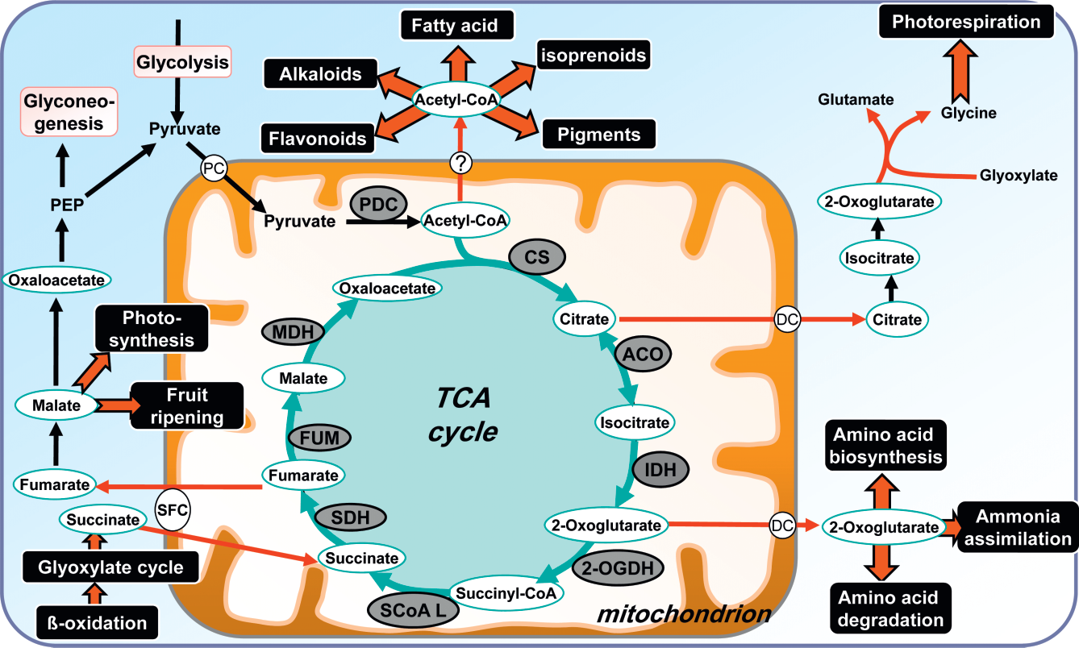
Mitochondria also play crucial roles in many other aspects of plant development and performance, and possess an array of unique properties which allow them to interact with the specialized features of plant cell metabolism.

Slide 6
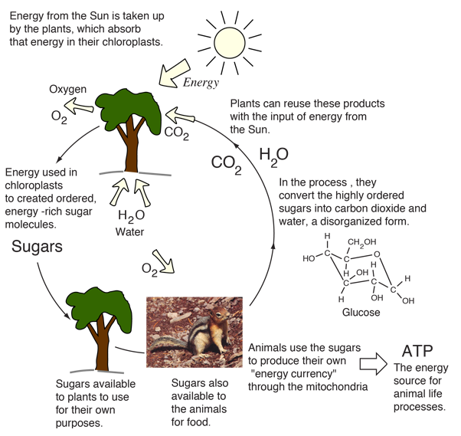
Energy Cycle in Living Things
Plants use energy from the sun in chloroplasts by using chlorophyll in the process of photosynthesis to convert the sun's energy into storable form in ordered sugar molecules such as glucose.
In this way, carbon dioxide from the air and water from the soil in a more disordered state are combined to form the more ordered sugar molecules.

Slide 7
Chloroplast
-usually found in plants and unicellular organisms
converts solar/light energy into chemical energy (sugar)
process is photosynthesis: composed of Light Reactions and Calvin Benson Cycle
Has three compartments:
thylakoids (traps sunlight)
granum (pl: grana; stacks of thylakoids)
stroma (fluid inside the outer membrane, which interacts with the cytoplasm. It surrounds the granum and thylakoids. The fluid of the chloroplast surrounding the thylakoid membrane; involved in the synthesis of organic molecules from carbon dioxide and water.

Slide 8
In the chloroplast, chlorophyll is the pigment that absorbs the sunlight. Chlorophyll is typically packed into stacks of membranes (called grana); it is in the grana where some of the sunlight is absorbed.
Sunlight is converted to chemical energy in the form of ATP (adenosine triphosphate), which is the main energy-storing molecule in living organisms.
Chlorophyll
A green pigment located in membranes within the chloroplasts of plants and algae and in the membranes of certain prokaryotes. Chlorophyll a participates directly in the light reactions, which convert solar energy to chemical energy.
ATP is then transported throughout the chloroplast and used to provide the chemical energy necessary to power other metabolic reactions.
For example, some of the ATP is used to power the metabolic reactions in the conversion of CO₂ into sugars and other compounds

Slide 9
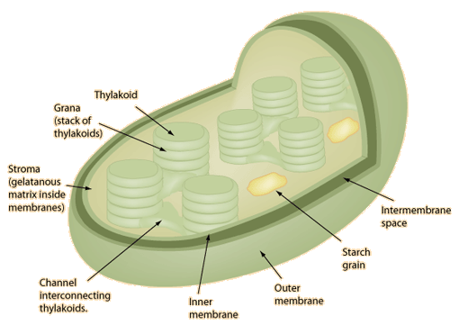
Plants use energy from the sun in tiny energy factories (chloroplasts).
The green color of leaves is because of chloroplasts because they contain chlorophyll for photosynthesis.
Dimension 5-10 μm by 3-4 μm.
40-200 chloroplasts per photosynthetic cell and about 500,000 per square millimeter of leaf area.
There are two membranes, and inside the inner membrane is the gelatanous matrix called the stroma.
The stroma contains ribosomes, DNA, and is the location for biochemical synthesis. Membranous sacs called thylakoids are arranged in stacks called grana.
The chlorophyll in the thylakoid membranes carries out photosynthesis.

Slide 10
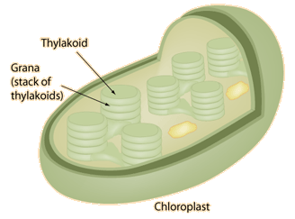
Inside the chloroplasts are stacks of discs called thylakoids.
They are compared to stacks of coins within the walls of the chloroplast.
Their function is to trap the energy from sunlight.
The stacks of thylakoids are called grana.
They are connected with an extensive system of tubules.
The thylakoid membranes contain chlorophyll and other pigments arranged in antenna arrays to capture light energy for two photosystems called Photosystem I and Photosystem II.
In most plants, both photosystems are used in an electron transport process that yields energy in the form of ATP and reduced coenzymes to the stroma of the chloroplast to be used in the synthesis of carbohydrates.
The energy is used in the Calvin cycle to fix carbon from atmospheric CO₂ and construct sugars.

Slide 11
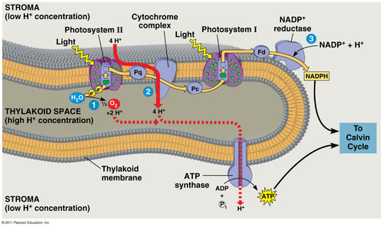
Thylakoids
A flattened membrane sac inside the chloroplast, used to convert light energy to chemical energy. Thylakoids often exist in stacks called grana that are interconnected; their membranes contain molecular "machinery" used to convert light energy to chemical energy.

Slide 12
Photosystem
A light-capturing unit located in the thylakoid membrane of the chloroplast or in the membrane of some prokaryotes, consisting of a reaction-center complex surrounded by numerous light-harvesting complexes. There are two types of photosystems, I and II; they absorb light best at different wavelengths.
Reaction-center complex
A complex of proteins associated with a special pair of chlorophyll a molecules and a primary electron acceptor.
Located centrally in a photosystem, this complex triggers the light reactions of photosynthesis. Excited by light energy, the pair of chlorophylls donates an electron to the primary electron acceptor, which passes an electron to an electron transport chain.

Slide 13
Light harvesting complex
A complex of proteins associated with pigment molecules (including chlorophyll a, chlorophyll b, and carotenoids) that captures light energy and transfers it to reaction-center pigments in a photosystem.
Primary electron acceptor
In the thylakoid membrane of a chloroplast or in the membrane of some prokaryotes, a specialized molecule that shares the reaction-center complex with a pair of chlorophyll a molecules and that accepts an electron from them.
What are the two stages of photosynthesis?
Light Reactions
The first of two major stages in photosynthesis (preceding the Calvin cycle). These reactions, which occur on the thylakoid membranes of the chloroplast or on membranes of certain prokaryotes, convert solar energy to the chemical energy of ATP and NADPH, releasing oxygen in the process.
Calvin cycle
The second of two major stages in photosynthesis (following the light reactions), involving fixation of atmospheric CO2 and reduction of the fixed carbon into carbohydrate.

Slide 14
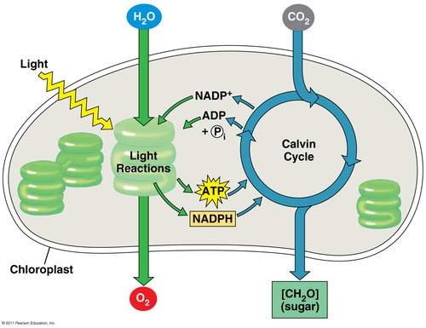
Photosynthesis
(converts light energy to the chemical energy of food)
The conversion of light energy to chemical energy that is stored in glucose or other organic compounds.
↓
Occurs in plants, algae, and certain prokaryotes.

Slide 15
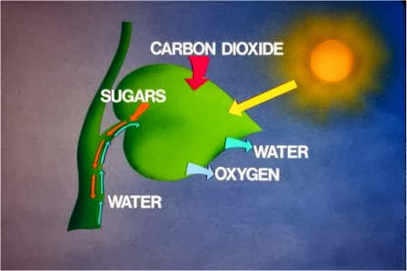
Photosynthesis is the process by which organisms that contain the pigment chlorophyll convert light energy into chemical energy which can be stored in the molecular bonds of organic molecules (e.g., sugars).
Photosynthesis powers almost all trophic chains and food webs on the Earth.
The net process of photosynthesis is described by the following equation:
6CO₂ + 6H₂O + Light Energy = C₆H₁₂O₆ + 6O₂
This equation means that carbon dioxide from the air and water combine in the presence of sunlight to form sugars.
↓
oxygen is released as a
by-product of this reaction
Chlorophyll a participates directly in the light reactions, which convert solar energy to chemical energy.

Slide 16
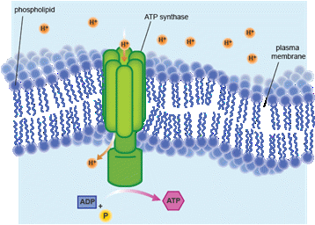
NADP (Nicotinamide adenine dinucleotide phosphate)
NADP is an electron acceptor that, as NADPH, temporarily stores energized electrons produced during the light reactions.
Photophosphorylation
The process of generating ATP from ADP and phosphate by means of chemiosmosis, using a proton-motive force generated across the thylakoid membrane of the chloroplast or the membrane of certain prokaryotes during the light reactions of photosynthesis.
Carbon Fixation
The initial incorporation of carbon from CO2 into an organic compound by an autotrophic organism (a plant, another photosynthetic organism, or a chemoautotrophic prokaryote).
The light reactions convert solar energy to the chemical energy of ATP and NADPH

Slide 17
Photo system II
One of two light-capturing units in a chloroplast's thylakoid membrane or in the membrane of some prokaryotes; it has two molecules of P680 chlorophyll a at its reaction center.
Photosystem I
A light-capturing unit in a chloroplast's thylakoid membrane or in the membrane of some prokaryotes; it has two molecules of P700 chlorophyll a at its reaction center.

Slide 18
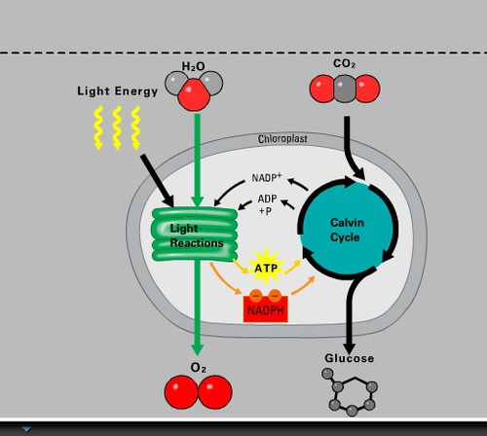
The Calvin Cycle uses the chemical energy of ATP and NADPH to reduce CO2 to sugar
What are the three phases of The Calvin cycle?
Carbon Fixation Energy Consumption and Redox Release of G3P; Regeneration of RuBP
Glyceraldehyde 3-phosphate (G3P)
A three-carbon carbohydrate that is the direct product of the Calvin cycle.
It is also an intermediate in glycolysis.

Slide 19
C3 plants
A plant that uses the Calvin cycle for the initial steps that incorporate CO2 into organic material, forming a three-carbon compound as the first stable intermediate.
C4 Plants
A plant in which the Calvin cycle is preceded by reactions that incorporate CO2 into a four-carbon compound, the end product of which supplies CO2 for the Calvin cycle.
Photorespiration
A metabolic pathway that consumes oxygen and ATP, releases carbon dioxide, and decreases photosynthetic output. Photorespiration generally occurs on hot, dry, bright days, when stomata close and the O2/CO2 ratio in the leaf increases, favoring the binding of O2 rather than CO2 by rubisco.

Slide 20
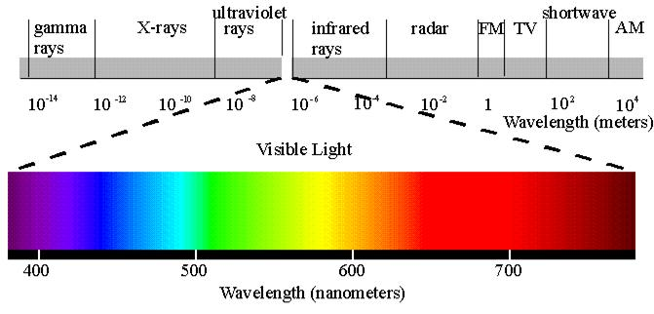
Electromagnetic Spectrum
Visible light ranges from low blue to far-red light and is described as the
wavelengths between 380 nm and 750 nm.
The region between 400 nm and 700 nm is what plants use to drive photosynthesis and is typically referred to as Photosynthetically Active Radiation (PAR).

Slide 21
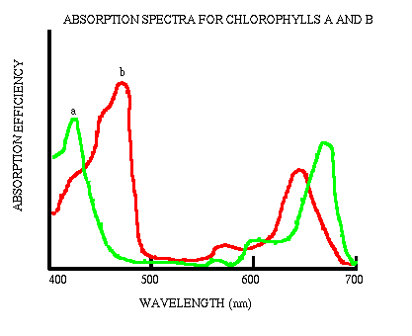
The wavelengths of sunlight between 400nm and 700nm are the wavelengths that are absorbed by chlorophyll and that drive photosynthesis.

Slide 22
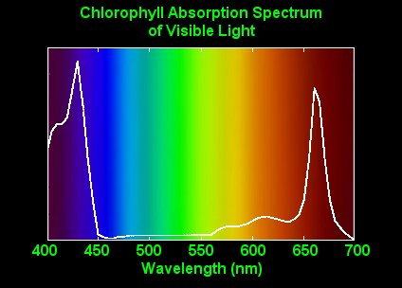
Electromagnetic Spectrum
The entire spectrum of electromagnetic radiation, ranging in wavelength from less than a nanometer to more than a kilometer.
Visible light
That portion of the electromagnetic spectrum that can be detected as various colors by the human eye, ranging in wavelength from about 380 nm to about 750 nm.
Plants use visible light (400 nm to 700 nm) for growth and photosynthesis.
The wavelength of red light is about 650 nm.
Green light has a wavelength of about 510 nm, and the wavelength of blue light is about 475 nm.
Photosynthesis depends on the absorption of light by pigments in the leaves of plants.
The most important of these pigments is chlorophyll-a.
Chlorophyll has its greatest absorption at 430 nm and 660 nm.
Other pigments such as chlorophyll b and β-carotene also contribute.
They absorb at different wavelengths and pass their energy to chlorophyll a.

Slide 23
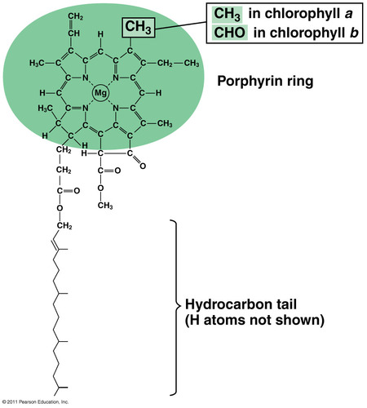
Chlorophyll a
A photosynthetic pigment that participates directly in the light reactions, which convert solar energy to chemical energy.
Chlorophyll b
An accessory photosynthetic pigment that transfers energy to chlorophyll a.
Carotenoids
An accessory pigment, either yellow or orange, in the chloroplasts of plants and in some prokaryotes. By absorbing wavelengths of light that chlorophyll cannot, carotenoids broaden the spectrum of colors that can drive photosynthesis.
A chlorophyll molecule

Slide 24
Light Reactions and the Calvin Cycle
The process of photosynthesis is broken up into two main groups of reactions: the "light reactions" which require light energy to operate, and the "Calvin cycle" which specifically takes carbon dioxide and turns it into organic molecules.
The electromagnetic energy of sunlight is converted to chemical energy in the chlorophyll-containing cells of photosynthetic organisms.
In eukaryotic cells these reactions occur in the organelle known as the chloroplast.
In the chloroplast, chlorophyll is the pigment that absorbs the sunlight. Chlorophyll is typically packed into stacks of membranes (called grana); it is in the grana where some of the sunlight is absorbed. Sunlight is converted to chemical energy in the form of ATP (adenosine triphosphate), which is the main energy-storing molecule in living organisms. ATP is then transported throughout the chloroplast and used to provide the chemical energy necessary to power other metabolic reactions. For example, some of the ATP is used to power the metabolic reactions in the conversion of CO₂ into sugars and other compounds.

Slide 25
H₂O Water
O₂ Oxygen
CO₂ Carbon dioxide
ATP Adenosine triphosophate
PGA Phosphoglyceric acid, a three carbon (C-C-C) organic acid.
Grana The stacked membranes that contain chlorophyll.
RuBP The five carbon (C-C-C-C-C) sugar-phosphate.
Rubisco The enzyme ribulose bisphosphate carboxylase/oxygenase.
It is the enzyme that catalyzes the conversion of CO₂ to the organic acid, PGA. It is the most abundant enzyme on Earth.

Slide 26
During the process of photosynthesis, light penetrates the cell and passes into the chloroplast. The light energy is intercepted by chlorophyll molecules on the granal stacks.
Some of the light energy is converted to chemical energy. During this process, a phosphate is added to a molecule to cause the formation of ATP. The third phosphate chemical bond contains the new chemical energy. The ATP then provides energy to some of the other photosynthetic reactions that are causing the conversion of CO₂ into sugars.
While the above reactions are proceeding CO₂ is diffusing into the chloroplast. In the presence of the enzyme Rubisco, one molecule of CO₂ is combined with one molecule of RuBP, and the first product of this reaction is two molecules of PGA.
The PGA then participates in a cycle of reactions that result in the production of the sugars and in the regeneration of RuBP.
The RuBP is then available to accept another molecule of CO₂ and to make more PGA.
PGA Phosphoglyceric acid, a three carbon (C-C-C) organic acid.
Grana The stacked membranes that contain chlorophyll.
RuBP The five carbon (C-C-C-C-C) sugar-phosphate.
Rubisco The enzyme ribulose bisphosphate carboxylase/oxygenase.
It is the enzyme that catalyzes the conversion of CO₂ to the organic acid, PGA.
It is the most abundant enzyme on Earth.

Slide 27
Photosynthesis is not a very efficient process.
Of the sunlight reaching the surface of a leaf, approximately:
75% is evaporated
15% is reflected
5% is transmitted through the leaf
4% is converted to heat energy
1% is used in photosynthesis

Slide 28
How do we know the O₂ is derived from H₂O during photosynthesis?
The oxygen product of photosynthesis could originate from either the CO₂ or the H₂O starting compounds.
To determine which of these original compounds contributed to the O₂ end product, an isotopic tracer experiment was performed using ¹⁸O:
¹⁸O is a heavy isotope of oxygen
H₂¹⁸O + CO₂ yields ¹⁸O₂
H₂O+C¹⁸0₂ yields O₂
Therefore, the O₂ end product must originate from water and not from the carbon dioxide.

Slide 29
How do we know what the first products of photosynthesis are?
Another isotopic tracer experiment:
¹⁴C is a radioactive isotope of carbon.
¹⁴CO₂ is exposed for a brief period to a green plant that is conducting a photosynthesis in the presence of sunlight.
Immediately after exposure to ¹⁴CO₂, the plant's photosynthetic tissue is killed by immersing it in boiling alcohol, and all of the biochemical reactions cease.
The chemical compounds in the dead tissue are all extracted and studied to determine which of them possesses the ¹⁴C.
Following the briefest exposure to ¹⁴CO₂, the only chemical compound that possessed ¹⁴C was PGA (phosphoglyceric acid, a three carbon molecule).
Following longer periods of exposure, much of the ¹⁴C was found in a variety of compounds including glucose.
By varying the length of the exposure period it was possible to identify the sequence of the reactions leading from PGA to glucose.
This research was conducted by Prof. Melvin Calvin and his colleagues at the Univ. of California, Berkeley. Calvin received the Nobel Prize for this work.

Slide 30
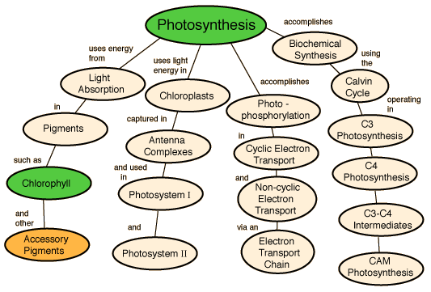

Slide 31
Photosynthesis is the light driven reaction that converts carbon dioxide and water in to energy rich sugars.
The process is coupled to the oxidation of water yielding oxygen as a
bi-product.
Depending on the photosynthetic mechanism there are 3 types of plants.
C3 plants
C4 plants
CAM plants

Slide 32
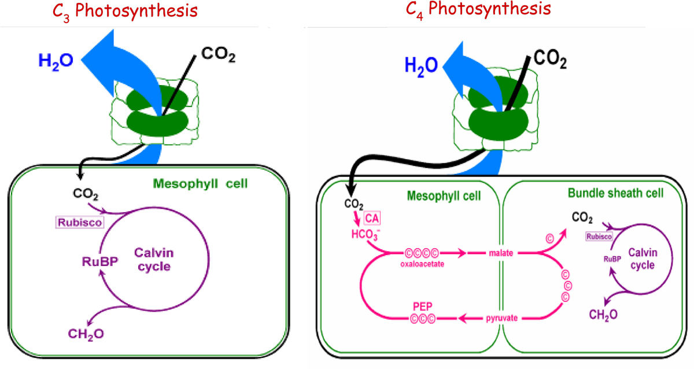
C4 plants such as maize, sorghum, and sugarcane, approximately have 50% higher photosynthesis efficiency than those of C3 plants such as rice, wheat, and potato.
This is because the different mechanism of carbon fixation by the two types of photosynthesis

Slide 33
C3 photosynthesis only uses the Calvin cycle for fixing CO₂ catalyzed by ribulose-1,5-bisphosphate carboxylase (Rubisco), which takes place inside of the chloroplast in mesophyll cell.
For C4 plants such as maize (NADP-ME subtype), photosynthetic activities are partitioned between mesophyll and bundle sheath cells that are anatomically and biochemically distinct.

Slide 34
The initial carbon fixation is catalyzed by phosphoenolpyruvate carboxylase (PEPC) forming oxaloacetate (OAA) from CO₂ and phosphoenolpyruvate (PEP).
OAA is metabolized into malate, and then diffuses into the BS cell where it is decarboxylated to provide increased concentration of CO₂ around Rubisco.
Finally, the initial substrate of the C4 cycle, PEP, is regenerated in mesophyll cell by pyruvate orthophosphate dikinase (PPDK).
The CO₂ concentration mechanism suppresses the oxygenation reaction by Rubisco and the subsequent energy-wasteful photorespiratory pathway, resulting in increased photosynthetic yield and more efficient use of water and nitrogen comparing to C3 plants

Slide 35
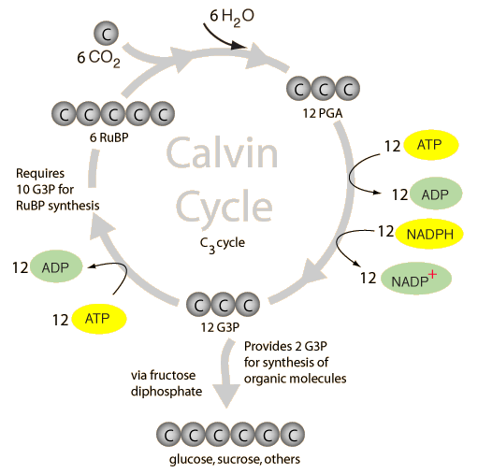
Carbon dioxide is captured in a cycle of reactions known as the Calvin cycle or the Calvin-Benson cycle after its discoverers.
(also known as just the C₃ cycle)
Plants that utilize just the Calvin cycle for carbon fixation are known as C3 plants.
Carbon dioxide diffuses into the stroma of chloroplasts and combines with a five-carbon sugar, ribulose1,5-biphosphate (RuBP).
The enzyme that catalyzes this reaction is referred to as RuBisCo, a large molecule that may be the most abundant organic molecule on the Earth.
This catalyzed reaction produces a 6-carbon intermediate which decays almost immediately to form two molecules of the 3-carbon compound 3-phosphoglyceric acid (3PGA).
This 3-carbon molecule is the first stable product of photosynthesis lead to being called the C₃ cycle.

Slide 36
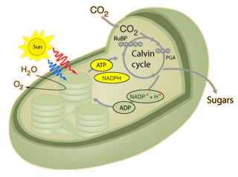
In C3 plants
the photosynthesis, carbon fixation and Calvin cycle all occur in a single chloroplast.

Slide 37
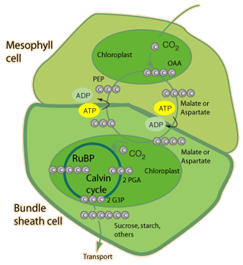
In C4 plants the photosynthesis takes place in a chloroplast
of a thin-walled mesophyll cell and a 4-carbon acid is handed off to a thick-walled bundle sheath cell where the Calvin cycle occurs in a chloroplast of that second cell.
This protects the Calvin cycle from the effects of photorespiration.

Slide 38
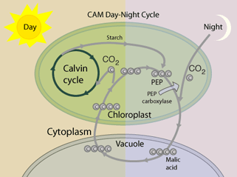
In CAM plants
the photosynthesis and initial carbon fixation occur at night and a 4-carbon acid is stored in the cell's vacuole.
During the day, the Calvin cycle operates in the same chloroplasts.

Slide 39
Energy from ATP and from the reduced coenyzme NADPH is used to remove a phosphate group from 3PGA and reduce the resulting diphosphoglycerate (DPGA) to produce the 3-carbon sugar glyceraladehyde-3-phosphate (G3P). Some of this G3P is used to regenerate the RuBP to continue the cycle, but some is available for molecular synthesis and is used to make fructose diphosphate. The fructose diphosphate is then used to make glucose, sucrose, starch and other carbohydrates.

Slide 40
C3 Plants
About 95% of the plants on earth are C3 plants.
As the name indicates they carry out C3 photosynthetic mechanism.
C3 photosynthesis is thought to have arisen nearly 3.5 billion years ago.
These plants are mostly woody and round leaf plants.
In these plants, carbon fixation is carried out in the mesophyll cells that are just beneath the epidermis.
Carbon dioxide from the atmosphere that enters through the stomata is accepted by Ribulose bisphosphate and is fixed in to phosphoglycerate by Ribulose bisphosphate carboxylase enzyme (Rubisco). This process is known as carboxylation. Phosphoglycerate molecules enter the Calvin cycle in the mesophyll cells.
C3 plants are known to be inefficient in terms of their photosynthetic mechanism.
This is because of the occurrence of photorespiration in C3 plants.
This effect is caused by the oxygenase activity of Rubisco.
Oxygenation of Rubisco works in the opposite direction to carboxylation, effectively undoes photosynthesis by wasting large amounts of carbon originally fixed by the Calvin cycle at great expense, and results in loss of carbon dioxide from the cells that are fixing carbon dioxide.
Interaction with oxygen and carbon dioxide occurs at the same site on Rubisco. These competing reactions normally run at a ratio of 3:1 (carbox: oxyg).
Thus, it is clear that photorespiration is a light stimulated process that consumes oxygen and evolves carbon dioxide.

Slide 41
C4 Plants
C4 plants are commonly seen in dry and high temperature areas.
Approximately 1% of plant species have C4 biochemistry.
Some examples for C4 plants are corn and sugarcane.
As the name indicates these plants carry out C4 photosynthetic mechanism.
C4 photosynthesis is thought to have arisen nearly 12 million years ago, long after the evolution of C3 mechanism.
C4 plants may be better adapted now, as carbon dioxide levels are much lower now than 100 million years ago.
C4 plants are much more efficient at capturing carbon dioxide.
C4 photosynthesis is found in both monocot and dicot species.
In contrast to C3 plants, the first stable product formed during photosynthesis is oxaloacetic, which is a C4 compound.
The leaves of these plants show a special type of anatomy called “Kranz Anatomy”. There is a circle of bundle sheath cells with chloroplasts around vascular bundles by which C4 plants can be identified.
In this pathway, carbon dioxide is fixed twice.
In the mesophyll cell cytoplasm, CO₂ is fixed with phosphoenol pyruvate (PEP), which acts as a primary acceptor. The reaction is catalyzed by PEP carboxylase enzyme. Then PEP is converted to malate and then to pyruvate liberating CO₂.
This CO₂ is then fixed with Ribulose bisphosphate, to form 2 phosphoglycerate to carry out Calvin cycle.

Slide 42
What is the difference between C3 Plants and C4 Plants ?
• C4 plants are more efficient than C3 plants
• C4 plant leaves show Kranz anatomy but C3 leaves do not.
• CO₂ is fixed once in C3 plants and twice in C4 plants.
• RuBP accepts CO₂ in C3 plants and PEP accepts CO₂ in C4 plants.
• PEP carboxylase in C4 has a higher affinity for CO₂ than RuBP carboxylase in C3 plants.
• Photorespiration present in C3 plants and it is absent in C4 plants.
• In C3 plants, photosynthesis does not take place efficiently under very high light concentrations or low CO₂ concentrations but, in C4 plants, it does take place efficiently under very high light concentrations and low CO₂ concentrations.

Slide 43
C₃ plants—all of carbon fixation and photosynthesis happens in mesophyll cells just on the surface of the leaf. C₃ plants include most temperate plants (except many grasses)—more than 95% of all earth’s plants.
The equation for the Calvin Cycle:
CO₂ (Carbon dioxide in from stomata) + RuBP (Ribulose bisphosphate already in plant) + the enzyme RUBISCO (Ribulose bisphosphate carboxylase) “fixes” carbon from the atmosphere → 2PGA (phospholygerate)
PGA enters Calvin cycle in Mesophyll cells → more RuBP (to fix more CO₂) + sugar (CH₂O)
C₃ are inefficient at CO₂ fixation because RUBISCO has a greater affinity for oxygen than CO₂
Mesophyll cells are packed with RUBISCO
Stomata open during day (CO_{2,} oxygen, and water can all flow out)
Photorespiration undoes CO₂ assimilation
2PGA → CO₂ + RuBP
increases when there is lots of O₂, low levels of CO₂, and increased temperature

Slide 44
C₄ plants—carbon fixation and photosynthesis split between the mesophyll cells and bundle sheath cells.
The equation:
In mesophyll (carbon fixation):
CO₂ + PEP (phosphoenol pyruvate) + PEP carboxylase fixes carbon → OAA (oxaloacetic acid)
OAA diffuses to bundle sheath cells
In bundle sheath (Calvin Cycle):
OAA → malic acid and aspartic acid is decarboxylated → CO₂ + pyruvate
Then the Calvin Cycle CO₂ + RuBP + the enzyme RUBISCO → 2PGA → RuBP + CH₂O
Pyruvate with ATP is moved back to mesophyll and turned into PEP (to fix more CO₂)
Feature of many grasses (i.e. big blue stem back campus), corn, and many arid/semi arid shrubs
Calvin cycle in bundle sheath cells where there is no oxygen to be bound by RUBISCO
Very high concentration of CO₂ in bundle sheath cells
PEP carboxylase has a high affinity for CO₂ so plants must open their stomata less to get CO₂ and hence lose less water (especially important in arid regions)
Low levels of photorespiration and higher net photosynthesis than C₃ because of low photorespiration
Costly adaptation because it requires lots of ATP (energy)—however, benefits outweigh energy costs.
Stomata are open during the day
Fixation and the calvin cyle are physically separate

Slide 45
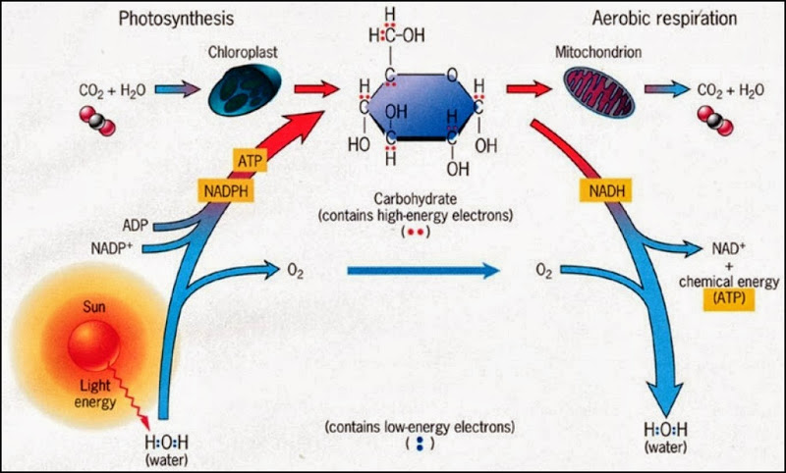

Slide 46
