Slide 1
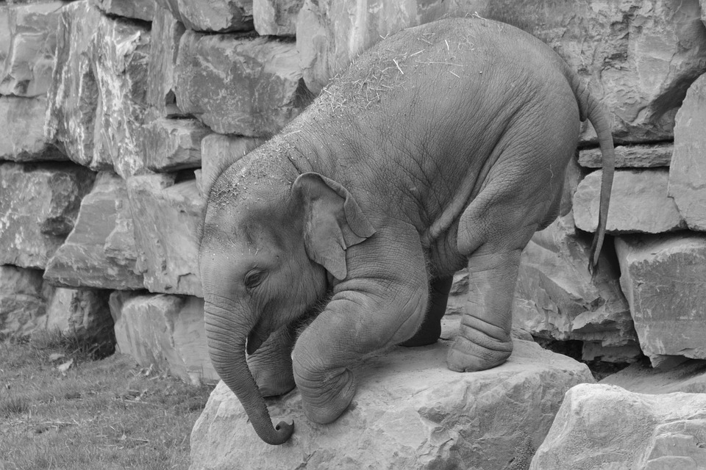
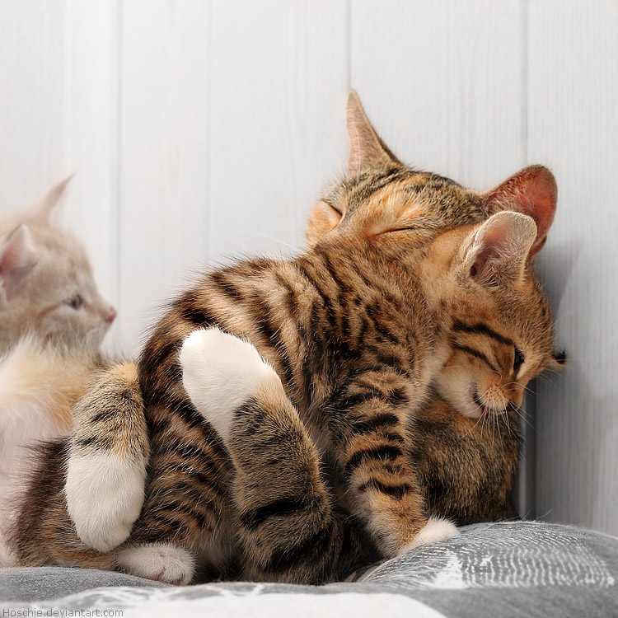
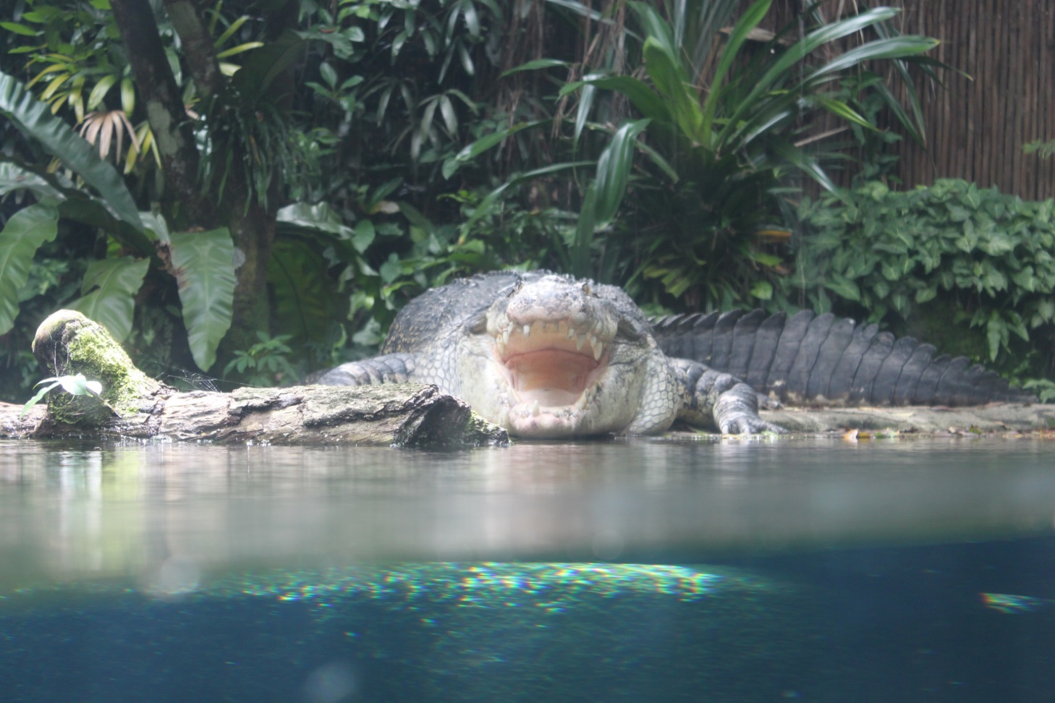
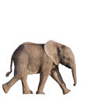
Animal Behavior
Animal behavior in response to stimuli in prompting survival instincts
Types of animal behavior:
Innate
learned (adaptive)

Slide 2
Ethology is the scientific study of animal behavior
Particularly in natural environments
Mid 20th-century ethologists
Developed a conceptual framework defined by a set of questions.
These questions
Highlight the complementary nature of proximate and ultimate perspectives
What are proximate and ultimate perspectives?

Slide 3
An animal’s behavior is the product of natural selection on phenotypes and on the genotypes that code for those phenotypes. Animal behavior is dependent on set of adaptations that helps it to survive.
Animal behavior is known to consist of two causes:
proximate causes - early investigation
ultimate causes - recent investigation
Behavioral ecologists distinguish between proximate and ultimate causes of behavior
The scientific questions that can be asked about behavior can be divided into two classes:
Those that focus on the immediate stimulus and mechanism for the behavior
Those that explore how the behavior contributes to survival and reproduction
Learning is also considered a behavioral process
Proximate, or “how,” questions about behavior
Focus on the environmental stimuli that trigger a behavior
Focus on the genetic, physiological, and anatomical mechanisms underlying a behavioral act
Ultimate, or “why,” questions about behavior
Address the evolutionary significance of a behavior
The modern scientific discipline of behavioral ecology
Extends observations of animal behavior by studying how such behavior is controlled and how it develops, evolves, and contributes to survival and reproductive success.

Slide 4
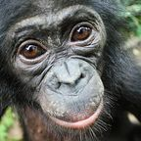
Animal Behavior involves the study of how animals interact with each other and the environment.
Behavior results from both genes inherited from parents and exposure to and the environment:
• Whether an animal can express a particular behavior is determined by genes
• Whether an animal acts on this behavior can be dependent
on environment.
An animal may not exhibit a possible behavior
in certain environments
Causes for behavior
• “proximate” - environmental stimuli that
trigger behavior, e.g., day length, visual
stimuli
• “ultimate” - why does stimulus trigger
behavior - generally believed to be due to
natural selection (adaptive behavior)

Slide 5
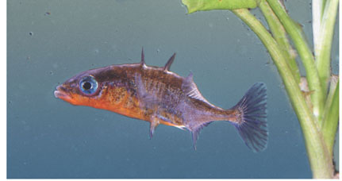
A fixed action pattern (FAP)
Is a sequence of unlearned, innate behaviors that is unchangeable.
Once initiated, is usually carried to completion.
A FAP is triggered by an external sensory stimulus known as a sign stimulus
In male stickleback fish, the stimulus for attack behavior is the red underside of an intruder.
(a) A male three-spined stickleback fish shows its red underside.

Slide 6
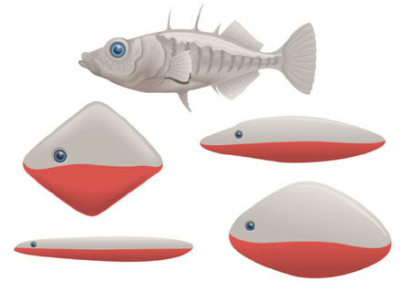
When presented with unrealistic models
As long as some red is present, the attack behavior occurs
(b) The realistic model at the top, without a red underside, produces no aggressive response in a male three-spined stickleback fish. The other models, with red undersides, produce strong responses.

Slide 7
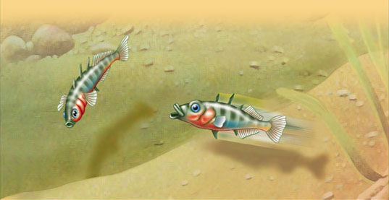
Proximate and ultimate causes for the FAP attack behavior in male stickleback fish
BEHAVIOR: A male stickleback fish attacks other male sticklebacks that invade its nesting territory.
PROXIMATE CAUSE: The red belly of the intruding male acts as a sign stimulus
that releases aggression in a male stickleback.
ULTIMATE CAUSE: By chasing away other male sticklebacks, a male decreases the chance that eggs laid in his nesting territory will be fertilized by another male.

Slide 8
Imprinting
Imprinting is a type of behavior
That includes both learning and innate components and is generally irreversible

Slide 9
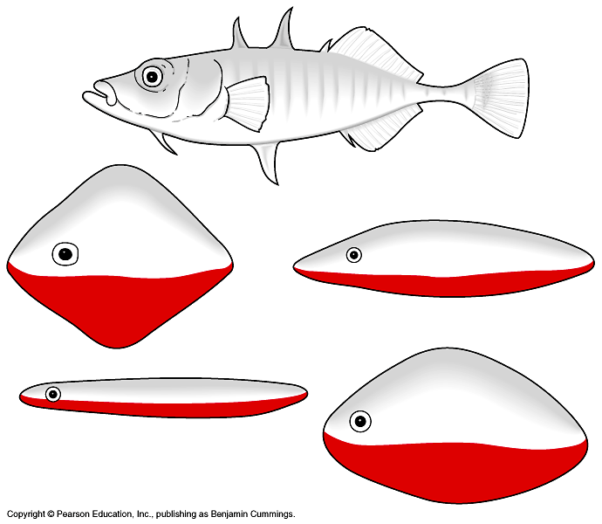
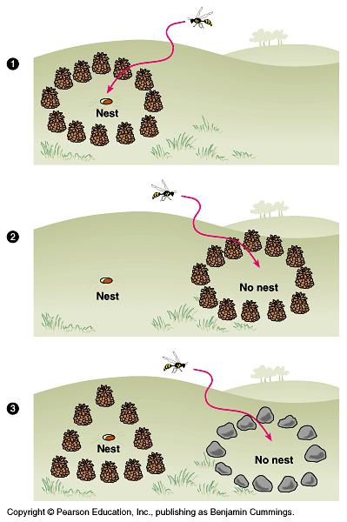
Digger wasp study
• Fixed action pattern is cueing on visual landmarks to locate nest.
• sign stimulus is pattern of
landmarks around nest.
Fixed action pattern
• Sequence of behavioral acts that is unchangeable and usually carried to completion once initiated.
• Fixed action pattern is stimulated by a sign stimulus.
• many animals only use a relatively small subset of sensory information to trigger behavior, humans are more complex.
Stickleback study
• Fixed action pattern = aggression towards other “males”
• sign stimulus = red belly

Slide 10
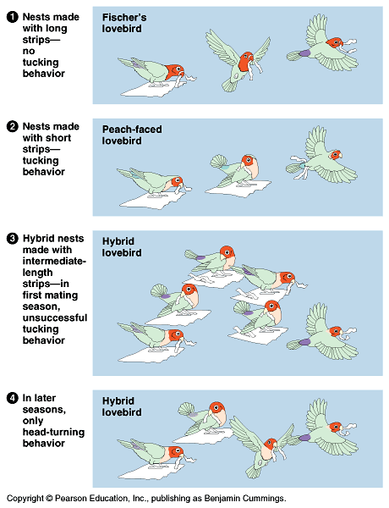
Genetic and environmental components of behavior: a case study
Lovebird study
• Genetic component - illustrated by
intermediate strips and tucking behavior in
hybrid
• Environmental component - illustrated by
loss of ineffective tucking behavior by
hybrids in later seasons.

Slide 11
Imprinting
Imprinting is a type of behavior
That includes both learning and innate components and is generally irreversible.
Imprinting is distinguished from other types of learning by a sensitive period.
A limited phase in an animal’s development that is the only time when certain behaviors can be learned.
An example of imprinting is young geese
Following their mother
Conrad Lorenz showed that
When baby geese spent the first few hours of their life with him, they imprinted on him as their parent

Slide 12
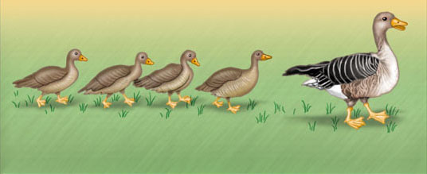
There are proximate and ultimate causes for this type of behavior
BEHAVIOR: Young geese follow and imprint on their mother.
PROXIMATE CAUSE: During an early, critical developmental stage, the young geese observe their mother moving away from them and calling.
ULTIMATE CAUSE: On average, geese that follow and imprint on their mother receive more care and learn necessary skills, and thus have a greater chance of surviving than those that do not follow their mother.

Slide 13
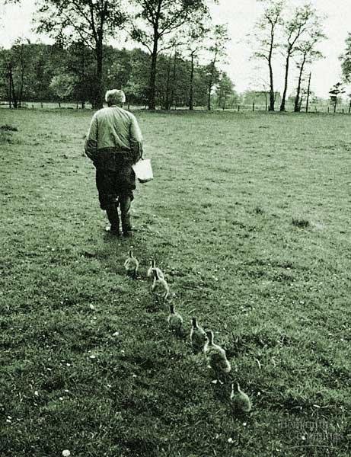
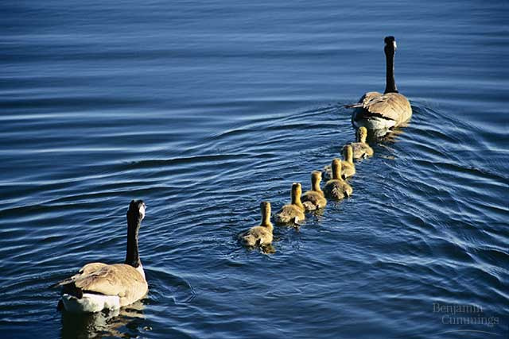
Imprinting in goose hatchlings
• Bonding occurs after hatching
• imprint of “mother”
– important for eliciting care, developing species
identity
• during sensitive period can be
experimentally imprinted on the wrong
mother.
Imprinting
• A type of learning that is limited to a
sensitive period of an animals life and is
generally irreversible
• Work of Konrad Lorenz (nobel prize 1973)
Konrad Lorenz with imprinted geese

Slide 14
Many behaviors have a strong genetic component
Biologists study the ways both genes and the environment
Influence the development of behavioral phenotypes
Behavior that is developmentally fixed
Is called innate behavior and is under strong genetic influence

Slide 15
Directed Movements
Many animal movements
Are under substantial genetic influence
These types of movements
Are called directed movements

Slide 16
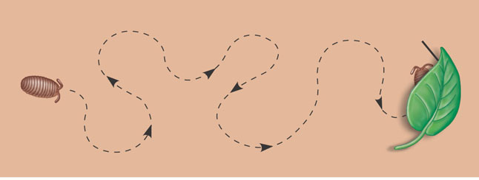
Kinesis
A kinesis
Is a simple change in activity or turning rate in response to a stimulus
Sow bugs
Become more active in dry areas and less active in humid areas
Moist site under leaf
Dry open area
(a) Kinesis increases the chance that a sow bug will encounter and stay in a moist environment.

Slide 17
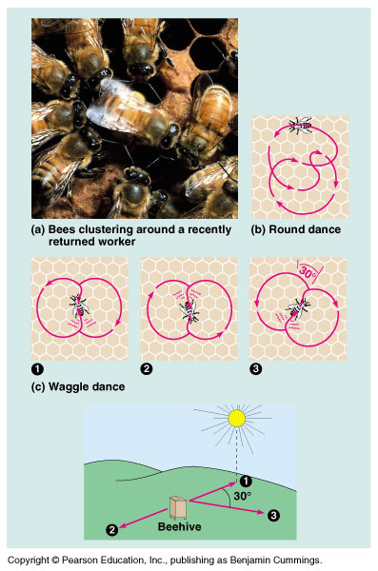
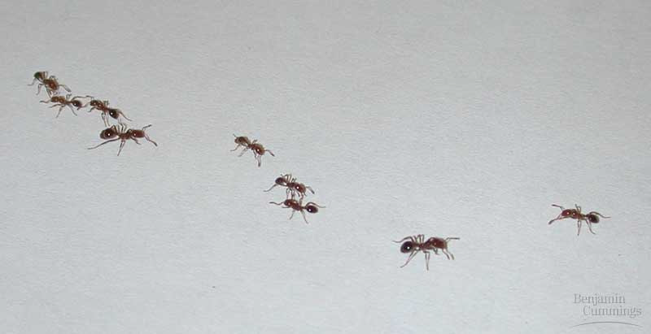
Communication in bees: one hypothesis
Communication
• Pheromones
• chemical trails
• honeybee “dancing”
Fire ants following a pheromone trail

Slide 18
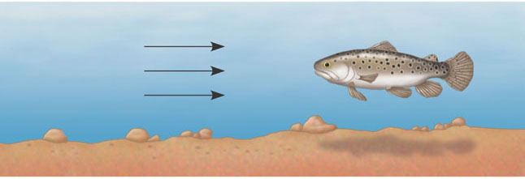
Taxis
A taxis is a more or less automatic, oriented movement toward or away from a stimulus
Many stream fish exhibit positive rheotaxis where they automatically swim in an upstream direction
Direction
of river
current
(b) Positive rheotaxis keeps trout facing into the current, the direction from which most food comes.

Slide 19
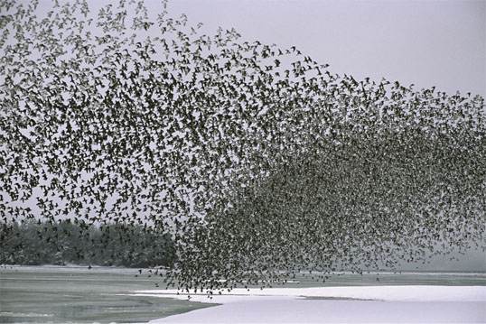
Migration
Many features of migratory behavior in birds
Have been found to be genetically programmed

Slide 20
Animal Signals and Communication
In behavioral ecology
A signal is a behavior that causes a change in another animal’s behavior
Communication
Is the reception of and response to signals

Slide 21
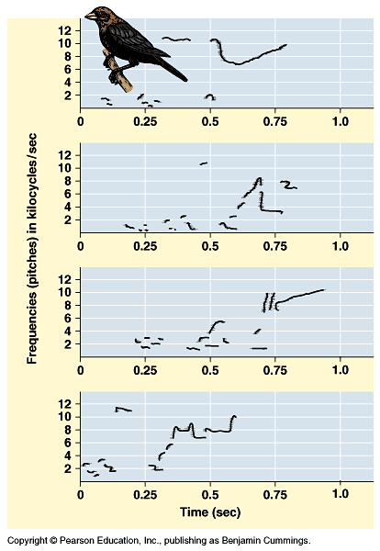
Why is there multisong behavior?
• Warning off enemies, attracting mates?
Attracting mates?
• What does song repertoire have to do with
being a good mate?
• Postulate that repertoire increases fitness by
making older more experienced males more
attractive to females.
• Testable hypotheses:
– males learn more song types as they get older
– females prefer males with large repertoires

Slide 22
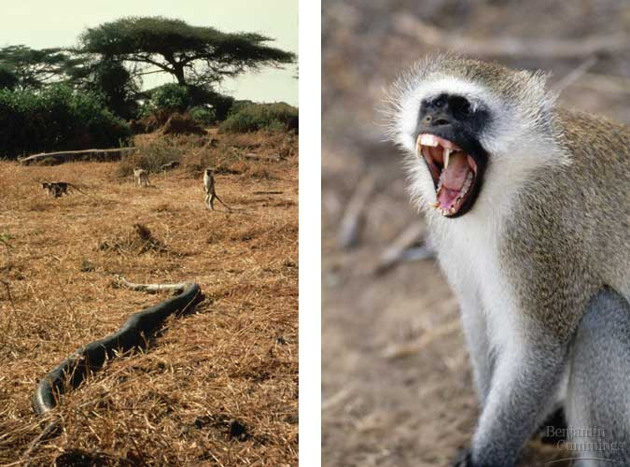
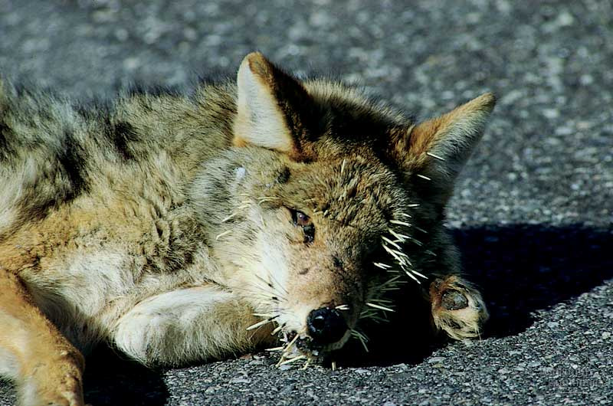
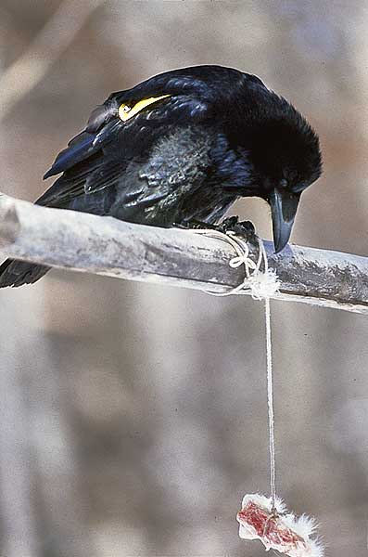
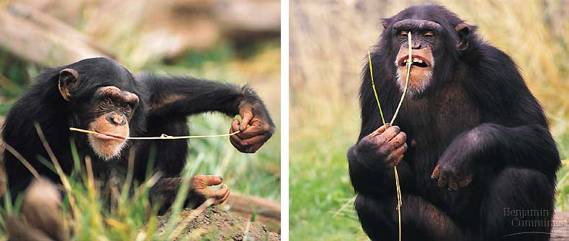
Learning
• Experience based modification of behavior
Associative learning
• Classical conditioning - Pavlov’s dogs,
arbitrary stimulus related to reward or
punishment
• Operant conditioning - trial and error
learning, learn to associate own behavior to
reward or punishment
Vervet monkeys learn correct use of alarm calls
Operant conditioning
Raven problem solving
Vervet monkey alarm calls
• Different alarm calls for leopards, eagles,
snakes
• Infant monkeys give indiscrimate alarm
calls but eventually learn to give the right
call at the appropriate time
Chimps making tools

Slide 23
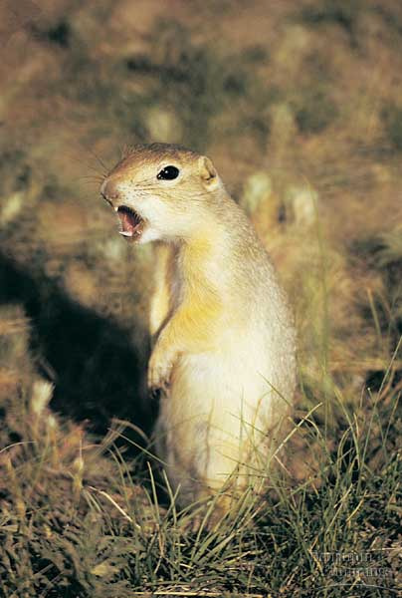
Altruistic behavior
• Behavior that does not immediately benefit
the individual
Giving alarm call
increases chance
of getting killed

