Slide 1
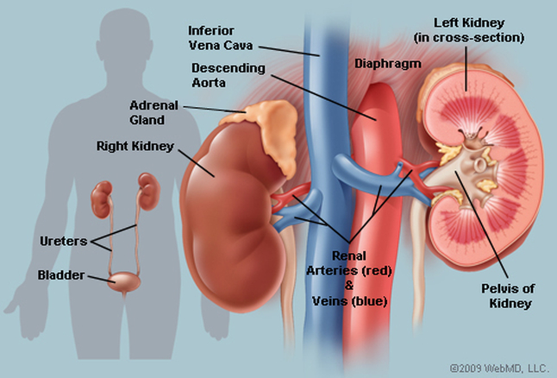
Topics:
Kidney Location
The internal structure of the kidney
Important Functions
Failure in Kidney Function

Slide 2
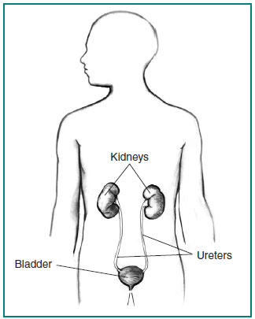
Location and Anatomy
The two kidneys are located to the rear of the abdominal cavity on either side of the spine.
They normally weigh about 5 ounces each, but receive about 20% of the blood flow coming from the heart.
The urine produced by each kidney drains through a separate ureter into the urinary bladder, located in the pelvic region.
The bladder is emptied in turn by a single urethra, which exits the body.

Slide 3
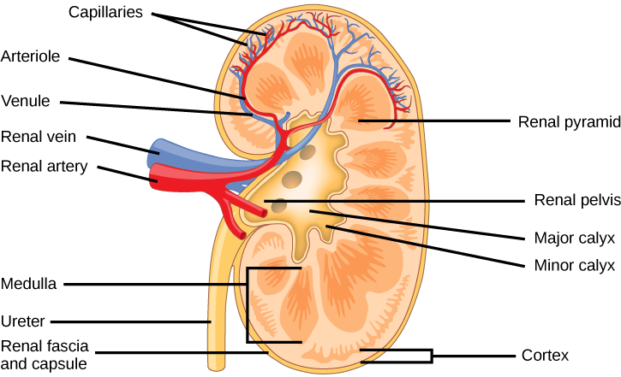
Each is about 4 to 5 inches (12 centimeters) long and weighs about one third of a pound (150 grams).
One lies on each side of the spinal column, just behind the abdominal cavity, which contains the digestive organs.
Each kidney receives blood through a branch of the aorta, called the renal artery.
Blood flows from the renal artery into progressively smaller arteries, the smallest being the arterioles.
From the arterioles, blood flows into glomeruli, which are tufts of microscopic blood vessels called capillaries.
The kidneys are bean-shaped organs
Blood exits each glomerulus through an arteriole that connects to a small vein. The small veins join to form a single large renal vein, which carries blood away from each kidney.

Slide 4
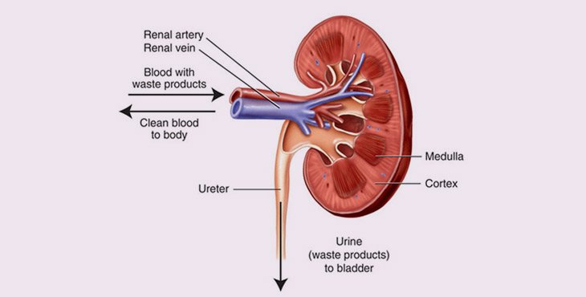
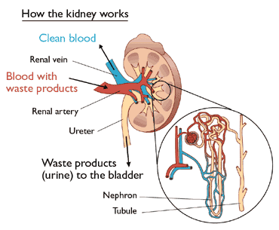
The kidneys are bean-shaped organs
The kidneys perform the essential function of removing waste products from the blood and regulating the water fluid levels.
The kidneys receive blood through the renal artery. The blood is passed through the structure of the kidneys called nephrons, where waste products and excess water pass out of the blood stream.

Slide 5
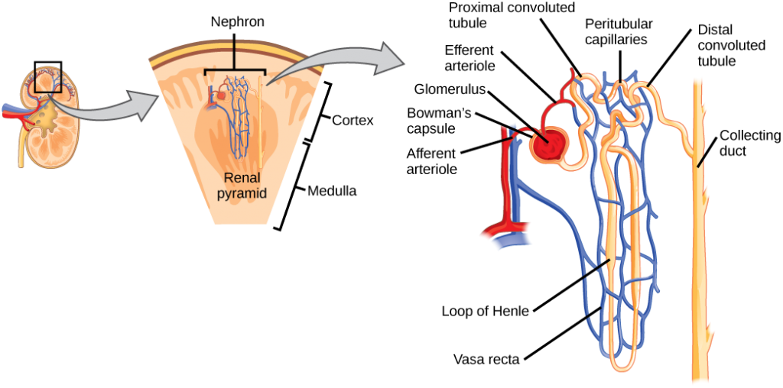
The nephron is the functional unit of the kidney.
The glomerulus and convoluted tubules are located in the kidney cortex,
while collecting ducts are located in the pyramids of the medulla.

Slide 6
Nephrons are microscopic units that filter the blood and produce urine.
Each kidney contains about one million nephrons.
Each nephron contains a glomerulus surrounded by a thin-walled, bowl-shaped structure (Bowman capsule). Also in the nephron is a tiny tube (tubule) that drains fluid (that soon becomes urine) from the space in Bowman capsule (Bowman space).

Slide 7
Each tubule has three interconnected parts: the proximal convoluted tubule, the loop of Henle, and the distal convoluted tubule.
A third part of the nephron is a collecting duct that drains the fluid from the tubule.
After the fluid leaves the collecting duct it is considered urine.
The kidneys consist of an outer part (cortex) and an inner part (medulla).
All glomeruli are located in the cortex, while tubules are located in both the cortex and the medulla. The urine drains from the collecting ducts of many thousands of nephrons into a cuplike structure (calix). Each kidney has several calices, all of which drain into a single central chamber (renal pelvis). Urine drains from the renal pelvis of each kidney into a ureter.

Slide 8
Functions of the Kidneys
All of the functions normally done by two kidneys can be carried out adequately by one healthy kidney.
Some people are born with only one kidney and others choose to donate one kidney for transplantation into another person with kidney failure.
In other cases, one kidney may be severely damaged by disease or injury.
The primary function of the kidneys is to:
Maintain the proper balance of water and minerals (including electrolytes) in the body
Additional kidney functions include
Filtration and excretion of waste products from the processing of food, drugs, and harmful substances (toxins)
Regulation of blood pressure
Secretion of certain hormones

Slide 9
Osmoregulation
Osmoregulation is the process by which the body regulated the osmotic pressure of any organisms fluids in order to keep the homeostasis of the organisms’ water level constant. Therefore osmoregulation is used to keep the bodily fluid from being too diluted or too concentrated.
An osmotic pressure is used to measure the ability of water to move from one solution to another solution through osmosis. Osmotic pressure refers to tendency for a liquid solution to diffuse therefore moving from a lower to higher concentration across a membrane.
As it is critical for humans to maintain a regulated osmotic pressure they are able to gain an isotonic solution which would mean that there is no total loss or gain of fluids or salts into the cells of the body. Rather there is a steady and constant flow of substances in and out of the cell membrane.

Slide 10
Osmoregulation
In humans the kidney plays a huge part in the osmoregulation of the body’s internal environment.
Regulation of water in the human body is carried out through the excretion of waste urine from the body.
Hormones which include: the antidiuretic hormone, aldosterone and angiotensin II are used in the body to help to increase the permeability of the collecting ducts found in the kidney. This further allows diffusing to occur easily, it also allows the kidney to be able to reabsorb water and prevent it from being excreted.
Humans are also able to regulate by controlling the total amount of water that is passed out of the body through urine waste or sweat, this is carried out with the help of the excretory system.

Slide 11
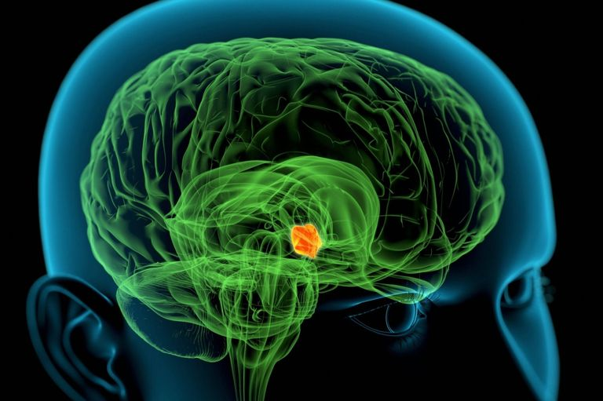
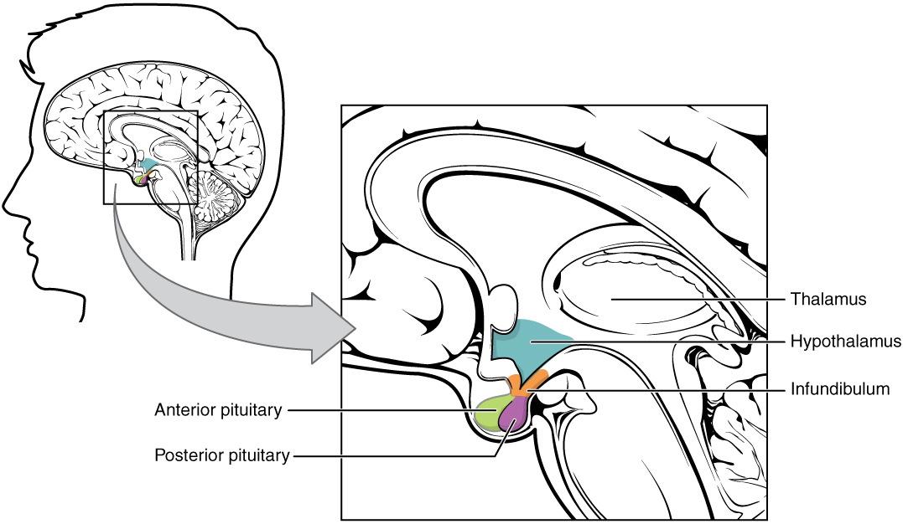
To prevent the loss or the gain of water from cell in the body, the water potential of the blood is regulated to suit the individual; this is controlled by the hypothalamus.
The hypothalamus is able to notice changes in the water potential off the blood that passes through the brain. This is process is carried out by the osmoreceptors cells in the hypothalamus.
As a response to the change in water potential the hypothalamus controls the urge for thirds and further secrets a hormone called the antidiuretic hormone.
The antidiuretic hormone which is stored in the pituitary gland mainly targets cells that are endothelial cells of the collecting ducts in the kidney nephrons.
These cells are unlike normal cells because they only allow water molecules to pass through their cell membrane through the water aquaporins rather than through the lipid bilayer like normal cells would.
The highlighted area shows the hypothalamus. The hypothalamus is a complex area of the brain with a number of important functions. One of the most important is to link the nervous system to the endocrine system via the pituitary gland
The antidiuretic hormone makes the water
channels to open and allow water molecules flow.

Slide 12
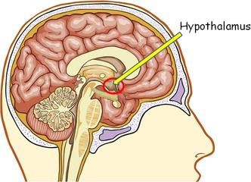
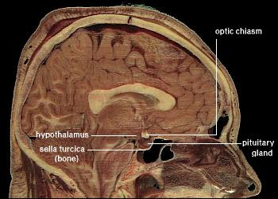
The hypothalamus directs a multitude of important functions in the body.
It is the control center for many autonomic functions of the peripheral nervous system.
Connections with structures of the endocrine and nervous systems enable the hypothalamus to play a vital role in maintaining homeostasis.
Homeostasis is the process of maintaining bodily equilibrium by monitoring and adjusting physiological processes.
The hypothalamus is a region of the brain that controls an immense number of bodily functions. It is located in the middle of the base of the brain

Slide 13
Hypothalamus Function
The hypothalamus is involved in several functions of the body including:
Autonomic Function Control
Endocrine Function Control
Homeostasis
Motor Function Control
Food and Water Intake Regulation
Sleep-Wake Cycle Regulation

Slide 14
There are two common ways in which the human body constantly shows osmoregulation in the body, this is through dehydration and waterlogging.
In the process of dehydration the hypothalamus is sent a signal that the water level in the body are critically low, the hypothalamus then sends a signal to pituitary glands where the antidiuretic hormone is secreted for further use.
This hormone is the sent to the kidney and causes it to reabsorb water from the body, where the net amount of antidiuretic hormone determines the amount of water absorbed by the kidneys.
As the fluid in the body become concentrated it would be noticed in the color of the urine passed by the individual, the kidneys however do not stop absorbing water until the pituitary glands send a signal to reduce the production of the hormone.
When the reduction is sensed in the body, another form of homeostasis called the negative feedback system occurs to take the body back to the desired set point.

Slide 15
Waterlogging on the other hand is the exact opposite of dehydration, in this case, the hypothalamus is signaled the level of water in the bodily fluids is too high, a signal is then sent to the pituitary gland, which stops the production and secretion of antidiuretic hormones making the kidney cease the reabsorption of water from the blood.
The cells in the body become waterlogged causing them to burst increasing the concentration of the blood.
The hypothalamus signals the pituitary gland to end to secretion of the hormone, this is also carried out by the negative feedback mechanism.
As humans consume water into the body, it is used to regulate the concentration of bodily fluid, this therefore dilutes the bodily fluids, or the body excretes the unneeded and less useful fluids from the body.
Fluids like alcohol create hypertonic solutions in the body, making the cells full of water, osmoregulation then works to reduce the diuretic fluid in the cells, in order to maintain a constant osmotic pressure.

Slide 16
Water and electrolyte balance
People consume water regularly in order to maintain life.
More water is produced by the processing (metabolism) of food.
If the amount of water added to the body is not matched by an equal amount going out, water accumulates rapidly and the person becomes ill and may even die.
Excess water dilutes the body's electrolytes, whereas water restriction concentrates them.
The body's electrolytes must be maintained at very precise concentrations.
The kidneys regulate and help maintain the proper balance of water and electrolytes.

Slide 17
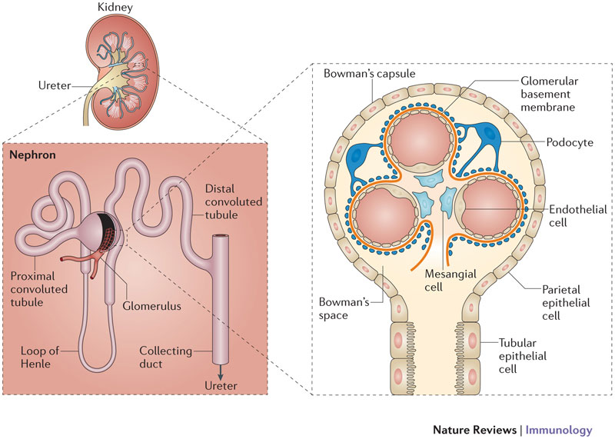
Water and electrolyte balance
Blood enters a glomerulus at high pressure.
Much of the fluid part of blood is filtered through small pores in the glomerulus, leaving behind blood cells and most large molecules, such as proteins.
The clear, filtered fluid enters Bowman space and passes into the tubule leading from Bowman capsule. In healthy adults, about 47 gallons (180 liters) of fluid is filtered into the kidney tubules each day.
Nearly all this fluid (and the electrolytes contained in it) is reabsorbed by the kidney.
Only about 1.5 to 2% of the fluid is excreted as urine. For this reabsorption to occur, different parts of the nephron actively secrete and reabsorb different electrolytes, which pull the water along, and other parts of the nephron vary their permeability to water, allowing more or less water to return to the circulation.

Slide 19
Water and electrolyte balance
In the first part of the tubule (the proximal convoluted tubule) most of the sodium, water, glucose, and other filtered substances are reabsorbed and ultimately returned to the blood.
In the next part of the tubule (the loop of Henle), sodium, potassium, and chloride are pumped out (reabsorbed). Thus, the remaining fluid becomes increasingly dilute.
The dilute fluid passes through the next part of the tubule (the distal convoluted tubule), where most of the remaining sodium is pumped out in exchange for potassium and acid, which are pumped in.
Fluid from the tubules of several nephrons enters a collecting duct. In the collecting ducts, the fluid may remain dilute, or water can be absorbed from the fluid and returned to the blood, making the urine more concentrated. Water reabsorption is regulated by antidiuretic hormone (produced by the pituitary gland) and other hormones.
These hormones help to regulate kidney function and control urine composition to maintain body water and electrolyte balance.

Slide 20
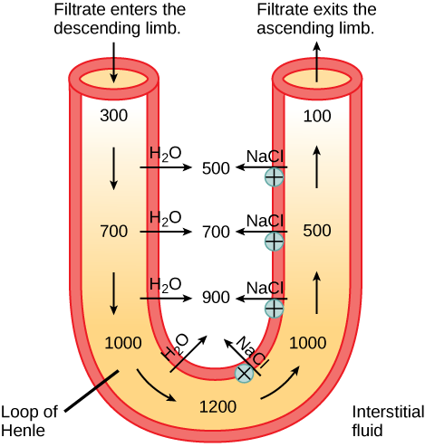
The loop of Henle acts as a countercurrent multiplier that uses energy to create concentration gradients.
The descending limb is water permeable. Water flows from the filtrate to the interstitial fluid, so osmolality inside the limb increases as it descends into the renal medulla.
At the bottom, the osmolality is higher inside the loop than in the interstitial fluid.
Thus, as filtrate enters the ascending limb, Na+ and Cl- ions exit through ion channels present in the cell membrane.
Further up, Na+ is actively transported out of the filtrate and Cl- follows.
Osmolarity is given in units of milliosmoles per liter (mOsm/L).

Slide 21
Key Points
Glomerular filtration, tubular reabsorption, and tubular secretion are the three primary steps in which kidneys filter blood and maintain proper electrolyte balance.
Glomerular filtration removes solutes from the blood; it is the first step of urine formation.
In tubular reabsorption, the second step of urine formation, almost all nutrients are reabsorbed in the renal tubule by active or passive transport.
Tubular secretion is the last step of urine formation, where solutes and waste are secreted into the collecting ducts, ultimately flowing to the bladder in the form of urine.
Urine is a byproduct of the osmoregulatory function of kidneys, which filter blood, reabsorb water and nutrients, and secrete wastes.

Slide 22
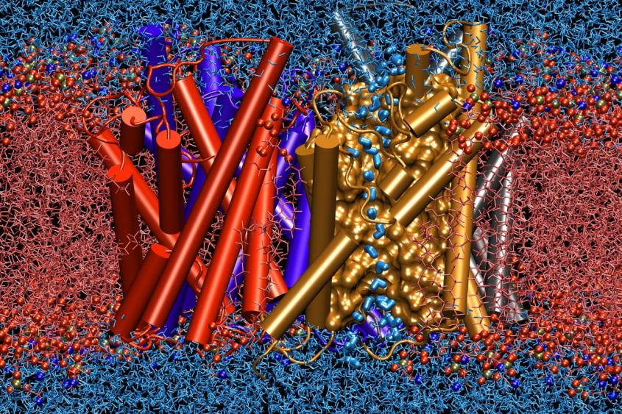
Aquaporin Water Channels in Kidney
Seven aquaporin water channels are expressed in human kidneys, and they have key roles in maintaining body water homeostasis.
Impairment of their function can result in nephrogenic diabetes insipidus and other water-balance disorders.
A lot of data have increased understanding of the functions and mechanisms of regulation of aquaporins both at the molecular and the clinical level.
Research has also focused on aquaporins as therapeutic targets.
Nature Reviews Nephrology 6, 168-178 (March 2010)
Aquaporins are a group of Transmembrane proteins, which function as molecular water channels.
They were discovered by Agre and co-workers.
The research on Aquaporins is providing molecular insight into the understanding of fundamental aspects of water balance in health and disease states.
https://www.researchgate.net/publication

Slide 23
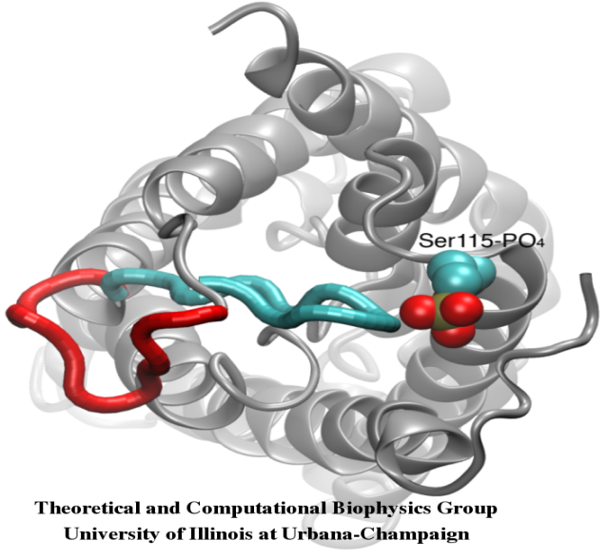
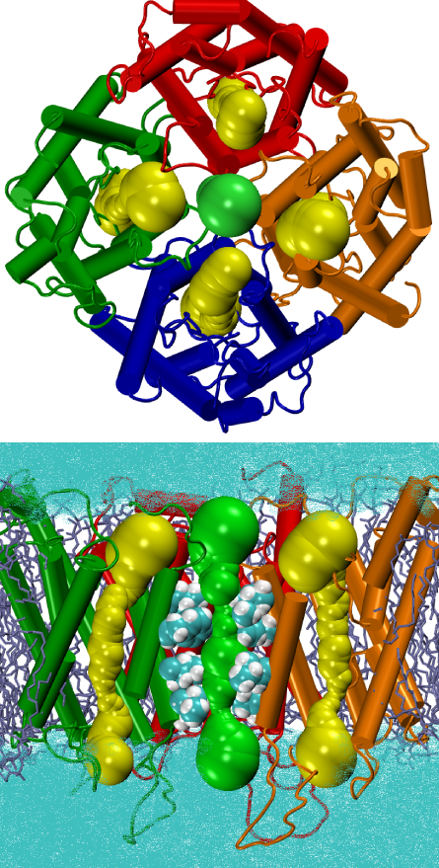
Gating of Water Channels
Water permeation through aquaporins is a passive process that follows the direction of osmotic pressure across the membrane. Although many aquaporins function as always-open channels, a subgroup of aquaporins, particularly in plants have evolved a sophisticated molecular mechanism through which the channel can be closed in response to harsh conditions of the environment, under which exchange of water can be harmful for the organism. Examples of such conditions are drought stress and flooding, which trigger certain cellular signals (dephosphorylation and change of pH) that result in closure of the channel.
A recently solved structure of an aquaporin from spinach was simulated under different conditions to investigate the molecular mechansim of gating in these membrane channels. It was found that an elongated cytoplasmic loop in gating-competent aquaporins physically occludes the entrance of the water pore in the closed channel and blocks the access of water molecules to the pore. Displacement of this loop in response to phosphorylation, as observed in simulations, removes the loop from the cytoplasmic entrance of the pore. Furthermore, a hydrophobic amino acid which is conformationally closely coupled to this loop will be pulled back from the channel as a result of the movement of the loop. Together, these molecular events result in an open channel that is permeable by water molecules.
Nature 2006.
Tetramerization is a common structural feature of AQPs. The fact that the four monomers each form a functionally independent water pore

Slide 24
Regulation of blood pressure
Another function of the kidneys is to help regulate the body's blood pressure by excreting excess sodium. If too little sodium is excreted, blood pressure is likely to increase.
The kidneys also help regulate blood pressure by producing an enzyme called renin. When blood pressure falls below normal levels, the kidneys secrete renin into the bloodstream, thereby activating the renin-angiotensin-aldosterone system, which in turn raises blood pressure.
The kidneys also produce urotensin, which causes blood vessels to constrict and helps raise blood pressure.
A person with kidney failure is less able to regulate blood pressure and tends to have high blood pressure.

Slide 25
Secretion of hormones
Through the secretion of hormones, the kidneys help regulate other important functions, such as the production of red blood cells and the growth and maintenance of bones.
The kidneys produce a hormone called erythropoietin, which stimulates the production of red blood cells in the bone marrow.
The bone marrow then releases red blood cells into the bloodstream.
Growth and maintenance of healthy bones is a complex process that depends on several organ systems, including the kidneys. The kidneys help regulate levels of calcium and phosphorus, minerals that are critical to bone health. They do so by converting an inactive form of vitamin D, which is produced in the skin and is also present in many foods, to an active form of vitamin D (calcitriol) that acts like a hormone to stimulate absorption of calcium and phosphorus from the small intestine.

Slide 26
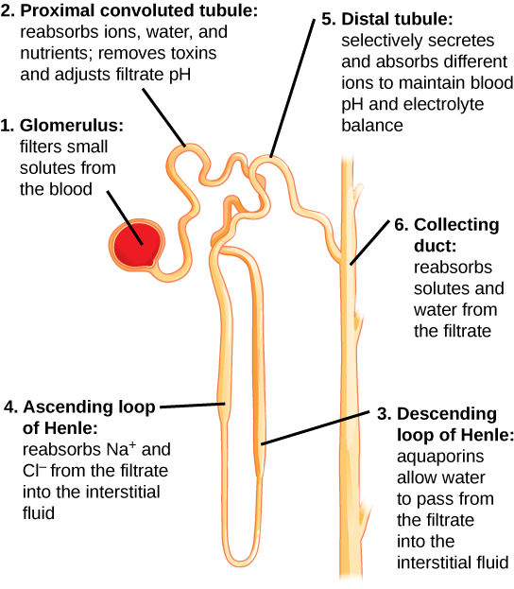
Kidneys filter blood process.
First, the nephrons filter blood that runs through the capillary network in the glomerulus. Almost all solutes, except for proteins, are filtered out into the glomerulus by a process called glomerular filtration.
Second, the filtrate is collected in the renal tubules. Most of the solutes get reabsorbed in the PCT by a process called tubular reabsorption. In the loop of Henle, the filtrate continues to exchange solutes and water with the renal medulla and the peritubular capillary network. Water is also reabsorbed during this step.
Then, additional solutes and wastes are secreted into the kidney tubules during tubular secretion, which is, in essence, the opposite process to tubular reabsorption. The collecting ducts collect filtrate coming from the nephrons and fuse in the medullary papillae. From here, the papillae deliver the filtrate, now called urine, into the minor calyces that eventually connect to the ureters through the renal pelvis.

Slide 27
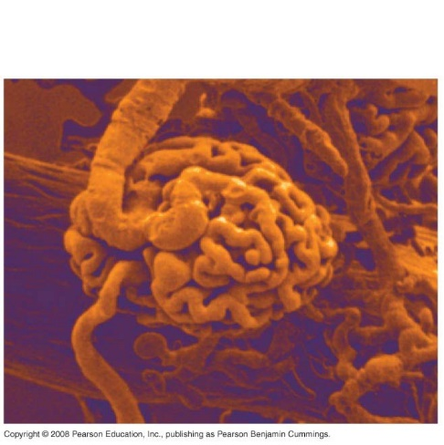
Each part of the nephron performs a different function in filtering waste and maintaining homeostatic balance.
The glomerulus forces small solutes out of the blood by pressure.
The proximal convoluted tubule reabsorbs ions, water, and nutrients from the filtrate into the interstitial fluid, and actively transports toxins and drugs from the interstitial fluid into the filtrate. The proximal convoluted tubule also adjusts blood pH by selectively secreting ammonia (NH3) into the filtrate, where it reacts with H+ to form NH4+. The more acidic the filtrate, the more ammonia is secreted.

Slide 28
Each part of the nephron performs a different function in filtering waste and maintaining homeostatic balance.
(3) The descending loop of Henle is lined with cells containing aquaporins that allow water to pass from the filtrate into the interstitial fluid.
(4) In the thin part of the ascending loop of Henle, Na+ and Cl- ions diffuse into the interstitial fluid. In the thick part, these same ions are actively transported into the interstitial fluid. Because salt but not water is lost, the filtrate becomes more dilute as it travels up the limb.
(5) In the distal convoluted tubule, K+ and H+ ions are selectively secreted into the filtrate, while Na+, Cl-, and HCO3- ions are reabsorbed to maintain pH and electrolyte balance in the blood.
(6) The collecting duct reabsorbs solutes and water from the filtrate, forming dilute urine.

Slide 29
Filtration and excretion
As the body metabolizes food, certain waste products are created, and these products need to be removed from the body.
One of the main waste products is urea, which comes from protein metabolism.
Urea passes freely through the glomerulus into the tubular fluid and, because it is not reabsorbed, is passed into the urine.
Other undesirable substances, including metabolic waste products such as acids, and many toxins and drugs, are actively secreted into the urine by cells in the renal tubule (and give urine its characteristic odor).

Slide 30
Details on The Kidney Function:
Apart from being an excretory organ, the kidney function also involves several other tasks.
These include the maintenance of acid-base homeostasis, synthesis of glucose, regulation of different substances, and so on.
Role in Excretion:
Kidney excretes harmful metabolic waste products, especially, nitrogenous compounds, such as urea, uric acid and creatinine. It helps the body in the removal of metabolites of various hormones and end products of hemoglobin breakdown. The kidneys also eliminate drugs, pesticides, food additives and other foreign toxic substances from the body.
Acid-base Homeostasis:
Kidney maintains the acid-base balance in the body. for this purpose, it controls the synthesis and excretion of bicarbonate and hydrogen ions. The organ can generate enough bicarbonate ions to neutralize net acid production from metabolism. All the renal tubules are capable of secreting a large amount of hydrogen ions into the urine eliminating excess hydrogen ions from the blood.

Slide 31
Details on The Kidney Function:
Glucose Synthesis:
Kidney reabsorbs essential nutrients such as amino acids from the filtered blood. During prolonged fasting kidneys can synthesize glucose from amino acids and then release glucose into the blood.
Calcium Homeostasis:
Here is another kidney function, i.e. it maintains calcium homeostasis by reabsorbing more than 90% of the filtered calcium. Reabsorption occurs in the proximal convoluted tubule and in the thick ascending limb of loop of Henle. Parathyroid hormone and vitamin D are the major hormones that influence calcium balance in the body. Parathyroid hormone acts on the distal convoluted tubule to increase calcium reabsorption into the blood.

Slide 32
Details on The Kidney Function:
Sodium and Water Metabolism:
As one of the important kidney functions, it regulates water balance within the body. For this purpose, either the kidneys concentrate or dilute the urine. Sodium reabsorption occurs along the entire length of the nephron to a varying degree.
Very little sodium becomes part of the urine. More than 67% reabsorption of the filtered sodium occurs in the proximal convoluted tubule. The pituitary gland releases antidiuretic hormone (ADH) when the sodium ion concentration becomes too high.
This causes kidney to retain more water. Greater quantity of water dilutes the excess sodium back to normal. There is also an increase in the blood volume. This, in turn, increases the arterial pressure in the kidney thus causing it to excrete more water and along with it excess sodium in the urine.

Slide 33
Details on The Kidney Function:
Regulation of Potassium, Phosphate and Magnesium Concentration:
High potassium ion concentration in the extracellular fluid (ECF) stimulates adrenal glands. They release aldosterone hormone. This hormone causes tubular cells in the kidneys to transport more potassium from the blood plasma and into the urine.
Majority of the filtered phosphate ions are reabsorbed in the proximal convoluted tubule by sodium-phosphate co-transporter.
The reabsorption of magnesium takes place in the proximal tubule, loop of Henle and in the distal tubule of the nephron.
Regulation of Blood Pressure and Volume:
When the volume of the blood becomes too high, blood pressure in the arteries increases. Such a condition increases the glomerular filtration. After that the kidney gets rid of excess water in the urine which returns the blood volume back to normal.

Slide 34
Conditions That Affect Your Kidneys
The kidneys' function are to filter the blood. All the blood in our bodies passes through the kidneys several times a day.
The kidneys remove wastes, control the body's fluid balance, and regulate the balance of electrolytes.
As the kidneys filter blood, they create urine, which collects in the kidneys' pelvis -- funnel-shaped structures that drain down tubes called ureters to the bladder.
Each kidney contains around a million units called nephrons, each of which is a microscopic filter for blood.
It's possible to lose as much as 90% of kidney function without experiencing any symptoms or problems.

Slide 35
Kidney Function in Endocrine System
Release of Renin:
It is a hormone that the juxtaglomerular apparatus of the kidney produces. The production starts in response to low blood pressure in the renal arteriole. Renin then initiates a cascade of events that result in the production of angiotensin ll and aldosterone.
Angiotensin ll raises blood pressure by causing vasoconstriction and by raising total peripheral resistance. It also stimulates adrenal cortex to release aldosterone, resulting in higher sodium and water retention by the kidneys. This renin-angiotensin-aldosterone system accomplishes the long term regulation of blood pressure.
Production of Erythropoietin (EPO):
EPO is a glycoprotein hormone produced by the fibroblasts in the renal interstitium. Kidney is the main site of production of EPO. This hormone acts on the bone marrow to stimulate RBC (red blood cells) formation and maturation.
Activation of Vitamin D:
Hydroxylation of Vitamin D takes place with the help of an enzyme in the proximal convoluted tubule. Vitamin D in turn increases calcium and phosphorus absorptions from the gut. It also promotes bone mineralization.

Slide 36
Kidney Conditions
Pyelonephritis (infection of kidney pelvis): Bacteria may infect the kidney, usually causing back pain and fever. A spread of bacteria from an untreated bladder infection is the most common cause of pyelonephritis.
Glomerulonephritis: An overactive immune system may attack the kidney, causing inflammation and some damage. Blood and protein in the urine are common problems that occur with glomerulonephritis. It can also result in kidney failure.
Kidney stones (nephrolithiasis): Minerals in urine form crystals (stones), which may grow large enough to block urine flow. It's considered one of the most painful conditions. Most kidney stones pass on their own but some are too large and need to be treated.

Slide 37
Kidney Conditions
Nephrotic syndrome: Damage to the kidneys causes them to spill large amounts of protein into the urine. Leg swelling (edema) may be a symptom.
Polycystic kidney disease: A genetic condition resulting in large cysts in both kidneys that impair their function.
Acute renal failure (kidney failure): A sudden worsening in kidney function. Dehydration, a blockage in the urinary tract, or kidney damage can cause acute renal failure, which may be reversible.
Chronic renal failure: A permanent partial loss of kidney function. Diabetes and high blood pressure are the most common causes.
End stage renal disease (ESRD): Complete loss of kidney function, usually due to progressive chronic kidney disease. People with ESRD require regular dialysis for survival.

Slide 38
Kidney Conditions
Papillary necrosis: Severe damage to the kidneys can cause chunks of kidney tissue to break off internally and clog the kidneys. If untreated, the resulting damage can lead to total kidney failure.
Diabetic nephropathy: High blood sugar from diabetes progressively damages the kidneys, eventually causing chronic kidney disease. Protein in the urine (nephrotic syndrome) may also result.
Hypertensive nephropathy: Kidney damage caused by high blood pressure. Chronic renal failure may eventually result.
Kidney cancer: Renal cell carcinoma is the most common cancer affecting the kidney. Smoking is the most common cause of kidney cancer.

Slide 39
Kidney Conditions
Interstitial nephritis: Inflammation of the connective tissue inside the kidney, often causing acute renal failure. Allergic reactions and drug side effects are the usual causes.
Minimal change disease: A form of nephrotic syndrome in which kidney cells look almost normal under the microscope. The disease can cause significant leg swelling (edema). Steroids are used to treat minimal change disease.
Nephrogenic diabetes insipidus: The kidneys lose the ability to concentrate the urine, usually due to a drug reaction. Although it's rarely dangerous, diabetes insipidus causes constant thirst and frequent urination.
Renal cyst: A benign hollowed-out space in the kidney. Isolated kidney cysts occur in many normal people and almost never impair kidney function.

