Slide 1
Overview of the Immune System
Function
Structural components
Lymphatic Organs
Immune cells and cell components
Immune Response

Slide 2
The overall function of the immune system is to prevent or limit infection.
↓ not optimal function in groups below
These groups of people are susceptible to a range of microbes that typically do not cause infection in healthy individuals:
Immune-compromised people
Genetic immune disorders
Immune-debilitating infections like HIV
Pregnant women
Young children
Elderly people

Slide 3
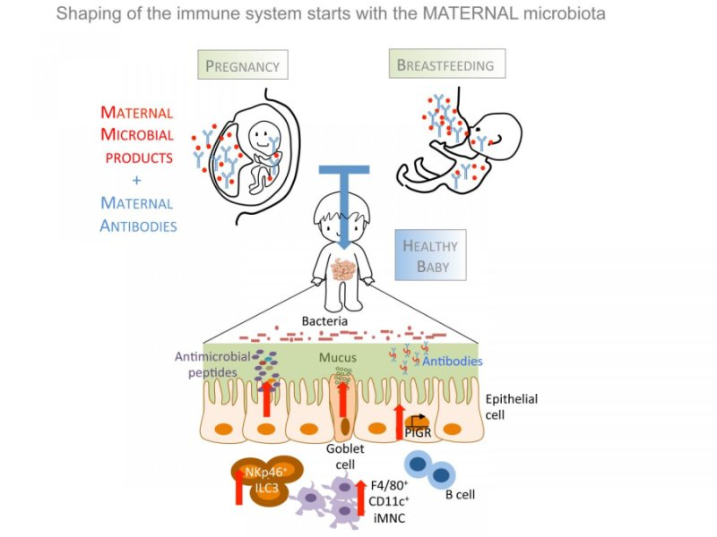

Slide 4
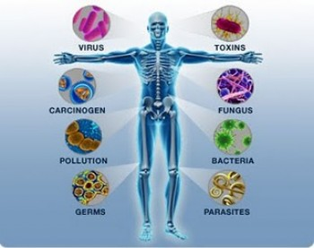
The Immune System
A network of cells, tissues, and organs that work together to defend the body against attacks by “foreign” invaders, primarily microbes (tiny, infection-causing organisms such as bacteria, viruses, parasites, and fungi).

Slide 5
The Immune System- plays more roles
The immune system covering elements involved in:
- antimicrobial defense
- autoimmune reactions
- hypersensitivity/graft rejection reactions
- antineoplastic reactions

Slide 6
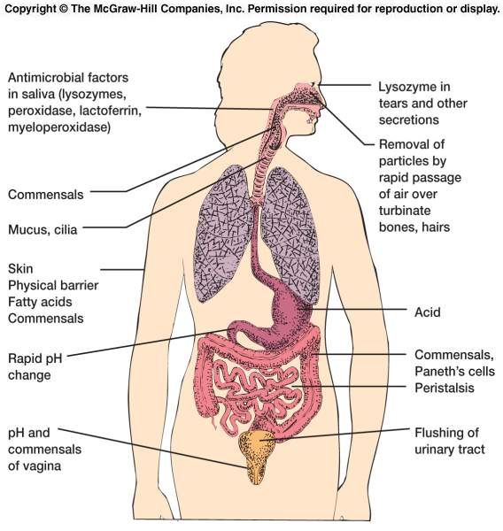

Slide 7
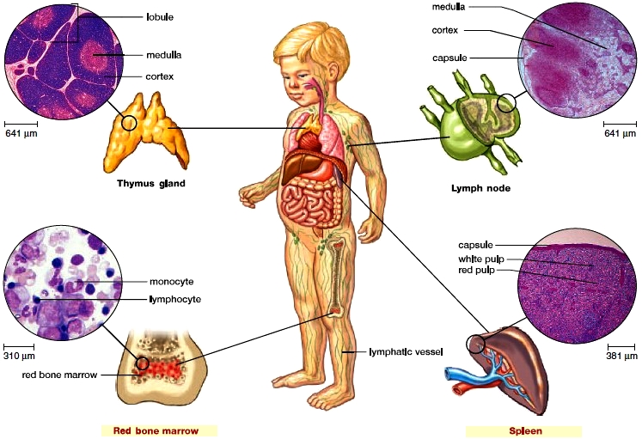
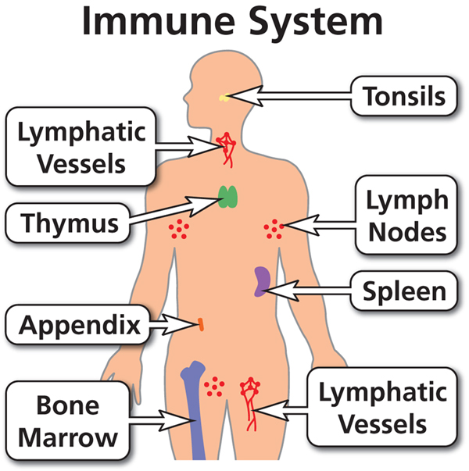
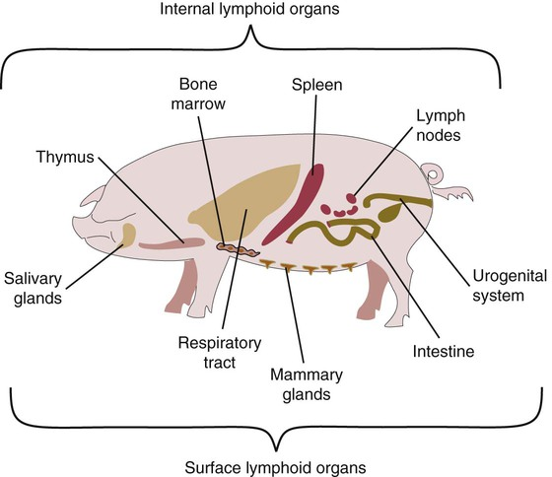
Lymphatic Organs
Primary Lymphatic Organs are:
- Red bone marrow
- Thymus gland

Slide 8
An immune response is generally divided into innate and adaptive immunity:
Innate immunity occurs immediately, when circulating innate cells recognize a problem.
Adaptive immunity occurs later, as it relies on the coordination and expansion of specific adaptive immune cells.
Immune memory follows the adaptive response, when mature adaptive cells, highly specific to the original pathogen, are retained for later use.

Slide 10
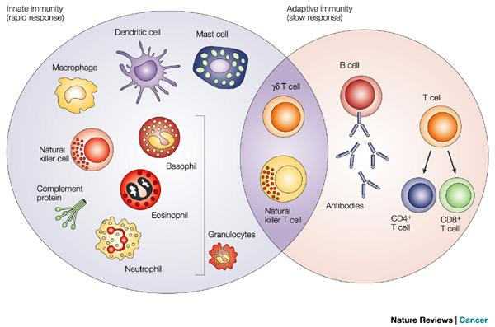

Slide 11
Anything that can trigger the immune response is called an antigen.
An antigen can be a microbe such as a virus, or even a part of a microbe.
Tissues or cells from another person (except an identical twin) also carry nonself markers and act as antigens.
↓
This explains why tissue transplants may be rejected.

Slide 12
Self and Nonself
The key to a healthy immune system is its remarkable ability to distinguish between the body’s own cells as self and foreign cells as non-self.
The body’s immune defenses normally coexist peacefully with cells that carry distinctive “self” marker molecules.
But when immune defenders encounter cells or organisms carrying markers that say “foreign,” they quickly launch an attack.

Slide 13
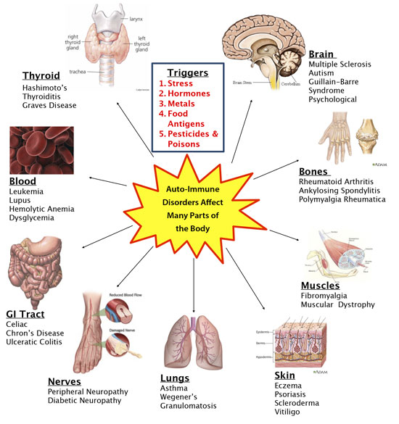
In abnormal situations
The immune system can mistake self for non-self and launch an attack against the body’s own cells or tissues.
The result is autoimmune disease.
(Some forms of arthritis and diabetes are autoimmune diseases.)
Why is rheumatoid arthritis an autoimmune disease?
Cells in joints are attacked by antibodies.

Slide 14
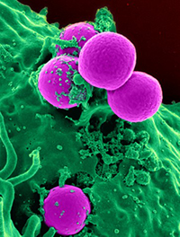
The immune system can distinguish between normal, healthy cells and unhealthy cells by recognizing a variety of "danger" cues called danger-associated molecular patterns (DAMPs).
Cells may be unhealthy because of infection or because of cellular damage caused by non-infectious agents like sunburn or cancer.
Infectious microbes such as viruses and bacteria release another set of signals recognized by the immune system called pathogen-associated molecular patterns (PAMPs).
Neutrophil (green) ingesting Staphylococcus aureus bacteria (purple).

Slide 15
Innate Immunity
Innate immune cells express genetically encoded receptors, called Toll-like receptors (TLRs), which recognize general danger- or pathogen-associated patterns.
These receptors can broadly recognize viruses, bacteria, fungi, and even non-infectious problems. However, they cannot distinguish between specific strains of bacteria or viruses.
There are numerous types of innate immune cells with specialized functions.
They include neutrophils, eosinophils, basophils, mast cells, monocytes, dendritic cells, and macrophages.
Their main feature is the ability to respond quickly and broadly when a problem arises, typically leading to inflammation.
Innate immune cells also are important for activating adaptive immunity. Innate cells are critical for host defense, and disorders in innate cell function may cause chronic susceptibility to infection.

Slide 16
Toll-like receptors (TLRs)
TLRs are class of proteins that play a key role in the innate immune system.
Humans possess ten TLR family members subsets of which are expressed in:
-epithelial cells
-endothelial cells
-leukocyte subtypes found in tissue and blood
TLRs are transmembrane receptors whose extracellular domain discriminates self from nonself through recognition of conserved structural components of viruses, bacteria, fungi, and protozoans.

Slide 17
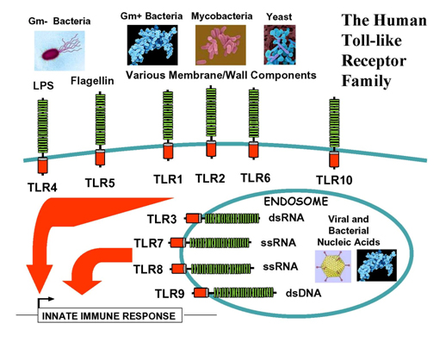
Toll-like receptors (TLRs)
TLRs are a type of pattern recognition receptor (PRR) and recognize molecules that are broadly shared by pathogens but distinguishable from host molecules, collectively referred to as pathogen-associated molecular patterns (PAMPs).
They receive their name from their similarity to the protein coded by the Toll gene identified in Drosophila in 1985 by Christiane Nüsslein-Volhard.
TLRs are a class of proteins that play a key role in the innate immune system.
TLRs recognize structurally conserved molecules from microbes.
Once these microbes have breached physical barriers such as the skin or intestinal tract mucosa, they are recognized by TLRs which activates immune cell responses.

Slide 18
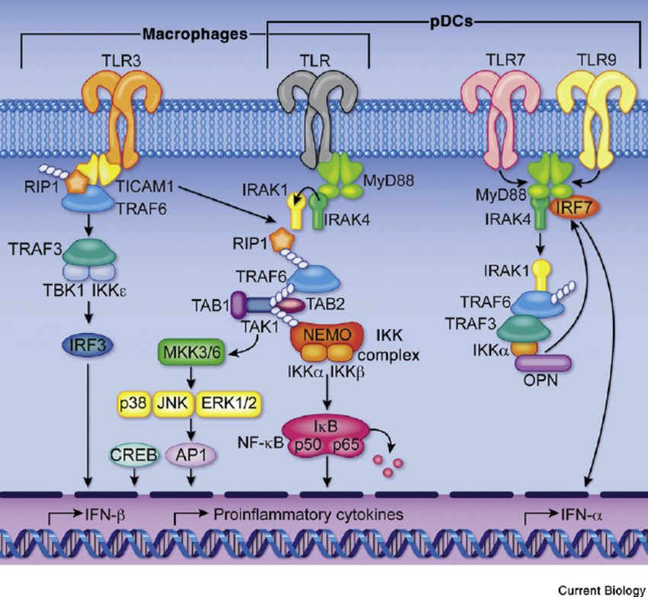

Slide 19
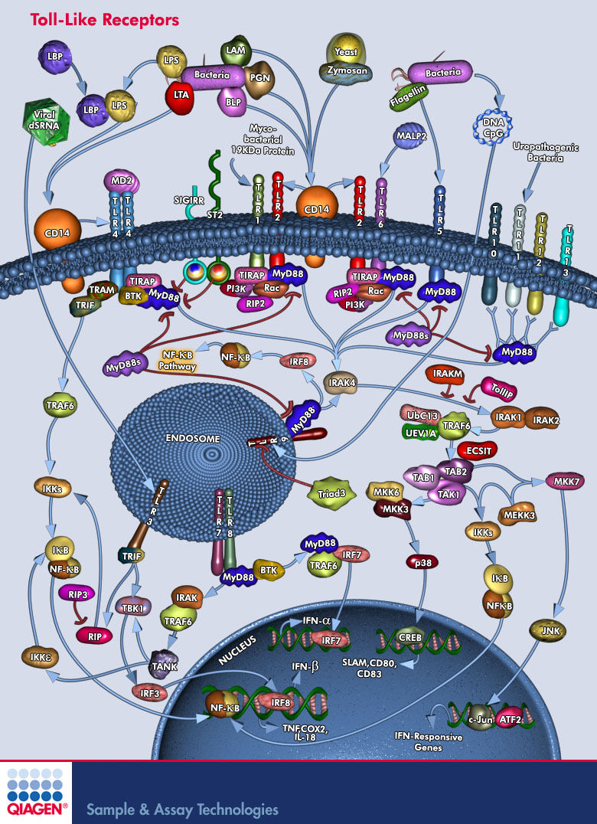

Slide 21
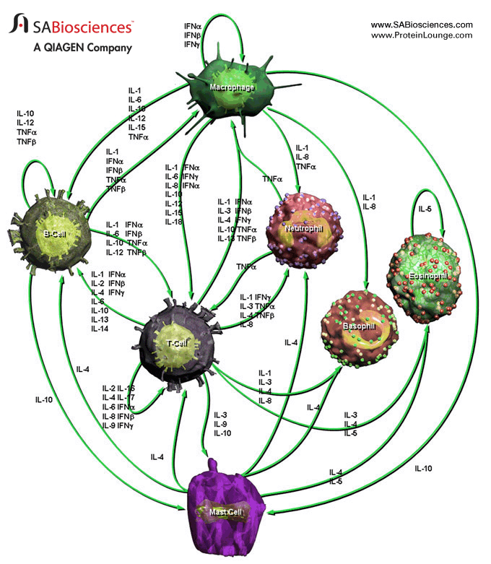

Slide 22
Basic understanding:
1. When the immune system first recognizes these signals, it responds to address the problem. If an immune response cannot be activated when there is sufficient need, problems arise, like infection. On the other hand, when an immune response is activated without a real threat or is not turned off once the danger passes, different problems arise, such as allergic reactions and autoimmune disease.
2. The immune system is complex and pervasive. There are numerous cell types that either circulate throughout the body or reside in a particular tissue. Each cell type plays a unique role, with different ways of recognizing problems, communicating with other cells, and performing their functions.
By understanding all the details behind this network, researchers may optimize immune responses to confront specific issues, ranging from infections to cancer.

Slide 23
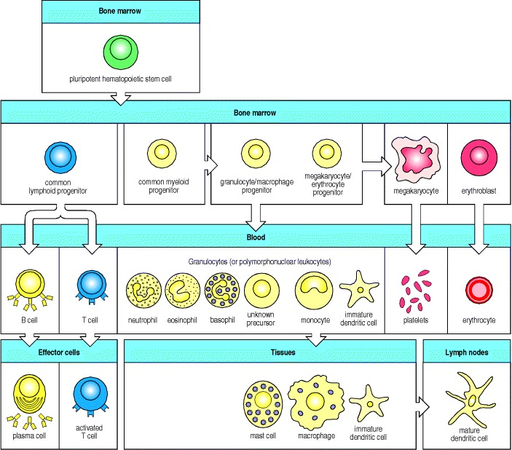
Location
All immune cells come from precursors in the bone marrow and develop into mature cells through a series of changes that can occur in different parts of the body.

Slide 24
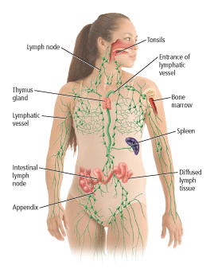
Location
Skin: The skin is usually the first line of defense against microbes. Skin cells produce and secrete important antimicrobial proteins, and immune cells can be found in specific layers of skin.
Bone marrow: The bone marrow contains stems cells that can develop into a variety of cell types. The common myeloid progenitor stem cell in the bone marrow is the precursor to innate immune cells—neutrophils, eosinophils, basophils, mast cells, monocytes, dendritic cells, and macrophages—that are important first-line responders to infection.

Slide 25
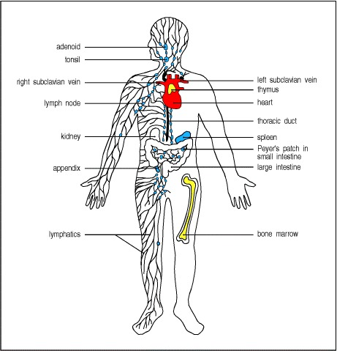
Bloodstream: Immune cells constantly circulate throughout the bloodstream, patrolling for problems. If a cell type is either scarce or over abundant in the bloodstream (blood test), this may reflect a problem.
Thymus: T cells mature in the thymus, a small organ located in the upper chest.
Lymphatic system: The lymphatic system is a network of vessels and tissues composed of lymph, an extracellular fluid, and lymphoid organs, such as lymph nodes. The lymphatic system is a conduit for travel and communication between tissues and the bloodstream. Immune cells are carried through the lymphatic system and converge in lymph nodes, which are found throughout the body.

Slide 26
Lymph nodes are a communication hub where immune cells sample information brought in from the body.
For instance, if adaptive immune cells in the lymph node recognize pieces of a microbe brought in from a distant area, they will activate, replicate, and leave the lymph node to circulate and address the pathogen.
Spleen: The spleen is an organ located behind the stomach. While it is not directly connected to the lymphatic system, it is important for processing information from the bloodstream. Immune cells are enriched in specific areas of the spleen, and upon recognizing blood-borne pathogens, they will activate and respond accordingly.
Mucosal tissue: Mucosal surfaces are prime entry points for pathogens, and specialized immune hubs are strategically located in mucosal tissues like the respiratory tract and gut.
Peyer's patches in the small intestine - immune cells can access samples from the gastrointestinal tract.​

Slide 27
The distribution of lymphoid tissues in the body
Lymphocytes arise from stem cells in bone marrow, and differentiate in the central lymphoid organs.
B cells in bone marrow
T cells in the thymus
They migrate from these tissues and are carried in the bloodstream to the peripheral or secondary lymphoid organs (blue), the lymph nodes, the spleen, and lymphoid tissues associated with mucosa, like the gut-associated tonsils, Peyer's patches, and appendix.

Slide 28
The peripheral lymphoid organs are the sites of lymphocyte activation by antigen, and lymphocytes recirculate between the blood and these organs until they encounter antigen.
Lymphatics drain extracellular fluid from the peripheral tissues, through the lymph nodes and into the thoracic duct, which empties into the left subclavian vein. This fluid, known as lymph, carries antigen to the lymph nodes and recirculating lymphocytes from the lymph nodes back into the blood. Lymphoid tissue is also associated with other mucosa such as the bronchial linings.

Slide 31
Adaptive Immunity
Adaptive immune cells are more specialized, with each adaptive B or T cell bearing unique receptors, B-cell receptors (BCRs) and T-cell receptors (TCRs), that recognize specific signals rather than general patterns.
Each receptor recognizes an antigen, which is simply any molecule that may bind to a BCR or TCR.
Antigens are derived from a variety of sources including pathogens, host cells, and allergens.
Antigens are typically processed by innate immune cells and presented to adaptive cells in the lymph nodes.

Slide 32
Adaptive Immunity
The genes for BCRs ( B cell receptors) and TCR (T cells receptors) s are randomly rearranged at specific cell maturation stages, resulting in unique receptors that may potentially recognize anything.
Random generation of receptors allows the immune system to respond to new or unforeseen problems. This concept is especially important because environments may frequently change, for instance when seasons change or a person relocates, and pathogens are constantly evolving to survive. Because BCRs and TCRs are so specific, adaptive cells may only recognize one strain of a particular pathogen, unlike innate cells, which recognize broad classes of pathogens. In fact, a group of adaptive cells that recognize the same strain will likely recognize different areas of that pathogen.

Slide 33
Adaptive Immunity
If a B or T cell has a receptor that recognizes an antigen from a pathogen and also receives cues from innate cells that something is wrong, the B or T cell will activate, divide, and disperse to address the problem.
B cells make antibodies, which neutralize pathogens, rendering them harmless.
T cells carry out multiple functions, including killing infected cells and activating or recruiting other immune cells. The adaptive response has a system of checks and balances to prevent unnecessary activation that could cause damage to the host.
If a B or T cell is autoreactive, meaning its receptor recognizes antigens from the body's own cells, the cell will be deleted. Also, if a B or T cell does not receive signals from innate cells, it will not be optimally activated.

Slide 34
Adaptive Immunity
Immune memory is a feature of the adaptive immune response.
After B or T cells are activated, they expand rapidly.
As the problem resolves, cells stop dividing and are retained in the body as memory cells.
The next time this same pathogen enters the body, a memory cell is already poised to react and can clear away the pathogen before it establishes itself.

Slide 35
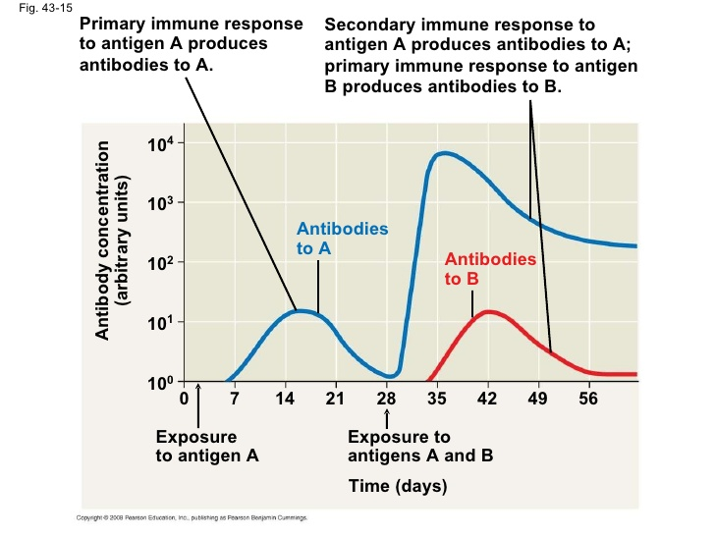
Immune memory follows the adaptive response, when mature adaptive cells, highly specific to the original pathogen, are retained for later use.

Slide 36
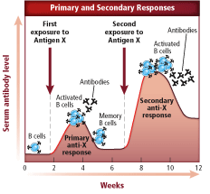
The differences between primary and secondary immune responses.

Slide 37
Which statement is true based on this graph?
Antigen X is only exposed once.
Secondary response is blocked by B cells.
Secondary response is strongest.
Primary response is strongest.

Slide 38
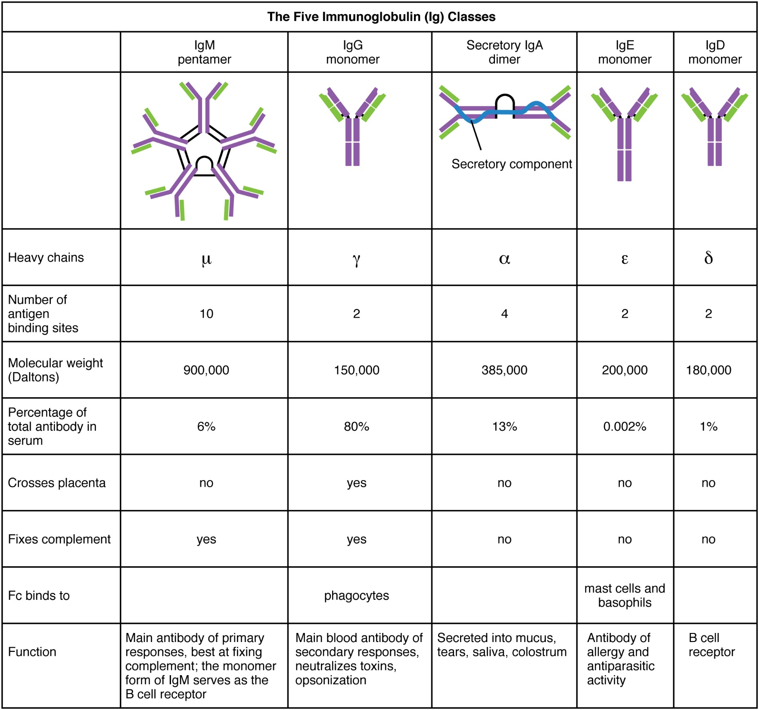

Slide 40
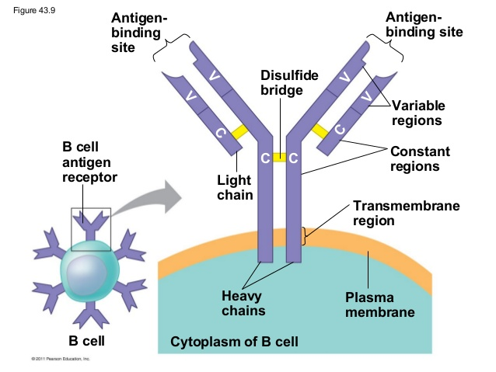
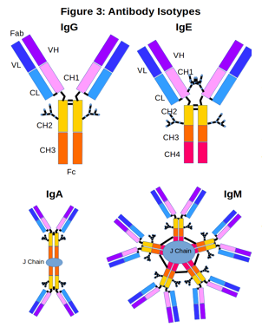

Slide 41
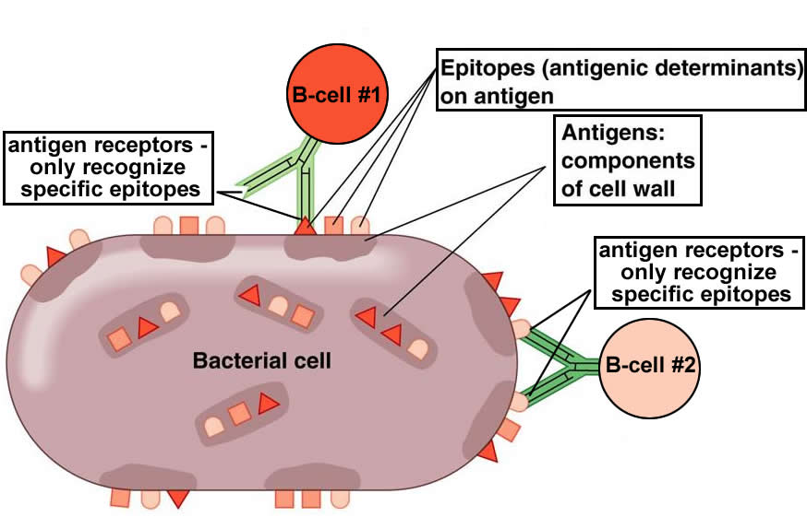

Slide 42
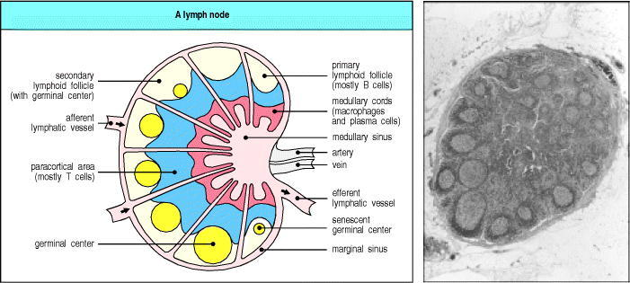
Organization of a lymph node
A lymph node consists of an outermost cortex and an inner medulla. The cortex is composed of an outer cortex of B cells organized into lymphoid follicles, and deep, or paracortical, areas made up mainly of T cells and dendritic cells
The light micrograph shows a section through a lymph node, with prominent follicles containing germinal centers. Magnification × 7. Photograph courtesy of N. Rooney.

Slide 43
When an immune response is underway, some of the follicles contain central areas of intense B-cell proliferation called germinal centers and are known as secondary lymphoid follicles. These reactions are very dramatic, but eventually die out as senescent germinal centers. Lymph draining from the extracellular spaces of the body carries antigens in phagocytic dendritic cells and macrophages from the tissues to the lymph node via the afferent lymphatics. Lymph leaves by the efferent lymphatic in the medulla. The medulla consists of strings of macro-phages and antibody-secreting plasma cells known as the medullary cords. Naive lymphocytes enter the node from the bloodstream through specialized postcapillary venules (not shown) and leave with the lymph through the efferent lymphatic.

Slide 45
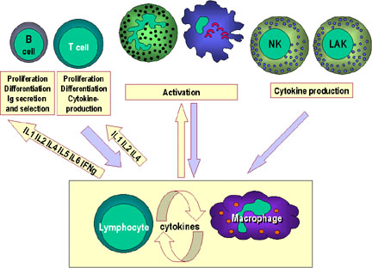

Slide 46
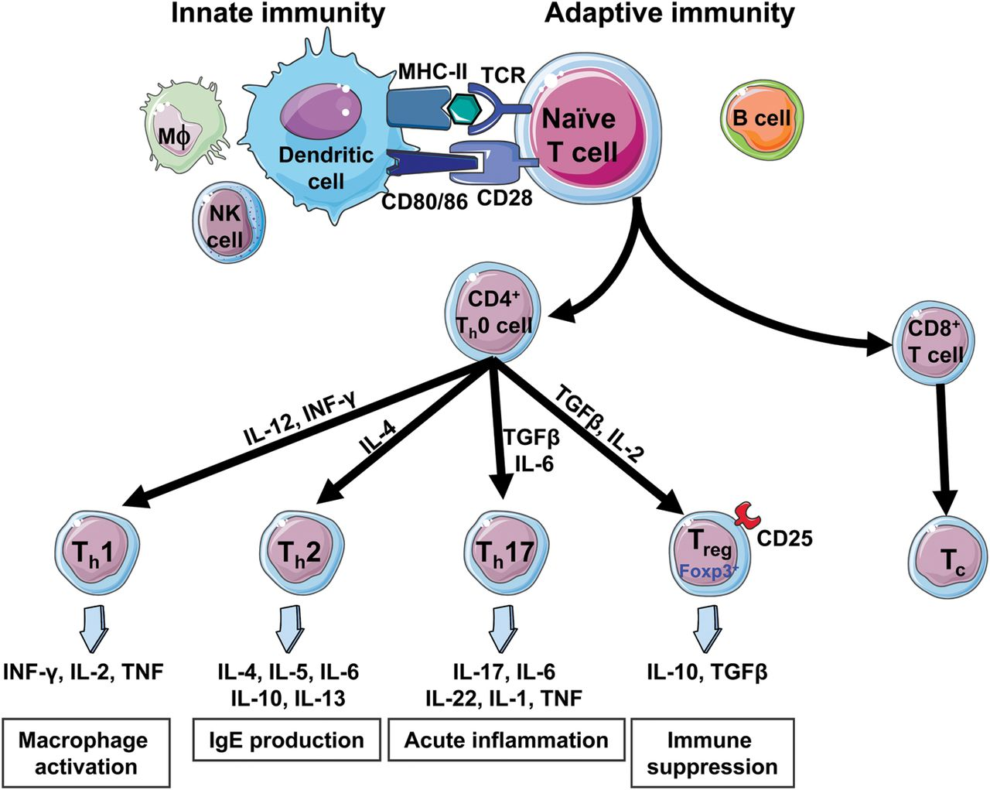

Slide 47
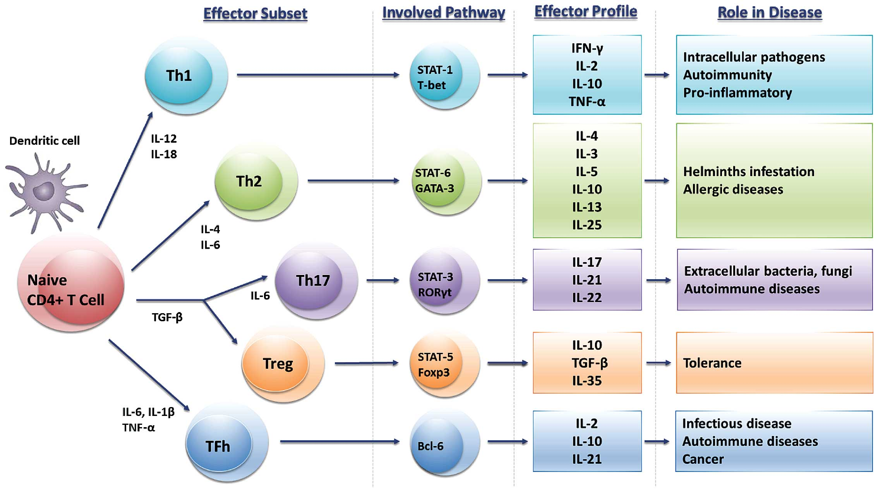

Slide 48
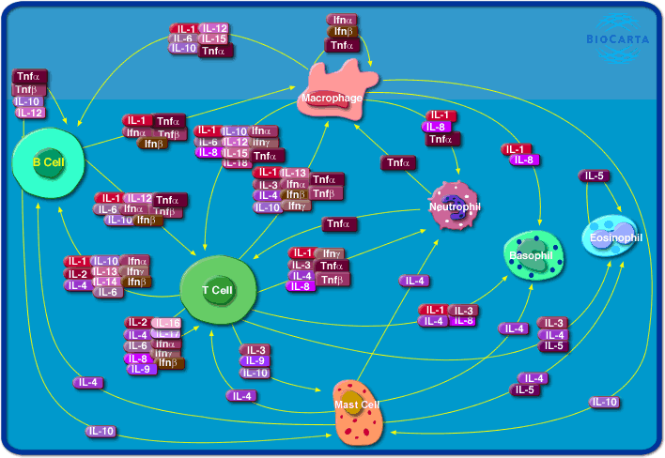

Slide 49
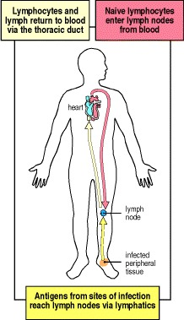
Circulating lymphocytes encounter antigen in peripheral lymphoid organs
Naive lymphocytes recirculate constantly through peripheral lymphoid tissue, here illustrated as a lymph node behind the knee, a popliteal lymph node. Here, they may encounter their specific antigen, draining from an infected site in the foot. These are called draining lymph nodes, and are the site at which lymphocytes may become activated by encountering their specific ligand.

Slide 50
Glossary: Immune Cells
Granulocytes include basophils, eosinophils, and neutrophils. Basophils and eosinophils are important for host defense against parasites. They also are involved in allergic reactions. Neutrophils, the most numerous innate immune cell, patrol for problems by circulating in the bloodstream. They can phagocytose, or ingest, bacteria, degrading them inside special compartments called vesicles.
Mast cells also are important for defense against parasites. Mast cells are found in tissues and can mediate allergic reactions by releasing inflammatory chemicals like histamine.
Monocytes, which develop into macrophages, also patrol and respond to problems. They are found in the bloodstream and in tissues. Macrophages, "big eater" in Greek, are named for their ability to ingest and degrade bacteria. Upon activation, monocytes and macrophages coordinate an immune response by notifying other immune cells of the problem. Macrophages also have important non-immune functions, such as recycling dead cells, like red blood cells, and clearing away cellular debris. These "housekeeping" functions occur without activation of an immune response.
Neutrophils (in red) accumulate within minutes at sites of local tissue injury (center). They then communicate with each other using lipid and other secreted mediators to form cellular "swarms." Their coordinated movement and exchange of signals then instructs other innate immune cells called macrophages and monocytes (in green) to surround the neutrophil cluster and form a tight wound seal. This 24-second video represents a two-hour recording.

Slide 51
Glossary: Immune Cells
Dendritic cells (DC) are an important antigen-presenting cell (APC), and they also can develop from monocytes. Antigens are molecules from pathogens, host cells, and allergens that may be recognized by adaptive immune cells. APCs like DCs are responsible for processing large molecules into "readable" fragments (antigens) recognized by adaptive B or T cells. However, antigens alone cannot activate T cells. They must be presented with the appropriate major histocompatiblity complex (MHC) expressed on the APC. MHC provides a checkpoint and helps immune cells distinguish between host and foreign cells.
Natural killer (NK) cells have features of both innate and adaptive immunity. They are important for recognizing and killing virus-infected cells or tumor cells. They contain intracellular compartments called granules, which are filled with proteins that can form holes in the target cell and also cause apoptosis, the process for programmed cell death. It is important to distinguish between apoptosis and other forms of cell death like necrosis. Apoptosis, unlike necrosis, does not release danger signals that can lead to greater immune activation and inflammation. Through apoptosis, immune cells can discreetly remove infected cells and limit bystander damage. Recently, researchers have shown in mouse models that NK cells, like adaptive cells, can be retained as memory cells and respond to subsequent infections by the same pathogen.
B cells have two major functions: They present antigens to T cells, and more importantly, they produce antibodies to neutralize infectious microbes. Antibodies coat the surface of a pathogen and serve three major roles: neutralization, opsonization, and complement activation.
Neutralization occurs when the pathogen, because it is covered in antibodies, is unable to bind and infect host cells. In opsonization, an antibody-bound pathogen serves as a red flag to alert immune cells like neutrophils and macrophages, to engulf and digest the pathogen. Complement is a process for directly destroying, or lysing, bacteria.

Slide 52
Glossary: Vaccination
Vaccination, or immunization, is a way to train your immune system against a specific pathogen. Vaccination achieves immune memory without an actual infection, so the body is prepared when the virus or bacterium enters. Saving time is important to prevent a pathogen from establishing itself and infecting more cells in the body.
An effective vaccine will optimally activate both the innate and adaptive response. An immunogen is used to activate the adaptive immune response so that specific memory cells are generated. Because BCRs and TCRs are unique, some memory cells are simply better at eliminating the pathogen. The goal of vaccine design is to select immunogens that will generate the most effective and efficient memory response against a particular pathogen. Adjuvants, which are important for activating innate immunity, can be added to vaccines to optimize the immune response. Innate immunity recognizes broad patterns, and without innate responses, adaptive immunity cannot be optimally achieved.

Slide 53
Glossary: Vaccines
Vaccines take advantage of your body’s natural ability to learn how to combat many disease-causing germs, or microbes, that attack it. Vaccines provide safe, cost-effective, and efficient means of preventing illness, disability, and death from infectious diseases.
How Vaccines Work
The human immune system is a complex network of cells and organs that evolved to fight off infectious microbes. Vaccines teach the immune system by mimicking a natural infection. Vaccines contain a weakened form of a virus that doesn’t cause disease or reproduce very well. The immune system can’t tell that the vaccine viruses are weakened, so they engulf the viruses as if they were dangerous.
Making Safe Vaccines
Each person’s immune system works differently, so occasionally a person will not respond to a vaccine. Very rarely, a person may have a serious adverse reaction to a vaccine, such as an allergic reaction that causes hives or difficulty breathing. But serious reactions are reported so infrequently—about once every 100,000 vaccinations—that they can be difficult to detect and confirm. More commonly, people will experience temporary side effects, such as fever, soreness, or redness at the injection site. These side effects are, of course, preferable to getting the illness.

