Slide 1
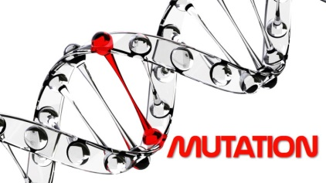
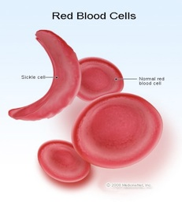
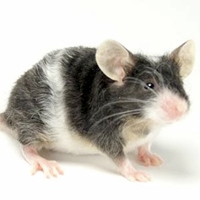
are changes in the genetic code that lead to different traits arising.
These mutations can be passed down genetically and either be lost or become fixed.
Since mutation usually affects a single individual in a population, the initial fraction is small and the probability of fixation is thus also small (high probability of loss).
However, in large populations even with a small initial fraction, it can take a long period of time for loss of a mutation to be complete.
Examples of mutations

Slide 2
Mutations, DNA Repair, and Evolution
Thus, mutations are not always a result of mutagens encountered in the environment. There is a natural low error rate that occurs during DNA replication.
In most cases, the extensive network of DNA repair machinery that exists in the cell halts cell division before an incorrectly placed nucleotide is set in place and a mismatch is made in the complementary strand.
If the repair machinery does not catch the mistake before the complementary strand is formed, the mutation is established in the cell. This mutation can then be inherited in daughter cells or in embryos
(if the mutation has occurred in the germ line).
Together, these different classes of mutations and their causes serve to place organisms at risk for disease and to provide the raw material for evolution. Thus, mutations are often detrimental to individuals, but they serve to diversify the overall population.

Slide 3
Mutations can arise in cells of all types as a result of a variety of factors.
Some of the mutations discussed above are the result of spontaneous events during replication, and they are thus known as spontaneous mutations.
Environmental exposure to certain chemicals, ultraviolet radiation, or other external factors can also cause DNA to change. These external agents of genetic change are called mutagens. Exposure to mutagens often causes alterations in the molecular structure of nucleotides, ultimately causing substitutions, insertions, and deletions in the DNA sequence.
The consequences of mutation:
(1) Mutations are a source of genetic diversity in populations.
In some cases, mutations prove beneficial to an organism by making it better able to adapt to environmental factors.
(2) In other situations, mutations are harmful to an organism — for instance, they might lead to increased susceptibility to illness or disease.
(3) In still other circumstances, mutations are neutral, proving neither beneficial nor detrimental outcomes to an organism.

Slide 4
Genetic Mutation
Mutations are changes in the genetic sequence, and they are a main cause of diversity among organisms.
These changes occur at many different levels, and they can have widely differing consequences. In biological systems that are capable of reproduction, we must first focus on whether they are heritable; specifically, some mutations affect only the individual that carries them, while others affect all of the carrier organism's offspring, and further descendants.
For mutations to affect an organism's descendants, they must: 1) occur in cells that produce the next generation, and 2) affect the hereditary material.
Ultimately, the interplay between inherited mutations and environmental pressures generates diversity among species.
Are Mutations Random?
Mutation rates are usually very low, and biological systems go to extraordinary lengths to keep them as low as possible, mostly because many mutational effects are harmful.
Mutation rates never reach zero, even despite both low-level protective mechanisms, like DNA repair or proofreading during DNA replication, and high-level mechanisms like melanin deposition in skin cells to reduce radiation damage.
Beyond a certain point, avoiding mutation simply becomes too costly to cells. Thus, mutation will always be present as a powerful force in evolution.

Slide 5
DNA replication
While most DNA replicates with fairly high fidelity, mistakes do happen, with polymerase enzymes sometimes inserting the wrong nucleotide or too many or too few nucleotides into a sequence.
Fortunately, most of these mistakes are fixed through various DNA repair processes. Repair enzymes recognize structural imperfections between improperly paired nucleotides, cutting out the wrong ones and putting the right ones in their place.
But some replication errors make it past these mechanisms, thus becoming permanent mutations. These altered nucleotide sequences can then be passed down from one cellular generation to the next, and if they occur in cells that give rise to gametes, they can even be transmitted to subsequent organismal generations.
Moreover, when the genes for the DNA repair enzymes themselves become mutated, mistakes begin accumulating at a much higher rate. In eukaryotes, such mutations can lead to cancer.

Slide 6
Mutations and the Environment
DNA interacts with the environment, and sometimes that interaction can be detrimental to genetic information.
Ultraviolet (UV) light from the sun can induce mutations in your skin cells.
One type of UV-generated mutation involves the hydrolysis of a cytosine base to a hydrate form, causing the base to mispair with adenine during the next round of replication and ultimately be replaced by thymine.
Researchers have found an extremely high rate of occurrence of this UV-induced C-to-T fingerprint-type mutation in genes associated with basal cell carcinoma, a form of skin cancer (Seidl et al., 2001).
UV light can also cause covalent bonds to form between adjacent pyrimidine bases on a DNA strand, which results in the formation of pyrimidine dimers.
Repair machinery exists to cope with these mutations, but it is somewhat prone to error, which means that some dimers go unrepaired. Furthermore, some people have an inherited genetic disorder called xeroderma pigmentosum (XP), which involves mutations in the genes that code for the proteins involved in repairing UV-light damage. In people with XP, exposure to UV light triggers a high frequency of mutations in skin cells, which in turn results in a high occurrence of skin cancer.
In addition to ultraviolet light, organisms are exposed to more energetic ionizing radiation in the form of cosmic rays, gamma rays, and X-rays. Ionizing radiation induces double-stranded breaks in DNA, and the resulting repair can likewise introduce mutations if carried out imperfectly. Unlike UV light, however, these forms of radiation penetrate tissue well, so they can cause mutations anywhere in the body.

Slide 7
Mutations Caused by Chemicals
Oxidizing agents, commonly known as free radicals, are substances that can chemically modify nucleotides in ways that alter their base-pairing capacities. For instance, dioxin intercalates between base pairs, disrupting the integrity of the DNA helix and predisposing that site to insertions or deletions. Similarly, benzo[a]pyrene, a known carcinogen and a component of cigarette smoke, has been demonstrated to induce lesions at guanine bases in the tumor suppressor gene P53 at codons 157, 248, and 273. These codons are the major mutational hot spots seen in clinical studies of human lung cancers (Denissenko et al., 1996).
Mutations such as these that are fairly specific to particular mutagens are called signature mutations. A variety of chemicals beyond those mentioned here are known to induce such mutations.

Slide 8
Extra Reading: Even Low Mutation Rates Can Be Cause for Concern
Mutation rates vary substantially among taxa, and even among different parts of the genome in a single organism. Scientists have reported mutation rates as low as 1 mistake per 100 million (10⁻⁸) to 1 billion (10⁻⁹) nucleotides, mostly in bacteria, and as high as 1 mistake per 100 (10⁻²) to 1,000 (10⁻³) nucleotides, the latter in a group of error-prone polymerase genes in humans (Johnson et al., 2000).
Even mutation rates as low as 10⁻¹⁰ can accumulate quickly over time, particularly in rapidly reproducing organisms like bacteria. This is one reason why antibiotic resistance is such an important public health problem; after all, mutations that accumulate in a population of bacteria provide ample genetic variation with which to adapt (or respond) to the natural selection pressures imposed by antibacterial drugs (Smolinski et al., 2003).
Example E. coli
The genome of this common intestinal bacterium has about 4.2 million base pairs, or 8.4 million bases. Assuming a mutation rate of 10⁻⁹(i.e., midway between reported estimates of 10⁻⁸ and 10⁻¹⁰), every time E. coli divides, each daughter cell will have, on average, 0.0084 new mutations. Or, another way to think about it is like this: Approximately 1% of bacterial cells will contain a new mutation. Bacteria can divide as rapidly as twice per hour, a single bacterium can grow into a colony of 1 million cells in only about 10 hours (2²⁰ = 1,048,576). At that point, approximately 10,000 of these bacteria will have accumulated at least one mutation. As the number of bacteria carrying different mutations increases, so too does the likelihood that at least one of them will develop a drug-resistant phenotype.

Slide 9
Extra Reading: Mutation can lead to antibiotic resistance
-Is crucial for maintaining the effectiveness of both existing and future drugs.
The rise of antibiotic-resistant bacteria is challenging clinicians, with some infections already resistant to nearly all available drugs.
A 2013 report from the Centers for Disease Control and Prevention estimates that such infections kill at least 23,000 people each year in the United States alone.
Some species of bacteria, including mycobacteria, develop drug resistance as a result of mutations in their genes.
Deborah Hung, senior author of the current study and Core Institute Member and Co-Director of the Infectious Disease and Microbiome Program at the Broad Institute did an experiment:
1.Cultures of the species Mycobacterium smegmatis (M. smegmatis), related to the bacterium that causes tuberculosis.
2.Exposed the bacteria to low antibiotic concentrations, where the drugs' microbe-killing effects were relatively slow which inorder to monitor the killing of sensitive bacteria while isolating individual wells where mutants developed.
3. Found: Each individual carried single mutations in different components of the ribosome.
Novel ribosomal mutations allowed the bacteria resistance to several different classes of antibiotics that do not even target the ribosome, and to which the mutants had never been exposed.
4. Explore this phenomenon across diverse bacterial species, including Mycobacterium tuberculosis, by coupling experimental biological approaches with a thorough exploration of genome sequence information to acquire a more complete understanding of how multidrug resistance emerges could help in the development or optimization of new drugs for treating bacterial infections.
.

Slide 10
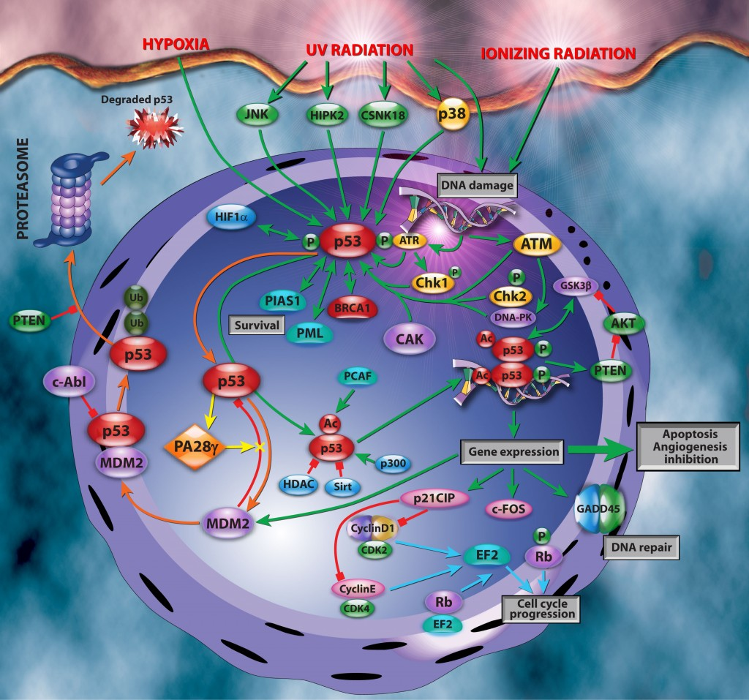
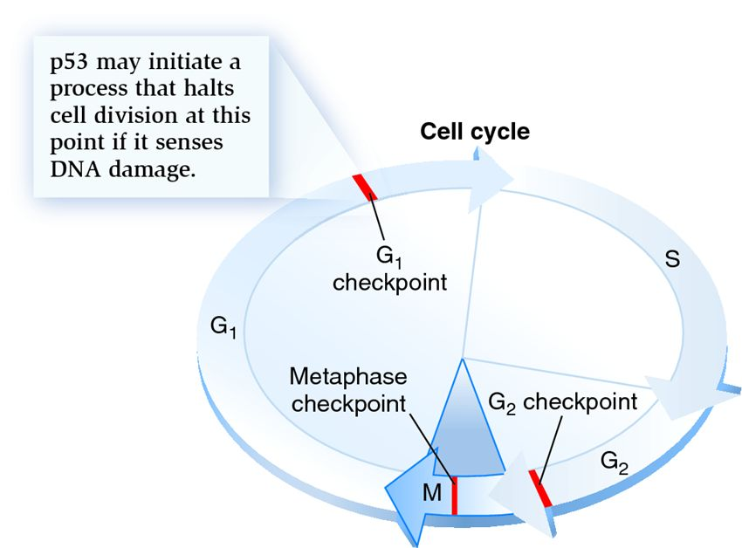

Slide 12
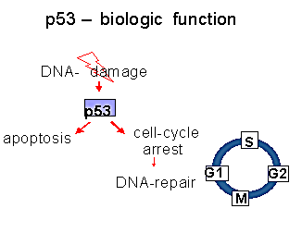
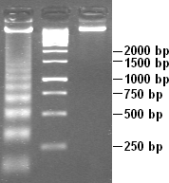
Apoptotic DNA fragmentation, visualised by the DNA laddering assay (left).
A 1 kb marker (middle) and control DNA (right) are included for comparison.

Slide 13
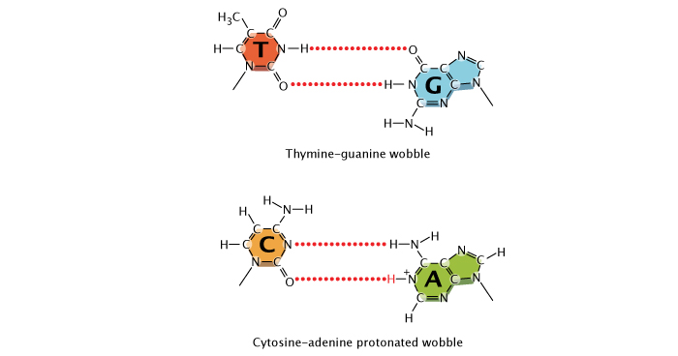
Scientists suspect that most DNA replication errors are caused by mispairings of a different nature: either between different but nontautomeric chemical forms of bases (e.g., bases with an extra proton, which can still bind but often with a mismatched nucleotide, such as an A with a G instead of a T) or between "normal" bases that nonetheless bond inappropriately (e.g., again, an A with a G instead of a T) because of a slight shift in position of the nucleotides in space. This type of mispairing is known as wobble.
It occurs because the DNA double helix is flexible and able to accommodate slightly misshaped pairings (Crick, 1966).
Wobble in mismatched nucleotide base pairs.
A shift in the position of nucleotides causes a wobble between a normal thymine and normal guanine. An additional proton on adenine causes a wobble in an adenine-cytosine base-pair.

Slide 14
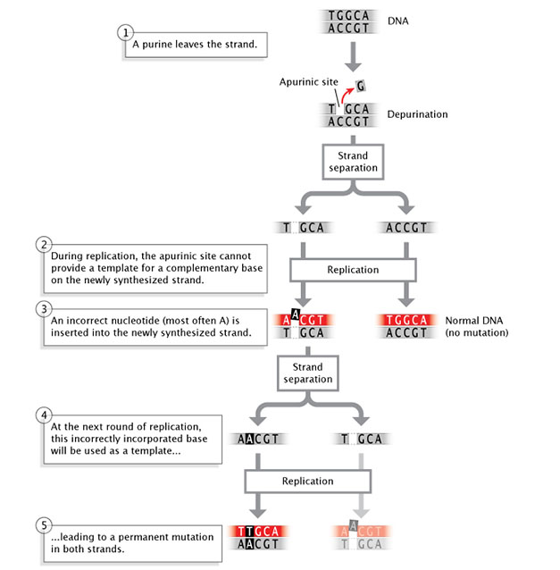
Spontaneous Mutations
Mutations can also occur spontaneously. For instance, depurination, in which a purine base is lost from a nucleotide through hydrolysis even though the sugar-phosphate backbone is unaltered, can occur without an explicit insult from the environment. If uncorrected by DNA repair enzymes, depurination may result in the incorporation of an incorrect base during the next round of replication.

Slide 15
Deamination, or the removal of an amine group from a base.
Deamination of cytosine converts it to uracil, which will pair with adenine instead of guanine at the next replication, resulting in a base substitution.
Repair enzymes can recognize uracil as not belonging in DNA, and they will normally repair such a lesion.
However, if the cytosine residue in question is methylated (a common modification involved in gene regulation), deamination will instead result in conversion to thymine. Because thymine is a normal component of DNA, this change will go unrecognized by repair enzymes.

Slide 16
The DNA sequence of a gene can be altered in a number of ways. Gene mutations have varying effects on health, depending on where they occur and whether they alter the function of essential proteins. The types of mutations include:
Missense mutation
This type of mutation is a change in one DNA base pair that results in the substitution of one amino acid for another in the protein made by a gene.
Nonsense mutation
A nonsense mutation is also a change in one DNA base pair. Instead of substituting one amino acid for another, however, the altered DNA sequence prematurely signals the cell to stop building a protein. This type of mutation results in a shortened protein that may function improperly or not at all.
Insertion
An insertion changes the number of DNA bases in a gene by adding a piece of DNA. As a result, the protein made by the gene may not function properly.
Deletion
A deletion changes the number of DNA bases by removing a piece of DNA. Small deletions may remove one or a few base pairs within a gene, while larger deletions can remove an entire gene or several neighboring genes. The deleted DNA may alter the function of the resulting protein(s).
Duplication
A duplication consists of a piece of DNA that is abnormally copied one or more times. This type of mutation may alter the function of the resulting protein.
Frameshift mutation
This type of mutation occurs when the addition or loss of DNA bases changes a gene's reading frame. A reading frame consists of groups of 3 bases that each code for one amino acid. A frameshift mutation shifts the grouping of these bases and changes the code for amino acids. The resulting protein is usually nonfunctional. Insertions, deletions, and duplications can all be frameshift mutations.
Repeat expansion
Nucleotide repeats are short DNA sequences that are repeated a number of times in a row. For example, a trinucleotide repeat is made up of 3-base-pair sequences, and a tetranucleotide repeat is made up of 4-base-pair sequences. A repeat expansion is a mutation that increases the number of times that the short DNA sequence is repeated. This type of mutation can cause the resulting protein to function improperly.

Slide 17
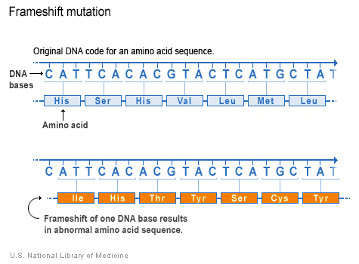
Insertion or deletion of one or more nucleotides during replication can also lead to another type of mutation known as a frameshift mutation.
The outcome of a frameshift mutation is complete alteration of the amino acid sequence of a protein.
This alteration occurs during translation because ribosomes read the mRNA strand in terms of codons, or groups of three nucleotides.
These groups are called the reading frame. Thus, if the number of bases removed from or inserted into a segment of DNA is not a multiple of three, the reading frame transcribed to the mRNA will be completely changed.
Once it encounters the mutation, the ribosome will read the mRNA sequence differently, which can result in the production of an entirely different sequence of amino acids in the growing polypeptide chain.

Slide 18
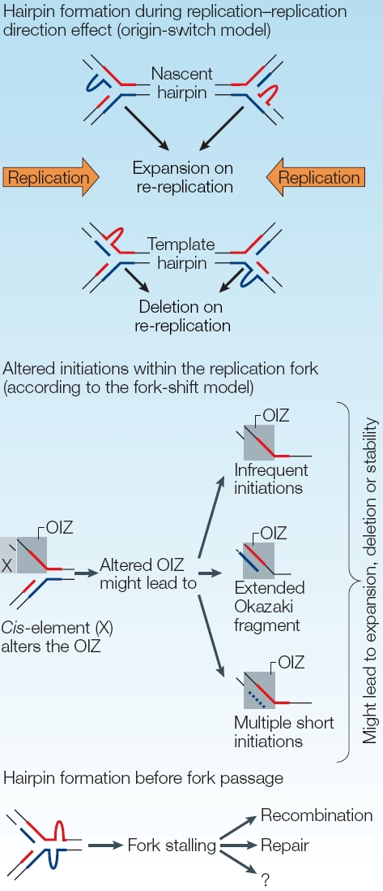
Extra Reading:

Slide 19
Fixing Mistakes in DNA Replication
DNA polymerase enzymes are amazingly particular with respect to their choice of nucleotides during DNA synthesis, ensuring that the bases added to a growing strand are correctly paired with their complements on the template strand (i.e., A's with T's, and C's with G’s).
These enzymes do make mistakes at a rate of about 1 per every 100,000 nucleotides.
In humans, with our 6 billion base pairs in each diploid cell, that would amount to about 120,000 mistakes every time a cell divides.
Cells have evolved highly sophisticated means of fixing most, but not all, of those mistakes. Some of the mistakes are corrected immediately during replication through a process known as proofreading, and some are corrected after replication in a process called mismatch repair.
When an incorrect nucleotide is added to the growing strand, replication is stalled by the fact that the nucleotide's exposed 3′-OH group is in the "wrong" position. New nucleotides are added to the growing strand during replication by means of their 5′-phosphate group binding to the 3′-OH group of the previous nucleotide on the strand.
During proofreading, DNA polymerase enzymes recognize this and replace the incorrectly inserted nucleotide so that replication can continue. Proofreading fixes about 99% of these types of errors, but that's still not good enough for normal cell functioning.
After replication, mismatch repair reduces the final error rate even further. Incorrectly paired nucleotides cause deformities in the secondary structure of the final DNA molecule. During mismatch repair, enzymes recognize and fix these deformities by removing the incorrectly paired nucleotide and replacing it with the correct nucleotide.

Slide 20
Reading: When Replication Errors Become Mutations
Incorrectly paired nucleotides that still remain following mismatch repair become permanent mutations after the next cell division. This is because once such mistakes are established, the cell no longer recognizes them as errors. Consider the case of wobble-induced replication errors. When these mistakes are not corrected, the incorrectly sequenced DNA strand serves as a template for future replication events, causing all the base-pairings thereafter to be wrong. For instance, in the lower half of Figure 2, the original strand had a C-G pair; then, during replication, cytosine (C) is incorrectly matched to adenine (A) because of wobble. In this example, wobble occurs because A has an extra hydrogen atom. In the next round of cell division, the double strand with the C-A pairing would separate during replication, each strand serving as a template for synthesis of a new DNA molecule. At that particular spot, C would pair with G, forming a double helix with the same sequence as its original (i.e., before the wobble occurred), but A would pair with T, forming a new DNA molecule with an A-T pair in place of the original C-G pair. This type of mutation is known as a base, or base-pair, substitution. Base substitutions involving replacement of one purine for another or one pyrimidine for another (e.g., a mismatched A-A pair, instead of A-T) are known as transitions; the replacement of a purine by a pyrimidine, or vice versa, is called a transversion.
Likewise, when strand-slippage replication errors are not corrected, they become insertion and deletion mutations.

Slide 21
Extra Reading:
Much of the early research on strand-slippage mutations was conducted by George Streisinger in the 1970s. Streisinger, a professor at the University of Oregon and a fish hobbyist, is known by some as the "founding father of zebrafish research." However, he is also known for his work with phage T4, a bacterial virus. Streisinger used this virus to show that most nucleotide insertion and deletion mutations occur in areas of DNA that contain many repeated sequences (also called tandem repeats), and he formulated the strand-slippage hypothesis to explain why this was the case (Streisinger et al., 1966). (In Figure 3, notice the series of repeat T's on the template strand where the slippage has occurred.) When slippage takes place, the presence of nearby duplicate bases stabilizes the slippage so that replication can proceed. During the next round of replication, when the two strands separate, the insertion or deletion on either the template or primer strand, respectively, will be perpetuated as a permanent mutation. Scientists have collected enough evidence to confirm Streisinger's strand-slippage hypothesis, and this type of mutagenesis remains an active field of scientific research.

Slide 22
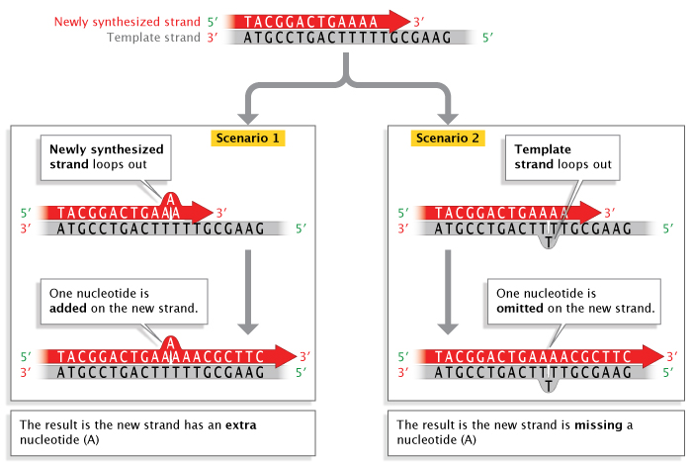
Strand slippage during DNA replication.
When strand slippage occurs during DNA replication, a DNA strand may loop out, resulting in the addition or deletion of a nucleotide on the newly-synthesized strand.

Slide 23
Genetic Mutation
Mutations are changes in the genetic sequence, and they are a main cause of diversity among organisms.
These changes occur at many different levels, and they can have widely differing consequences. In biological systems that are capable of reproduction, we must first focus on whether they are heritable; specifically, some mutations affect only the individual that carries them, while others affect all of the carrier organism's offspring, and further descendants.
For mutations to affect an organism's descendants, they must:
occur in cells that produce the next generation
affect the hereditary material
Ultimately, the interplay between inherited mutations and environmental pressures generates diversity among species.

Slide 24
To connect the idea of mutations back to our discussion of DNA and proteins, here are some examples of how a mutation in the DNA can lead to a change in the protein:
1)A number of nucleotides not divisible by three is either inserted into or deleted from the DNA. This shifts the position of the codons being read to create amino acids and is known as a frameshift mutation. For example, if the original sequence is CCC CAG AGA (corresponding to amino acids proline, glutamine and arginine) and there is an insertion (in red) leading to the sequence CCG ACC AGA GA, the corresponding amino acids will change to proline, threonine and arginine and will shift which bases are in the codons in the rest of the RNA read after this sequence.
2)A nonsense mutation is a change of base at one point in the DNA that causes a stop signal where one shouldn’t be and halts the creation of a protein in the middle.
3)A missense mutation is a change of base at a point in the DNA that results in the substitution of a different amino acid than originally intended at some point in the protein. This can change or inhibit the function of the protein.
4)A neutral mutation is one leading to a substitution of a different amino acid than originally intended, but not to one that alters the function of the protein.
5)A silent mutation is one that does not lead to a change in the amino acid sequence of a protein.

Slide 25
Did you know that very small changes in DNA sequences called point mutations can have huge impacts on the body?
What Are Point Mutations?
A mutation is a permanent change in a DNA sequence.
Since DNA is the unit of heredity of all organisms, this means that mutations can often be passed on to offspring.
Mutations don't have to be bad. Some are beneficial, while others are neutral and have no effect.
There are many different categories of mutations.
Focus on point mutations - resulting from a change in one or a few nucleotides at a single location in a DNA sequence.
Nucleotides are the repeating units of a DNA sequence. There are four nucleotides, each with a different nitrogenous base: thymine (T), adenine (A), guanine (G), cytosine (C).
Genes are sequences of DNA that code for proteins, and the order of these bases determines the order of amino acids in a protein.
Not all mutations are in these coding sequences but if they are, then the result can be different or non-functioning proteins will be made.

Slide 26
Types of Changes in DNA
The DNA in any cell can be altered through environmental exposure to certain chemicals, ultraviolet radiation, other genetic insults, or even errors that occur during the process of replication.
If a mutation occurs in a germ-line cell (one that will give rise to gametes, i.e., egg or sperm cells), then this mutation can be passed to an organism's offspring. This means that every cell in the developing embryo will carry the mutation.
As opposed to germ-line mutations, somatic mutations occur in cells found elsewhere in an organism's body. Such mutations are passed to daughter cells during the process of mitosis, but they are not passed to offspring conceived via sexual reproduction.

Slide 27
Mutations are also categorized by the length of the nucleotide sequences they affect.
(1) Gene-level mutations are changes to short stretches of nucleotides; these mutations affect the specific genes that provide instructions for various functional molecules, including proteins. Changes in these molecules can have an impact on any number of an organism's physical characteristics.
(2) Chromosomal mutations alter longer stretches of DNA (ranging from multiple genes up to entire chromosomes). These mutations often have serious consequences for affected organisms.
Mutation at the gene-level mutations are more common than chromosomal level.

Slide 28
Mutations can be grouped into two main categories based on where they occur:
(1) Somatic mutations take place in non-reproductive cells. Many kinds of somatic mutations have no obvious effect on an organism, because genetically normal body cells are able to compensate for the mutated cells. Nonetheless, certain other mutations can greatly impact the life and function of an organism. For example, somatic mutations that affect cell division (particularly those that allow cells to divide uncontrollably) are the basis for many forms of cancer.
(2) Germ-line mutations occur in gametes or in cells that eventually produce gametes. In contrast with somatic mutations, germ-line mutations are passed on to an organism's progeny. As a result, future generations of organisms will carry the mutation in all of their cells (both somatic and germ-line).

Slide 29
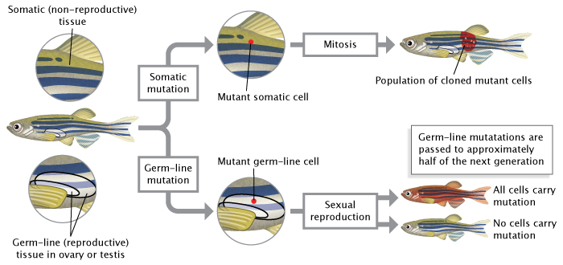
Mutations can occur in germ-line cells or somatic cells.
Germ-line mutations occur in reproductive cells (sperm or eggs) and are passed to an organism’s offspring during sexual reproduction. Somatic mutations occur in non-reproductive cells; they are passed to daughter cells during mitosis but not to offspring during sexual reproduction.

Slide 30
Extra Reading: Types of Mutations
So, how do mutations occur? The answer to this question is closely linked to the molecular details of how both DNA and the entire genome are organized. The smallest mutations are point mutations, in which only a single base pair is changed into another base pair.
Yet another type of mutation is the nonsynonymous mutation, in which an amino acid sequence is changed. Such mutations lead to either the production of a different protein or the premature termination of a protein.
As opposed to nonsynonymous mutations, synonymous mutations do not change an amino acid sequence, although they occur, by definition, only in sequences that code for amino acids. Synonymous mutations exist because many amino acids are encoded by multiple codons. Base pairs can also have diverse regulating properties if they are located in introns, intergenic regions, or even within the coding sequence of genes.
For some historic reasons, all of these groups are often subsumed with synonymous mutations under the label "silent" mutations. Depending on their function, such silent mutations can be anything from truly silent to extraordinarily important, the latter implying that working sequences are kept constant by purifying selection.
This is the most likely explanation for the existence of ultraconserved noncoding elements that have survived for more than 100 million years without substantial change, as found by comparing the genomes of several vertebrates (Sandelin et al., 2004).

Slide 31
Extra Reading:
Mutations may also take the form of insertions or deletions, which are together known as indels.
Indels can have a wide variety of lengths. At the short end of the spectrum, indels of one or two base pairs within coding sequences have the greatest effect, because they will inevitably cause a frameshift (only the addition of one or more three-base-pair codons will keep a protein approximately intact).
At the intermediate level, indels can affect parts of a gene or whole groups of genes.
At the largest level, whole chromosomes or even whole copies of the genome can be affected by insertions or deletions, although such mutations are usually no longer subsumed under the label indel.
At this high level, it is also possible to invert or translocate entire sections of a chromosome, and chromosomes can even fuse or break apart. If a large number of genes are lost as a result of one of these processes, then the consequences are usually very harmful. Of course, different genetic systems react differently to such events.
Other sources of mutations are the many different types of transposable elements, which are small entities of DNA that possess a mechanism that permits them to move around within the genome.
Some of these elements copy and paste themselves into new locations, while others use a cut-and-paste method. Such movements can disrupt existing gene functions (by insertion in the middle of another gene), activate dormant gene functions (by perfect excision from a gene that was switched off by an earlier insertion), or occasionally lead to the production of new genes (by pasting material from different genes together). This is seen a lot in bacteria genomes that have high resistance to antibiotics.

Slide 32
Many diseases are associated with mutations, it is common for mutations to have a negative connotation.
Sickle-cell anemia is one of hundreds of life-threatening disorders that are known to be caused by a change in just one of those 3 billion A's, T's, C's, or G’s. Sickle-cell anemia is the result of a change in a single nucleotide, and it represents just one class of mutations called point mutations.
However, while many mutations are indeed deleterious, others are "silent"; that is, they have no discernible effect on the phenotype of an individual and remain undetected unless a molecular biologist takes a DNA sample for sequence analysis.
Some mutations are actually beneficial.
For example, the very same mutation that causes sickle-cell anemia in affected individuals (i.e., those people who have inherited two mutant copies of the beta globin gene) can confer a survival advantage to unaffected carriers (i.e., those people who have inherited one mutant copy and one normal copy of the gene, and who generally do not show symptoms of the disease) when these people are challenged with the malaria pathogen. The sickle-cell mutation persists in populations where malaria is endemic.
Beyond the individual level, perhaps the most dramatic effect of mutation relates to its role in evolution; indeed, without mutation, evolution would not be possible. This is because mutations provide the "raw material" upon which the mechanisms of natural selection can act. By way of this process, those mutations that furnish individual organisms with characteristics better adapted to changing environmental conditions are passed on to offspring at an increased rate, thereby influencing the future of the species.

Slide 33
Changes in the DNA sequence can also occur at the level of the chromosome, in which large segments of chromosomes are altered. In this case, fragments of chromosomes can be deleted, duplicated, inverted, translocated to different chromosomes, or otherwise rearranged, resulting in changes such as modification of gene dosage, the complete absence of genes, or the alteration of gene sequence. The type of variation that occurs when entire areas of chromosomes are duplicated or lost, called copy number variation (CNV), has especially important implications for human disease and evolution.

Slide 34
Extra Reading:
Mutations can result from a number of events, including unequal crossing-over during meiosis.
In addition, some areas of the genome simply seem to be more prone to mutation than others. These "hot spots" are often a result of the DNA sequence itself being more accessible to mutagens. Hot spots include areas of the genome with highly repetitive sequences, such as trinucleotide repeats, in which a sequence of three nucleotides is repeated many times.
During DNA replication, these repeat regions are often altered because the polymerase can "slip" as it disassociates and reassociates with the DNA strand (Viguera et al., 2001). To better understand a polymerase slip, imagine you are reading a page of text that is a repeat of a simple sequence. Say that the whole page is just copies of the word "And" ("And And And..."). Now, imagine that while reading the page, you briefly glance away and then look back at the text. It's quite likely that you will have lost your place. As a result, you may read the wrong number of copies from the page.
Similarly, DNA polymerase sometimes slips and makes mistakes when reading repeats.

Slide 35
Base substitutions are the simplest type of gene-level mutation, and they involve the swapping of one nucleotide for another during DNA replication. For example, during replication, a thymine nucleotide might be inserted in place of a guanine nucleotide. With base substitution mutations, only a single nucleotide within a gene sequence is changed, so only one codon is affected.
Although a base substitution alters only a single codon in a gene, it can still have a significant impact on protein production. In fact, depending on the nature of the codon change, base substitutions can lead to three different subcategories of mutations.
The first of these subcategories consists of missense mutations, in which the altered codon leads to insertion of an incorrect amino acid into a protein molecule during translation;
the second consists of nonsense mutations, in which the altered codon prematurely terminates synthesis of a protein molecule;
and the third consists of silent mutations, in which the altered codon codes for the same amino acid as the unaltered codon.

Slide 36
Although the haploid human genome consists of 3 billion nucleotides, changes in even a single base pair can result in dramatic physiological malfunctions. For example, sickle-cell anemia is a disease caused by the smallest of genetic changes.
The alteration of a single nucleotide in the gene for the beta chain of the hemoglobin protein (the oxygen-carrying protein that makes blood red) is all it takes to turn a normal hemoglobin gene into a sickle-cell hemoglobin gene.
This single nucleotide change alters only one amino acid in the protein chain, but the results are devastating.
Beta hemoglobin (beta globin) is a single chain of 147 amino acids.
In sickle-cell anemia, the gene for beta globin is mutated.
The resulting protein still consists of 147 amino acids, but because of the single-base mutation, the sixth amino acid in the chain is valine, rather than glutamic acid.
Single-Base Mutation Associated with Sickle-Cell Anemia
Sequence for Wild-Type Hemoglobin
ATG | GTG | CAC | CTG | ACT | CCT | GAG | GAG | AAG | TCT | GCC | GTT | ACT
Start | Val | His | Leu | Thr | Pro | Glu | Glu | Lys | Ser | Ala | Val | Thr
Sequence for Mutant (Sickle-Cell) Hemoglobin
ATG | GTG | CAC | CTG | ACT | CCT | GTG | GAG | AAG | TCT | GCC | GTT | ACT
Start | Val | His | Leu | Thr | Pro | Val | Glu | Lys | Ser | Ala | Val | Thr

Slide 37
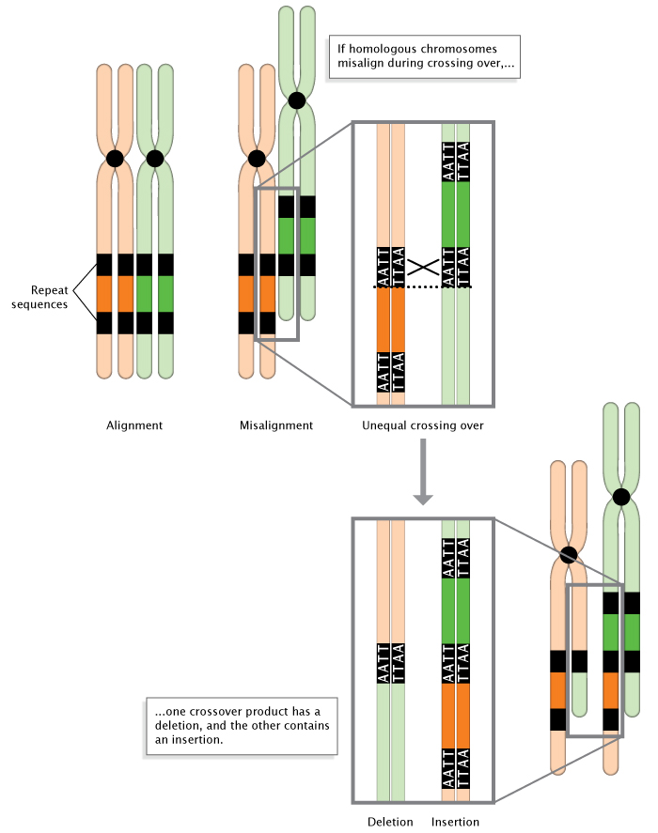
Unequal crossing-over during meiosis.
When homologous chromosomes misalign during meiosis, unequal crossing-over occurs. The result is the deletion of a DNA sequence in one chromosome, and the insertion of a DNA sequence in the other chromosome.

Slide 38
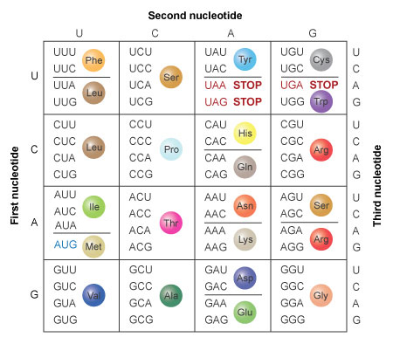
In other cases, mutations alter the way a gene is read through either the insertion or the deletion of a single base. In these so-called frameshift mutations, entire proteins are altered as a result of the deletion or insertion. This occurs because nucleotides are read by ribosomes in groups of three, called codons. Thus, if the number of bases removed or inserted from a gene is not a multiple of three, the reading frame for the rest of the protein is thrown off.

Slide 39
Replication errors can also involve insertions or deletions of nucleotide bases that occur during a process called strand slippage.
Sometimes, a newly synthesized strand loops out a bit, resulting in the addition of an extra nucleotide base.
Other times, the template strand loops out a bit, resulting in the omission, or deletion, of a nucleotide base in the newly synthesized, or primer, strand.
Regions of DNA containing many copies of small repeated sequences are particularly prone to this type of error.

Slide 40
Strand slippage during DNA replication.
When strand slippage occurs during DNA replication, a DNA strand may loop out, resulting in the addition or deletion of a nucleotide on the newly-synthesized strand.

Slide 41
Extra Reading: When Replication Errors Become Mutations
Incorrectly paired nucleotides that still remain following mismatch repair become permanent mutations after the next cell division. This is because once such mistakes are established, the cell no longer recognizes them as errors. Consider the case of wobble-induced replication errors. When these mistakes are not corrected, the incorrectly sequenced DNA strand serves as a template for future replication events, causing all the base-pairings thereafter to be wrong. For instance, in the lower half of Figure 2, the original strand had a C-G pair; then, during replication, cytosine (C) is incorrectly matched to adenine (A) because of wobble. In this example, wobble occurs because A has an extra hydrogen atom. In the next round of cell division, the double strand with the C-A pairing would separate during replication, each strand serving as a template for synthesis of a new DNA molecule. At that particular spot, C would pair with G, forming a double helix with the same sequence as its original (i.e., before the wobble occurred), but A would pair with T, forming a new DNA molecule with an A-T pair in place of the original C-G pair. This type of mutation is known as a base, or base-pair, substitution. Base substitutions involving replacement of one purine for another or one pyrimidine for another (e.g., a mismatched A-A pair, instead of A-T) are known as transitions; the replacement of a purine by a pyrimidine, or vice versa, is called a transversion.
Likewise, when strand-slippage replication errors are not corrected, they become insertion and deletion mutations. Much of the early research on strand-slippage mutations was conducted by George Streisinger in the 1970s. Streisinger, a professor at the University of Oregon and a fish hobbyist, is known by some as the "founding father of zebrafish research." However, he is also known for his work with phage T4, a bacterial virus. Streisinger used this virus to show that most nucleotide insertion and deletion mutations occur in areas of DNA that contain many repeated sequences (also called tandem repeats), and he formulated the strand-slippage hypothesis to explain why this was the case (Streisinger et al., 1966). (In Figure 3, notice the series of repeat T's on the template strand where the slippage has occurred.) When slippage takes place, the presence of nearby duplicate bases stabilizes the slippage so that replication can proceed. During the next round of replication, when the two strands separate, the insertion or deletion on either the template or primer strand, respectively, will be perpetuated as a permanent mutation. Scientists have collected enough evidence to confirm Streisinger's strand-slippage hypothesis, and this type of mutagenesis remains an active field of scientific research.

Slide 42
The DNA sequence of a gene can be altered in a number of ways. Gene mutations have varying effects on health, depending on where they occur and whether they alter the function of essential proteins. The types of mutations include:
Missense mutation
Nonsense mutation
Insertion
Deletion
Duplication
Frameshift mutation
Repeat expansion

Slide 43
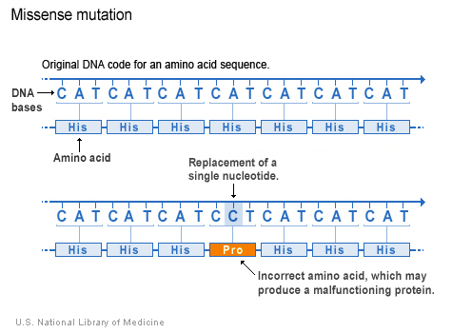
A change in one DNA base pair that results in the substitution of one amino acid for another in the protein made by a gene.

Slide 44
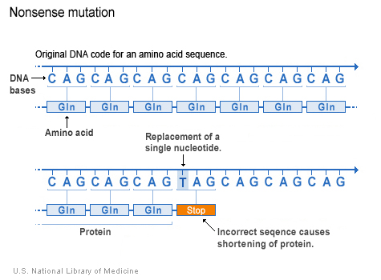
A change in one DNA base pair.
Instead of substituting one amino acid for another, the altered DNA sequence prematurely signals the cell to stop building a protein.
This type of mutation results in a shortened protein that may function improperly or not at all.

Slide 45
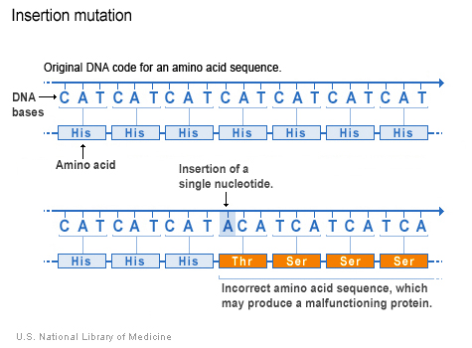
An insertion changes the number of DNA
bases in a gene by adding a piece of DNA.
As a result, the protein made by the gene
may not function properly.

Slide 46
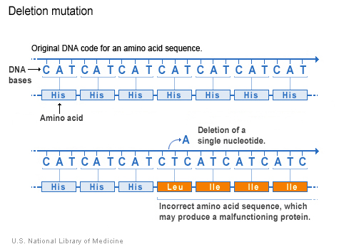
A deletion changes the number of DNA bases by removing a piece of DNA.
Small deletions may remove one or a few base pairs within a gene, while larger deletions can remove an entire gene or several neighboring genes. The deleted DNA may alter the function of the resulting protein(s).
Deletions occur when a chromosome breaks and some genetic material is lost. Deletions can be large or small, and can occur anywhere along a chromosome.

Slide 47
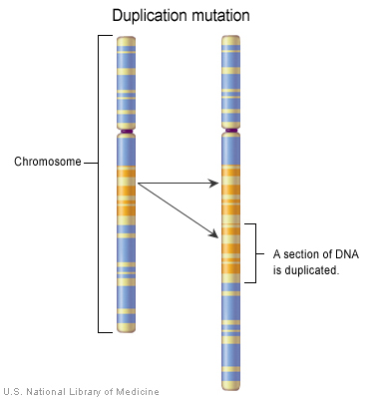
Duplication A duplication consists of a
piece of DNA that is abnormally copied one
or more times. This type of mutation may
alter the function of the resulting protein.
Duplications occur when part of a chromosome is copied (duplicated) too many times. This type of chromosomal change results in extra copies of genetic material from the duplicated segment.

Slide 48
Frameshift mutation This type of mutation occurs when the addition or loss of DNA bases changes a gene's reading frame. A reading frame consists of groups of 3 bases that each code for one amino acid. A frameshift mutation shifts the grouping of these bases and changes the code for amino acids. The resulting protein is usually nonfunctional. Insertions, deletions, and duplications can all be frameshift mutations.

Slide 49
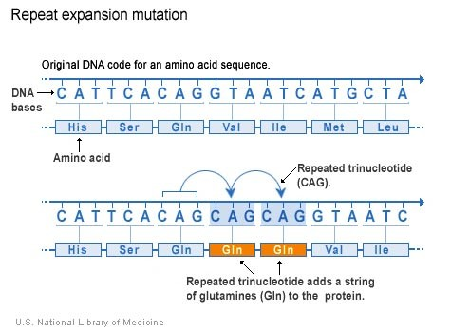
Repeat expansion Nucleotide repeats are short DNA sequences that are repeated a number of times in a row. For example, a trinucleotide repeat is made up of 3-base-pair sequences, and a tetranucleotide repeat is made up of 4-base-pair sequences. A repeat expansion is a mutation that increases the number of times that the short DNA sequence is repeated. This type of mutation can cause the resulting protein to function improperly.

Slide 50
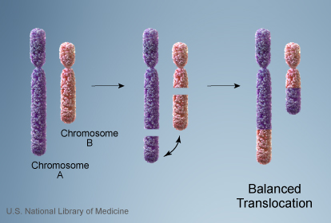
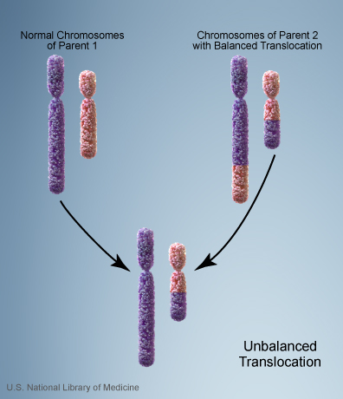
Changes in chromosome structure include:
Translocations
A translocation occurs when a piece of one chromosome breaks off and attaches to another chromosome.
If there is a gain or loss of genetic material,
the translocation is described as unbalanced.
This type of rearrangement is described as balanced if no genetic material is gained or lost in the cell.

Slide 51
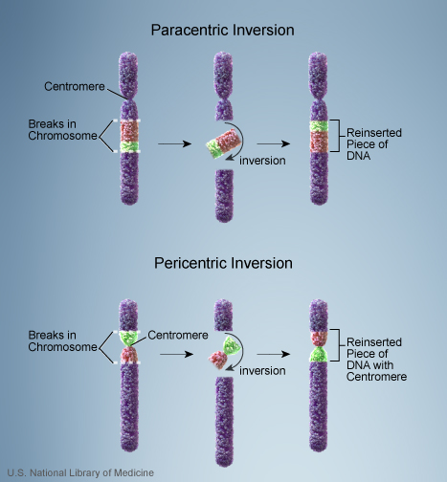
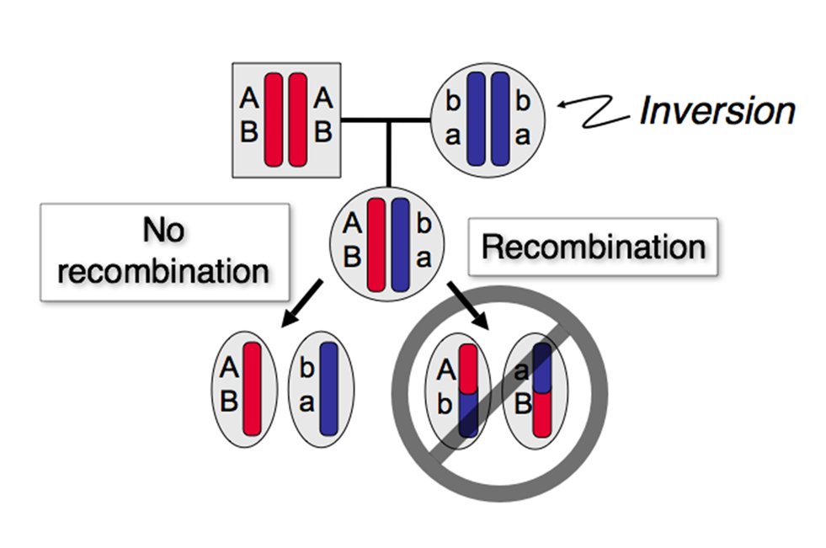
Inversion
One of the causes of chromosomes mutation is inversion. This occurs when an area of DNA on a chromosome flips its orientation with regard to the remainder of the chromosome.
Example- If chromosome 16 is affected by just one inversion it can cause leukemia. If inversion leads to an embryo having too few or too many copies of genes, the embryo can miscarry, fail to grow, or be born alive with substantial medical problems.
Inversions involves the breakage of a chromosome in two places; the resulting piece of DNA is reversed and re-inserted into the chromosome. Genetic material may or may not be lost as a result of the chromosome breaks. An inversion that involves the chromosome's constriction point (centromere) is called a pericentric inversion. An inversion that occurs in the long (q) arm or short (p) arm and does not involve the centromere is called a paracentric inversion.

Slide 52
Do all gene mutations affect health and development?
No; only a small percentage of mutations cause genetic disorders—most have no impact on health or development.
For example, some mutations alter a gene's DNA sequence but do not change the function of the protein made by the gene.
Often, gene mutations that could cause a genetic disorder are repaired by certain enzymes before the gene is expressed and an altered protein is produced. Each cell has a number of pathways through which enzymes recognize and repair mistakes in DNA. Because DNA can be damaged or mutated in many ways, DNA repair is an important process by which the body protects itself from disease.
A very small percentage of all mutations actually have a positive effect. These mutations lead to new versions of proteins that help an individual better adapt to changes in his or her environment.
For example, a beneficial mutation could result in a protein that protects an individual and future generations from a new strain of bacteria.
Because a person's genetic code can have a large number of mutations with no effect on health, diagnosing genetic conditions can be difficult. Sometimes, genes thought to be related to a particular genetic condition have mutations, but whether these changes are involved in development of the condition has not been determined; these genetic changes are known as variants of unknown significance (VOUS) or (VUS).
Sometimes, no mutations are found in suspected disease-related genes, but mutations are found in other genes whose relationship to a particular genetic condition is unknown. It is difficult to know whether these variants are involved in the disease.

Slide 53
Can changes in mitochondrial DNA affect health and development?
Mitochondria are structures within cells that convert the energy from food into a form that cells can use.
Although most DNA is packaged in chromosomes within the nucleus, mitochondria also have a small amount of their own DNA (known as mitochondrial DNA or mtDNA). In some cases, inherited changes in mitochondrial DNA can cause problems with growth, development, and function of the body’s systems. These mutations disrupt the mitochondria’s ability to generate energy efficiently for the cell.
Conditions caused by mutations in mitochondrial DNA often involve multiple organ systems. The effects of these conditions are most pronounced in organs and tissues that require a lot of energy (such as the heart, brain, and muscles). Although the health consequences of inherited mitochondrial DNA mutations vary widely, frequently observed features include muscle weakness and wasting, problems with movement, diabetes, kidney failure, heart disease, loss of intellectual functions (dementia), hearing loss, and abnormalities involving the eyes and vision.
Mitochondrial DNA is also prone to somatic mutations, which are not inherited. Somatic mutations occur in the DNA of certain cells during a person’s lifetime and typically are not passed to future generations.

